Slide 1
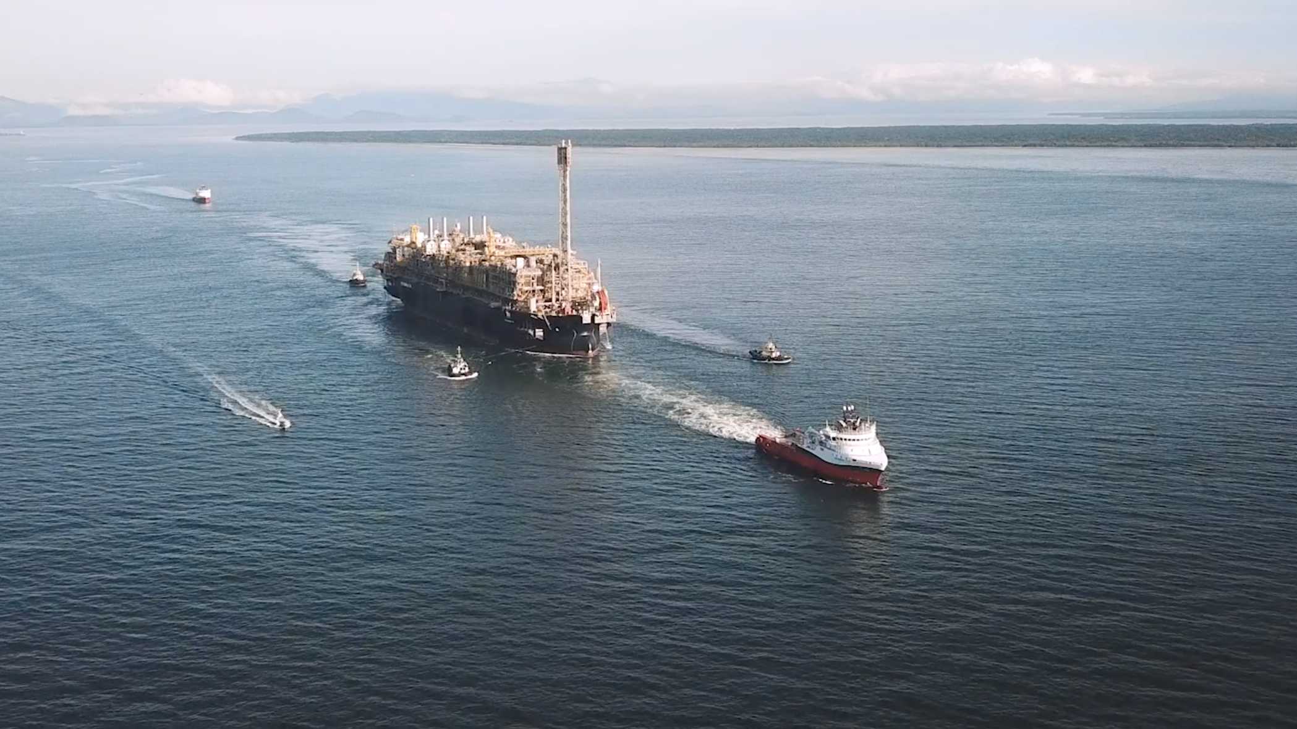

BUILDING
THE FUTURE

Slide 2
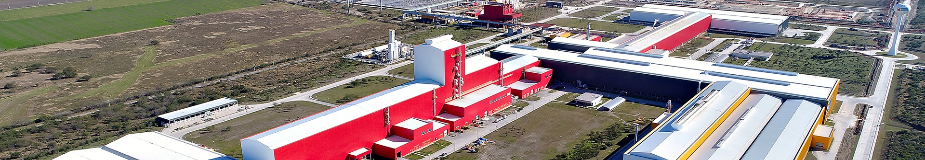
In summary
We provide project management, engineering, supplies, construction and operation services
at an international scale. We develop BOT projects with financing
We understand the needs of our customers from the Oil & Gas, energy, mining, infrastructure and industrial markets, and provide customized solutions accordingly
We add value to our ventures thanks to an innovative approach, a global vision, and
a local presence
We have a strong commitment to people's safety and environmental protection and meet the most demanding quality standards
Notes:
la 7

Slide 3
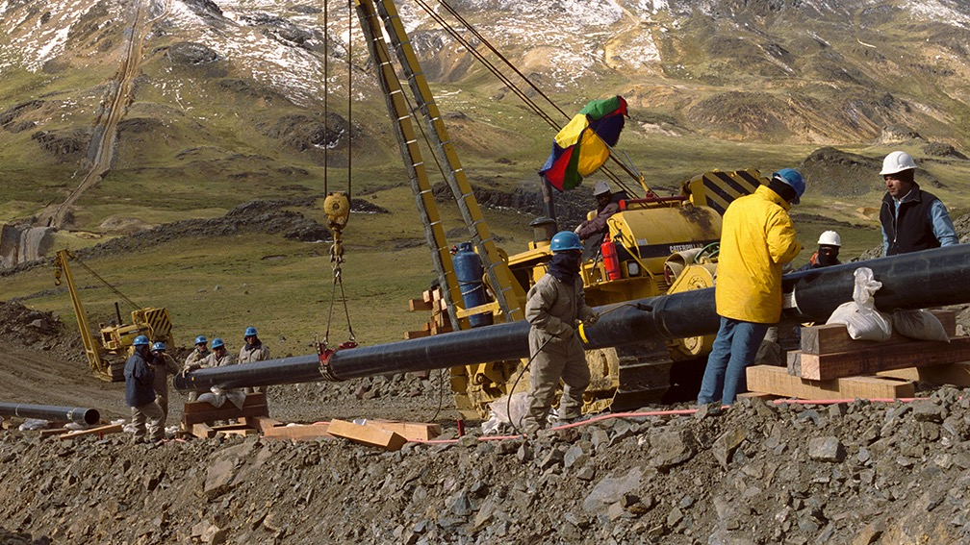
A reliable partner
for project execution
Data as of February 2021
+75
+3,300
1.7
+15,000
years of global
experience
projects completed successfully around
the world
million man-hours per year
of engineering capacity
employees

Slide 4
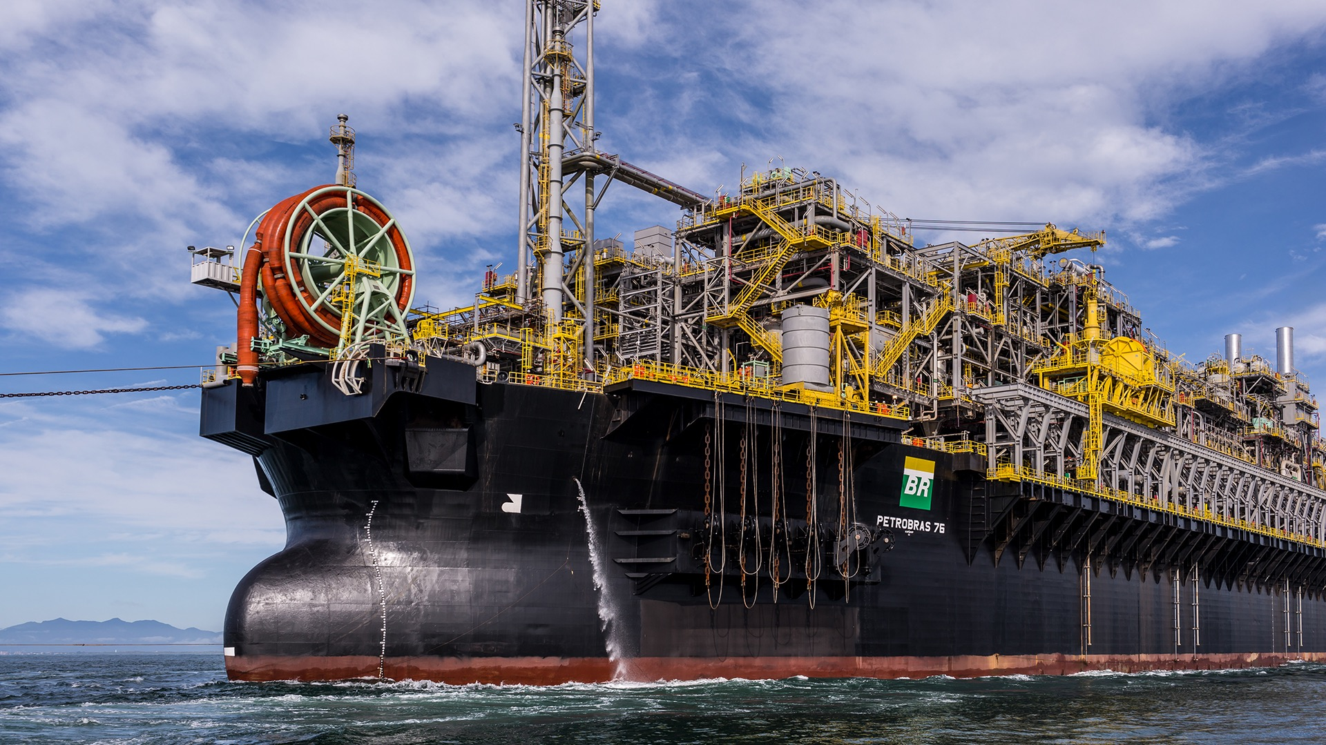

We deliver results
(*) Between projects developed totally or
partially by Techint E&C
+550
+600
+900
+14,000
Completed projects
in the energy sector
Projects in the Downstream and Petrochemical sectors (*)
Projects undertaken
in the Oil & Gas
sector (*)
Megawatts installed in combined cycle
power plants (*)
+550
+600,000
+900,000
Pipelines and
10 mountain crossings built (*)
Tons of assembled
steel structures
Tons of installed equipment

Slide 5
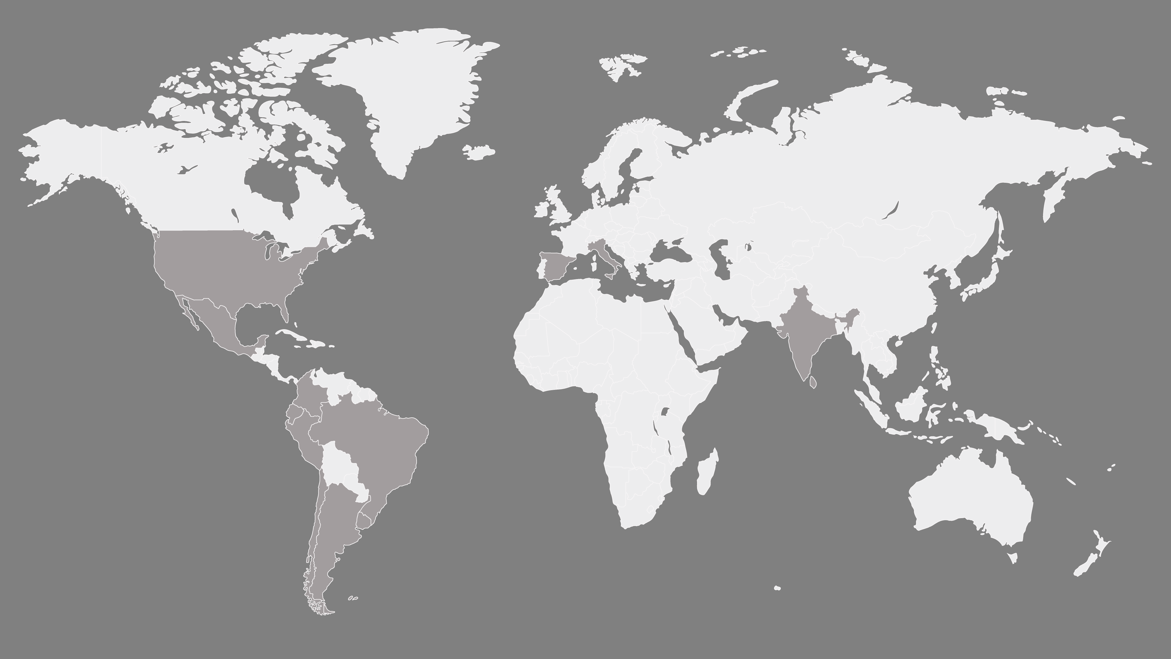











International scope | Local partner
Milan
Italy
Monterrey
Mexico
Houston
United States
Madrid
Spain
City of Mexico
Mexico
Bombay
India
Veracruz
Mexico
Seville
Spain
El Cairo
Egypt
Quito
Ecuador
Bogota
Colombia
Lima
Peru
Rio de Janeiro
Brazil
References
Chincha
Peru
San Pablo
Brazil
Parana
Brazil
Engineering centers
Antofagasta
Chile
Regional offices
Montevideo
Uruguay
Santiago
Chile
Sales and operational centers
Neuquen
Argentina
Buenos Aires
Argentina
Offshore Unit
Equipment Management Parks

Slide 6
Preventive Management
Single Integrated Management System
Certifications
Quality Management
ISO 9001:2015
Goal of zero deviations thanks
to active leadership
Environmental Management
ISO 14001:2015
Environmental protection programs and technical sustainability solutions
Occupational Health and Safety at Work
ISO 45001:2018
Management Manual
Management Policy
Preventive Management Plan
Implementation
Audits, Inspections
and Monitoring
Revision and continuous improvement
We ensure people's safety and protect the environment
Committed to sustainability in quality,
health and safety, and the environment
We promote standardization and process predictability, achieving efficient
products and services by capitalizing our Knowledge Management.
We pursue social responsibility in all our operations, promoting sustainable
development and respecting the communities where we interact.
Notes:
la 7

Slide 7
Commitment to safety, quality and the environment
Active and visible management leadership
Preventive indicators
LTIR
Preventive activities
100%
12
98,3%
A behavioral system based on people's commitment
10
80%
8
Active and visible leadership
60%
6
40%
4
Accident liability
Sustainability, efficiency and environmental management
20%
2
0,99
2005
0%
2019

Slide 8
Our actions are enshrined in the principles
of Integrity, Transparency and Business Ethics
Our Business Conduct Compliance Program involves our personnel as well as our partners, suppliers and subcontractors.
Our Code of Conduct
regulates our relationship with employees, partners, customers, suppliers and third parties.
Our Business Conduct Policy
focuses on the risks of bribery, specific procedures for third party evaluation and rules for interaction with the public sector (donations, gifts and other attentions, etc.)
The Business Conduct
Compliance Program
ensures a culture of respect for ethical business principles and different anti-corruption regulations.
Permanent
personnel training
in ethics and compliance
Whistleblower channel
Anonymous, confidential and fully accessible (whether by phone, mail or internet) for employees and third parties.
Continuous monitoring
by the Business Conduct Compliance and Internal Audit departments.
Rigorous international standards
regulate corporate governance, financial reporting
and disclosure of information.

Slide 9
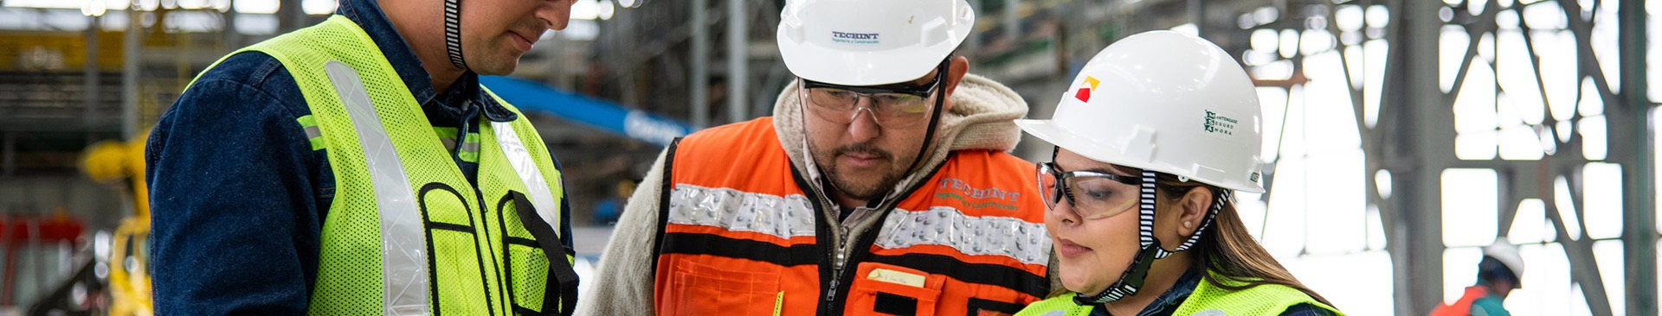
Our most valuable
asset is our people
An experienced and multicultural team with a structured knowledge transmission program
Young Professionals Program:
+2,500 university students have participated since 1983
Continuous training programs:
+146,000 hours a year
A working environment that values initiative, teamwork and professional growth.
Notes:
la 7

Slide 10



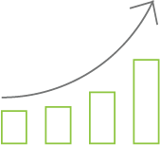
Techint is all about its human capital
+43 million
man hours worked
Percentage of employees by country
Referencias
5%
10%
+146,000 hours
of training
Argentina (33%)
6%
Mexico (22%)
33%
Peru (13%)
11%
+15,000
employees in 2021
Brazil (11%)
Ecuador (10%)
Chile (6%)
22%
13%
+10,400
new hires in 2018
Other (5%)
Notes:
la 7

Slide 11
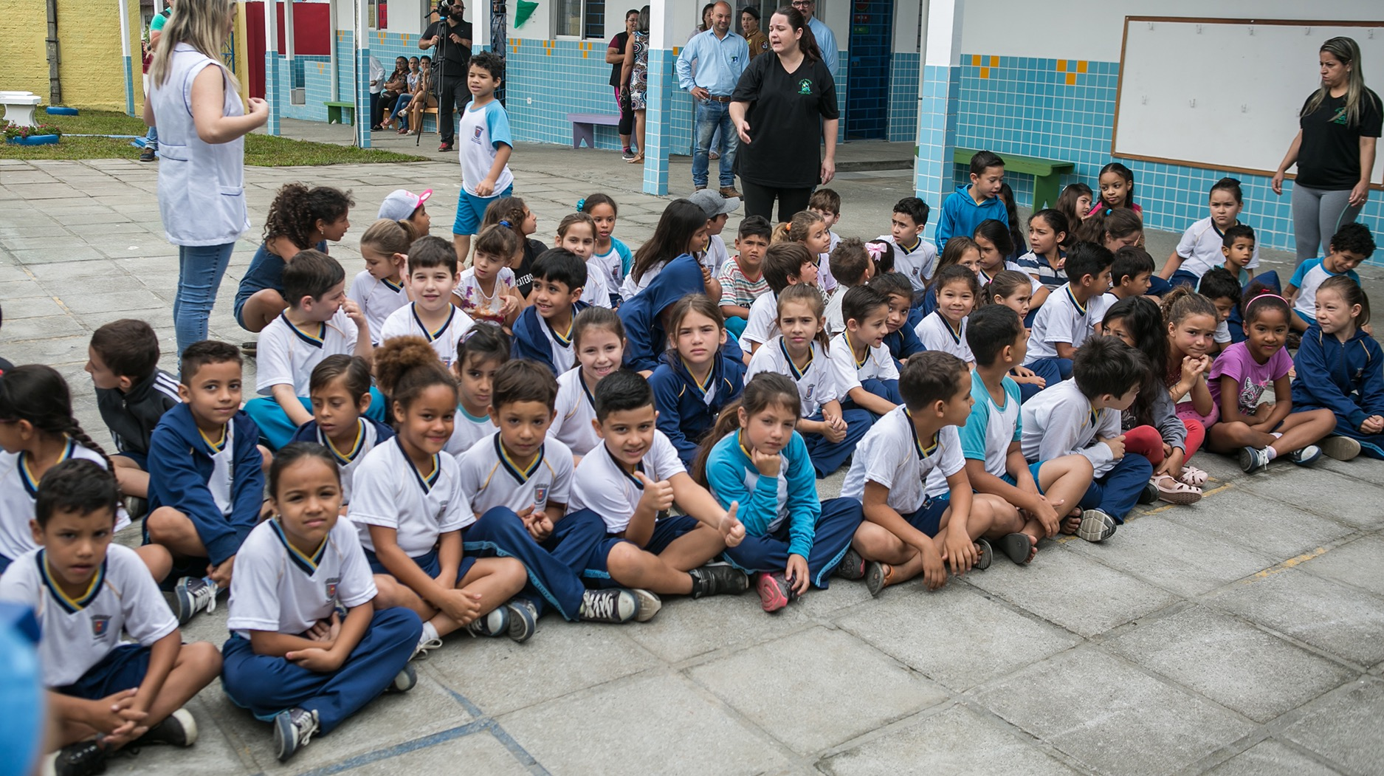
We promote the development
of the communities where we operate
Our conviction is that the industry contributes to sustainable growth and community development with
a long-term view.
Education is the main focus of our actions: secondary and university scholarships, volunteering in schools
and support to universities.
We support cultural activities focused on excellence, diversity
and integration.
Notes:
Es por eso que a lo largo de los años hemos invertido en la educación, fuente de desarrollo personal y social. La educación es el motor que permite una real transformación en las sociedades, sobre todo en un tiempo como el actual, en el que nos enfrentamos a una revolución tecnológica que está cambiando todos los órdenes sociales, y en especial, al mundo del trabajo.

Slide 12

Innovation in Engineering
and Construction
Safety & Enviroment
Competitiveness
Differentiation
2019 Achievements
High-impact projects developed
+ 200 ideas received
+ 45 in development
+ 20 high impact projects
Design centered on data
Automation for construction tasks
Digitalization of processes and systems integration
Drones for topographical and underground
mapping as well as to survey progress
Registration using mobile devices
IIOT and Sensoring
Big Data and Analytics
Virtual and Augmented Reality

Slide 13
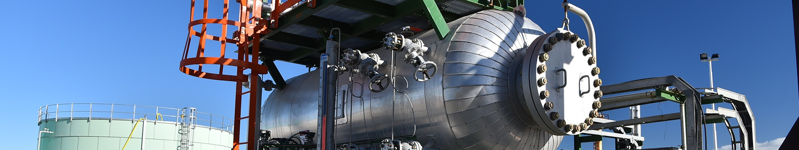
Engineering solutions
tailored to each project
Feasibility studies
and cost estimates
Conceptual engineering
Basic engineering and FEED
Value Engineering
Debottlenecking
and revamping studies
Detail engineering
Modularized projects
Management of engineering projects
Precommissioning and commissioning services and plant start-up
Construction assistance

Slide 14
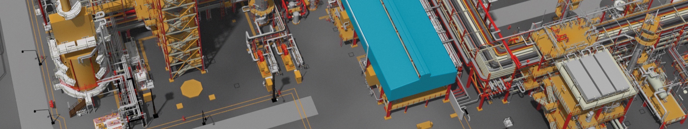

Engineering
centers
Buenos Aires/Neuquen, Argentina
Mexico City/Monterrey, Mexico
Milan, Italy
Mumbai, India
Quito, Ecuador
Seville, Spain
San Pablo, Brazil
Experienced personnel
with specific knowledge in different regional areas.
Engineering teams at the projects,
made up of Senior Staff and Young Professionals.
World class services
carried out according to the highest engineering standards
and with the ability to integrate management procedures.
Shared software licenses
as well as lessons learned in global databases.
Notes:
la 7

Slide 15
Engineering
Specialties
1024
permanent employees
1.7
million engineering
man-hours per year
5%
man-hours of engineering
invested in research
& development.
31%
26%
22%
Mechanical equipment and pipelines
Electric, instrumentation and control
Civil, architecture
and structure
14%
4%
3%
Management and Engineering Coordination
Processes and HSE
Steel and mining plants
Notes:
la 7

Slide 16
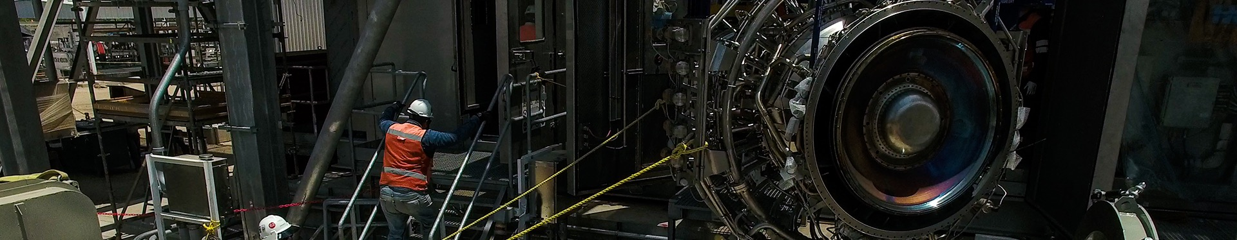
Value added
through Supplies
Comprehensive management of Purchases, Inspection, Activation, Logistics and Imports
Extensive suppliers base with more than 60,000 assets. Strategic agreements with
key manufacturers
Professional experts in the field, distributed throughout multiple countries
Ad-hoc IT tools, automating management, controls
and reports
Synergies with Exiros, the Ternium and Tenaris procurement agent and part of the Techint Group
Processes and Procedures under high standards of quality, integrity and transparency
International experience
in various market segments

Slide 17
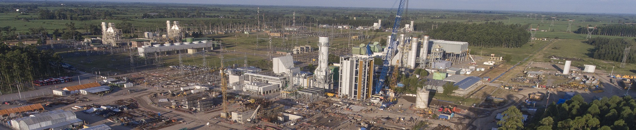
Comprehensive solutions
for EPC projects
Experience in constructibility solutions which meet deadlines
and cost requirements under the most challenging conditions
Knowledge management: solid process
to exchange lessons learned
Techint Offshore Unit: construction and integration of equipment, modules, and jackets for offshore projects
Efficiency in project control and updated project management tools (PMI Certification)

Slide 18
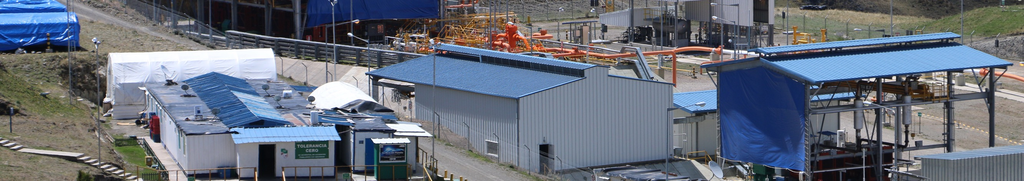
Operation and
Maintenance Services
For O&G projects, industrial plants
and mining, Techint E&C provides:
BOT and BOOT projects
Benefits for the client:
Maintenance of pipelines and plants
Facilities management
Operational
support
Reduction in operational costs, increase
in productivity and preservation
of the value of the investment
Improved asset performance
Operational completion
Pre-commissioning and commissioning

Slide 19
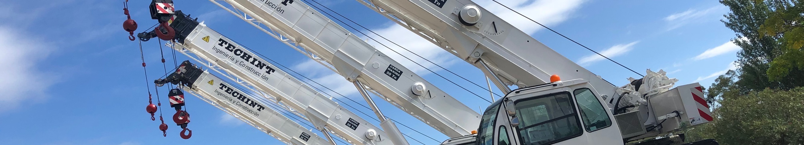
Equipment management and maintenance
6 Equipment Management Yards
in Argentina, Brazil, Chile, Mexico, Peru and Uruguay.
We supply the equipment required by projects in different countries, ensuring mechanical availability, and we plan and carry out corrective, preventive and predictive maintenance.
+2700 own pieces of machinery
for earthworks, work with pipes, and hoists.
20-hectare yard
for offshore projects in Pontal do Paraná, Brazil,
where we build jackets, decks, modules and
integrated elements for FPSO.

Slide 20
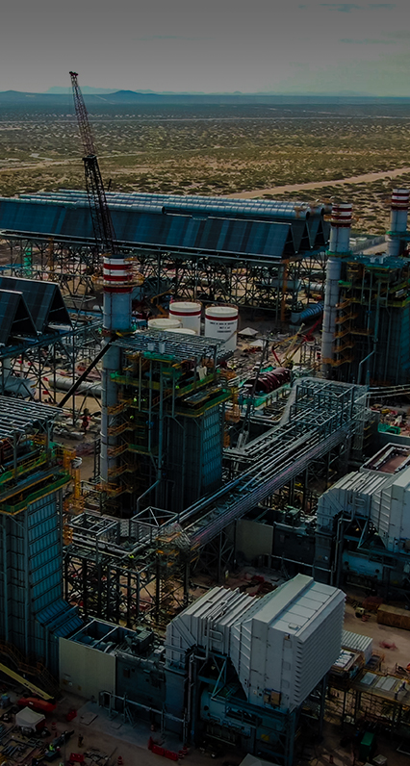
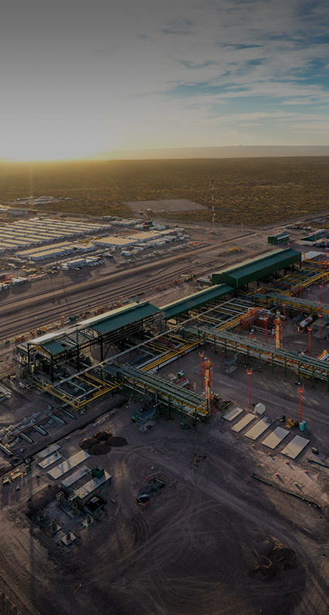
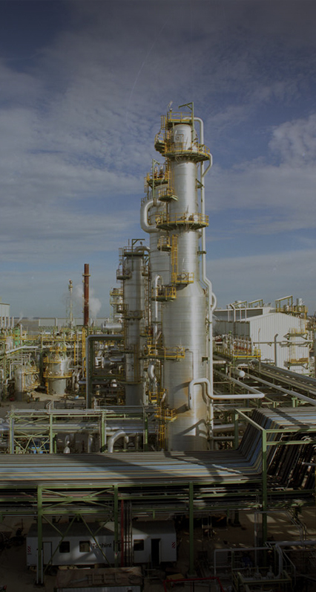
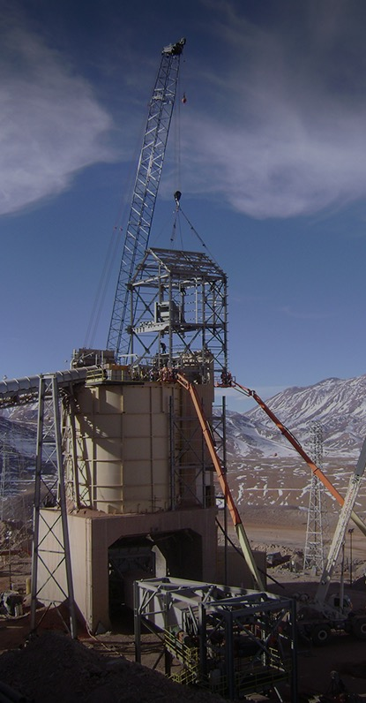
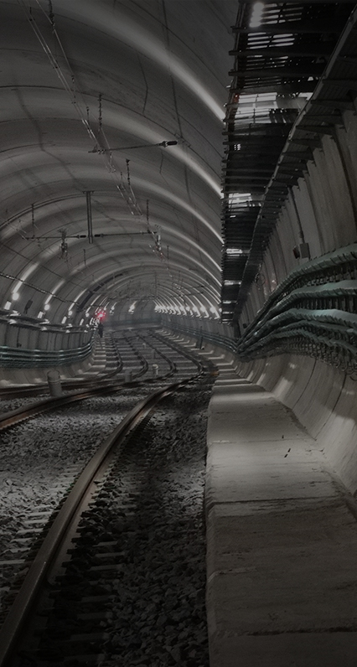
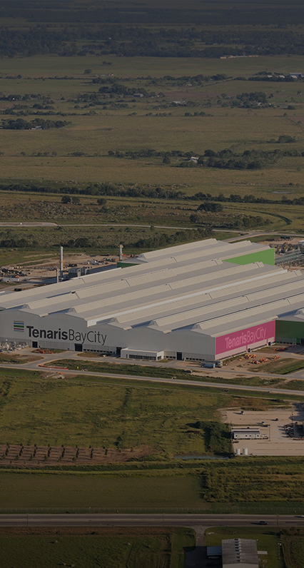
Market segments
Click on the market segments for more information
Energy
Oil & Gas
Downstream
& Petrochemical Plants
Mining
Civil Infrastructure Works
Industrial Plants
01.
02.
03.
04.
05.
06.

Slide 21
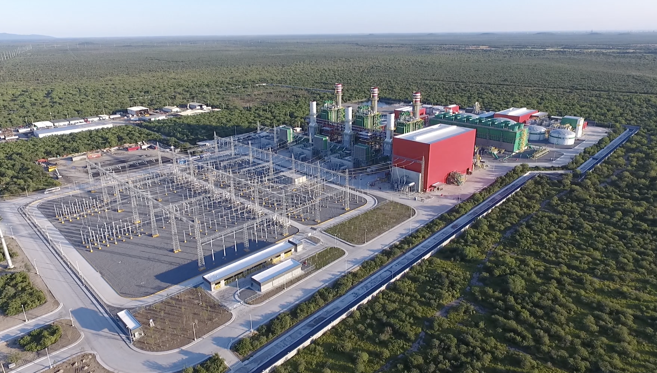
1/Energy
GENERATION
TRANSMISSION
  Open cycle
  power plants
  Combined cycle power plants
  Transmission
  lines
  Transformer
  stations
  Cogeneration
  plants
  Nuclear
  facilities
Return to market segments
Continue with the presentation

Slide 22
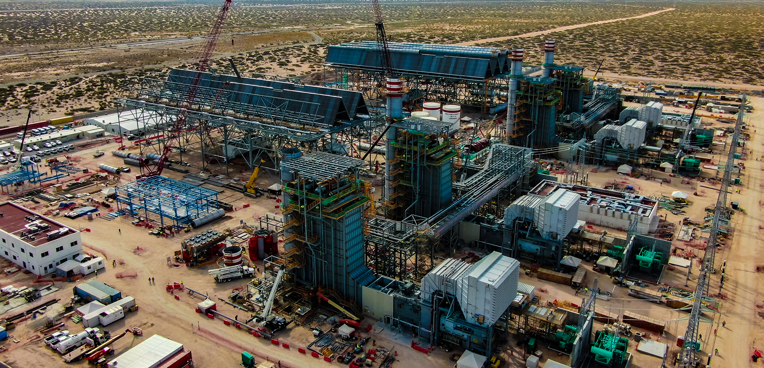
Project highlights | Energy
01 | NORTE III COMBINED
CYCLE POWER PLANT
02 | PESQUERIA POWER PLANT
03 | SOUTH HELWAN SUPERCRITICAL THERMOELECTRIC POWER PLANT
04 | GENELBA PLUS COMBINED CYCLE POWER PLANT
05 | ATUCHA II NUCLEAR POWER PLANT
NORTE III COMBINED CYCLE POWER PLANT
COSTUMER:
AJNIII
COUNTRY:
Mexico
SCOPE:
EPC
COMPLETION:
2020
DESCRIPTION:
Construction and operation, for a period of 25 years, of a Combined Cycle Power Plant consisting of two 2TGx1TV modules with a guaranteed minimum net power of 907 MW and a Heat Rate of 6,369 kJ/kWh.
Return to market segments
Continue with the presentation

Slide 23
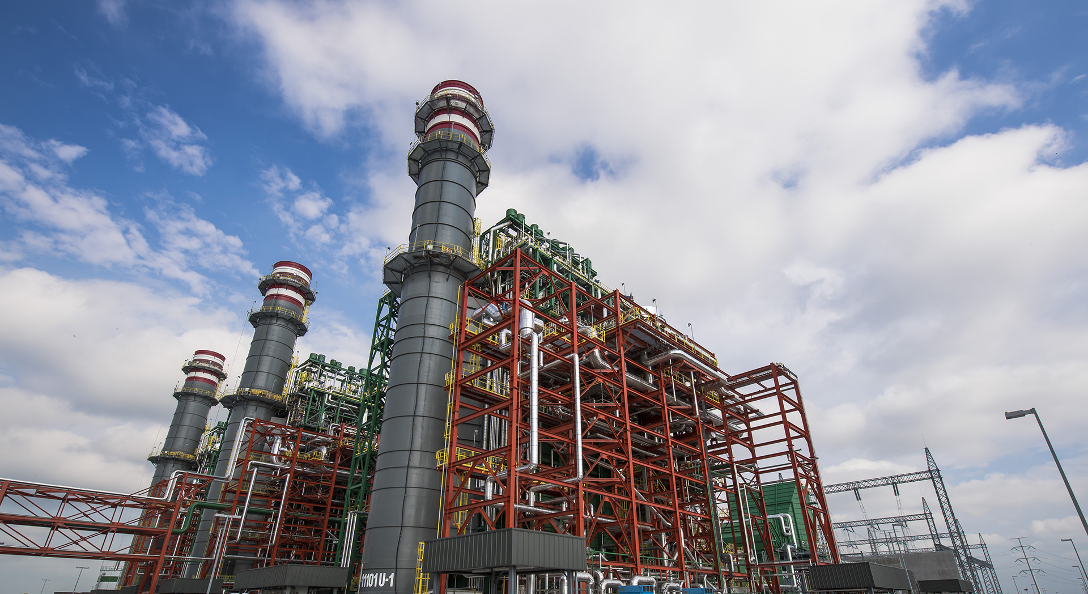
Project highlights | Energy
01 | NORTE III COMBINED CYCLE POWER PLANT
02 | PESQUERIA POWER PLANT
03 | SOUTH HELWAN SUPERCRITICAL THERMOELECTRIC POWER PLANT
04 | GENELBA PLUS COMBINED CYCLE POWER PLANT
05 | ATUCHA II NUCLEAR POWER PLANT
PESQUERÍA POWER PLANT [900MW]
CUSTOMER:
Techgen
COUNTRY: Mexico
SCOPE:
EPC
COMPLETION: 2015
DESCRIPTION:
Combined cycle power generation with a capacity of 900 MW
and a configuration of three gas turbines.
Return to market segments
Continue with the presentation

Slide 24
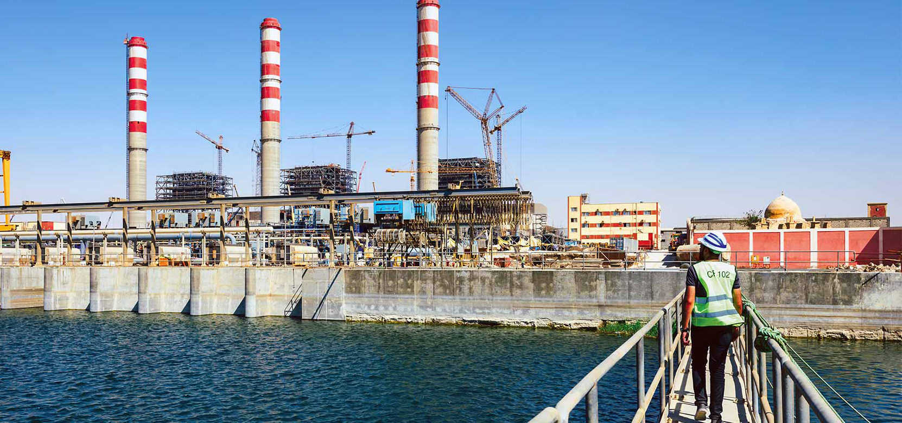
Project highlights | Energy
01 | NORTE III COMBINED CYCLE POWER PLANT
02 | PESQUERIA POWER PLANT
03 | SOUTH HELWAN SUPERCRITICAL THERMOELECTRIC POWER PLANT
04 | GENELBA PLUS COMBINED CYCLE POWER PLANT
05 | ATUCHA II NUCLEAR POWER PLANT
SOUTH HELWAN SUPERCRITICAL THERMOELECTRIC POWER PLANT [650MW]
CUSTOMER:
Upper Egypt Electricity Production Company; Egyptian Electricity Holding Company
COUNTRY:
Egypt
SCOPE:
EPC
COMPLETION:
2018
DESCRIPTION:
EPC services for the auxiliary systems (Plant Balance) of the oil- and gas-fueled Supercritical Thermoelectric Power Plant. Work includes installing three steam generation boilers, operated by 3 steam turbines with a generation capacity of 650 MW each.
Return to market segments
Continue with the presentation

Slide 25
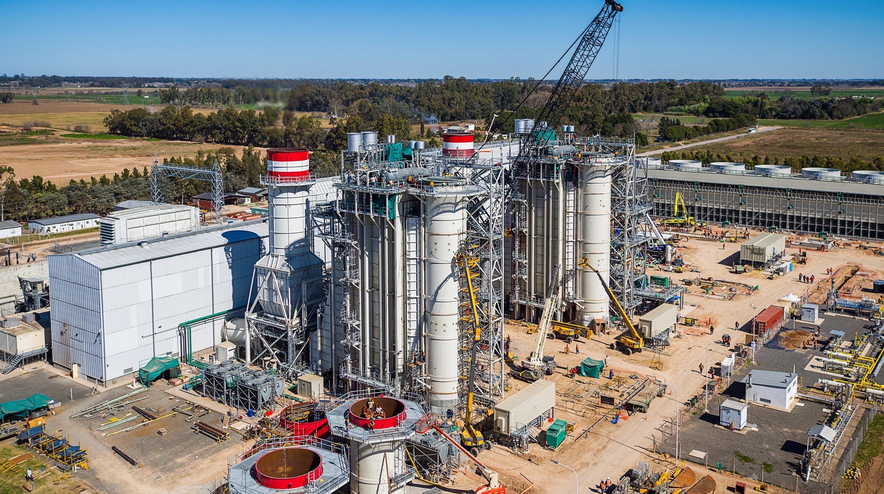
Project highlights | Energy
01 | NORTE III COMBINED CYCLE POWER PLANT
02 | PESQUERIA POWER PLANT
03 | SOUTH HELWAN SUPERCRITICAL THERMOELECTRIC POWER PLANT
04 | GENELBA PLUS COMBINED CYCLE POWER PLANT
05 | ATUCHA II NUCLEAR POWER PLANT
GENELBA PLUS COMBINED CYCLE POWER PLANT [360MW]
CUSTOMER:
Pampa Energy
COUNTRY:
Argentina
SCOPE:
EPC
COMPLETION:
2020
DESCRIPTION:
Expansion of the GENELBA Thermoelectric Power Plant, taking the existing 169 MW gas turbine to a 2+1 combined cycle configuration with a thermal design power of 360 MW.
Return to market segments
Continue with the presentation

Slide 26
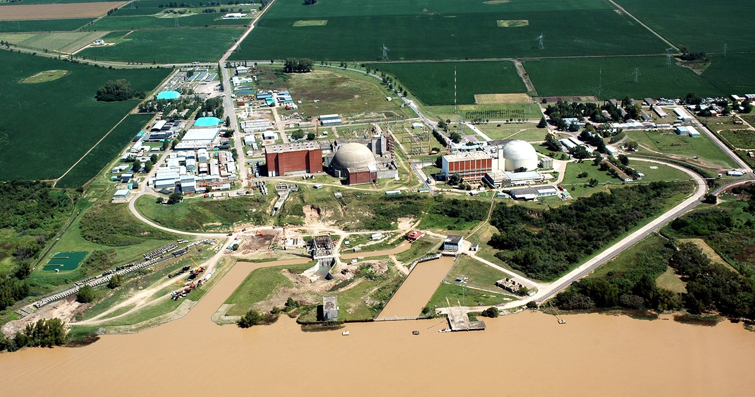
Project highlights | Energy
01 | NORTE III COMBINED CYCLE POWER PLANT
02 | PESQUERIA POWER PLANT
03 | SOUTH HELWAN SUPERCRITICAL THERMOELECTRIC POWER PLANT
04 | GENELBA PLUS COMBINED CYCLE POWER PLANT
05 | ATUCHA II NUCLEAR POWER PLANT
ATUCHA II NUCLEAR POWER PLANT [700MW]
CUSTOMER: Nucleoelectrica Argentina
COUNTRY:
Argentina
SCOPE:
EC
COMPLETION:
1992
DESCRIPTION:
Mechanical assembly for the auxiliary reactor building (UKA Building).
Return to market segments
Continue with the presentation

Slide 27
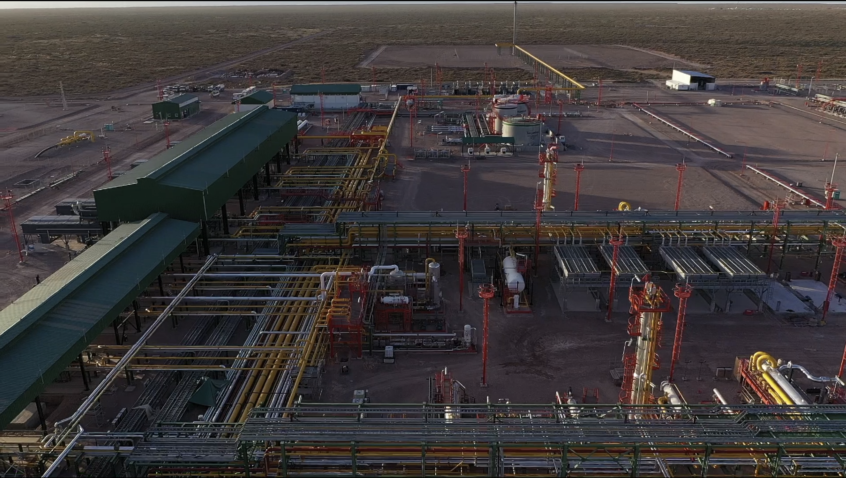
2/Oil &Gas
UPSTREAM
MIDSTREAM
  Platforms and wellhead installations
  Gas, oil and water treatment plants
  Trunk pipelines for gas, oil and liquids
  Storage tanks
  Multi-phase flow and collection pipelines
  Reservoir electrification
  Pumping and compression installations
  Plants for crude
  oil conditioning
  Liquefaction and LNG regasification terminals
  Dehydration plants, dew point adjustment and gas sweetening
Return to market segments
Continue with the presentation

Slide 28
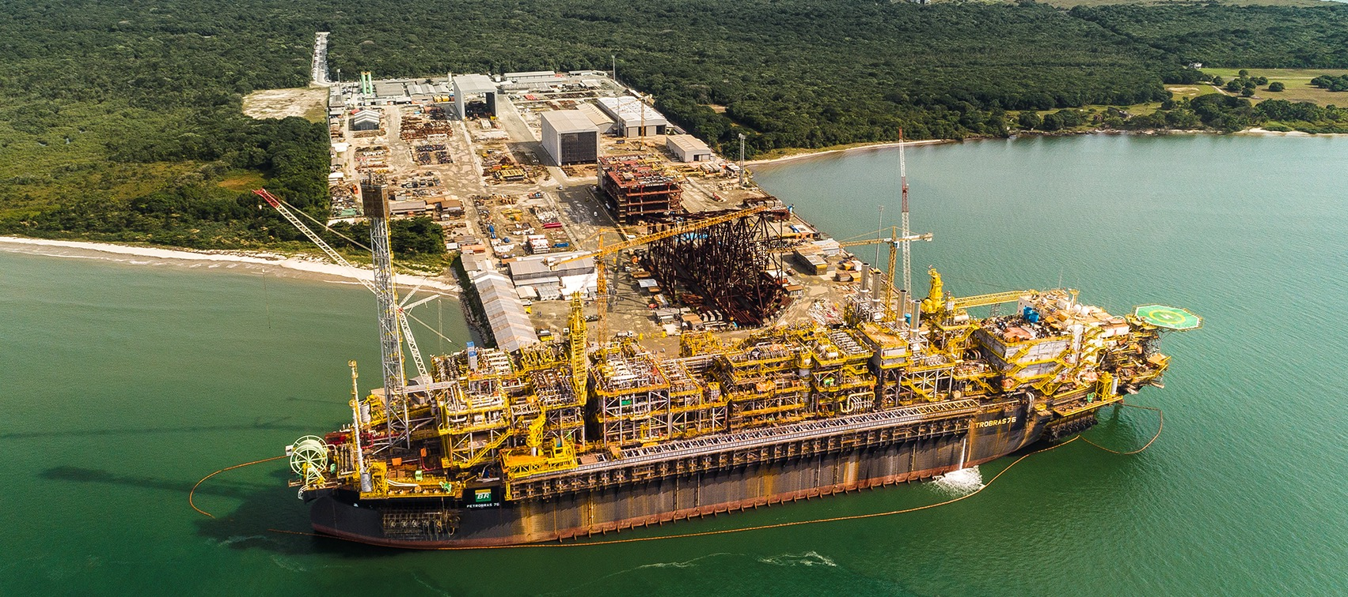
Projects highlights | Oil & Gas
01 | OFFSHORE PLATFORM P-76
02| CAMISEA GAS PIPELINE
03 DUNKIRK LNG REGASIFICATION TERMINAL
04 | FORTIN DE PIEDRA - VACA MUERTA
05 | COMPRESSION STATION ALTAMIRA
06 | AUCA - SHUSHUFINDI
P-76 OFFSHORE PLATFORM
CUSTOMER:
Petrobras
COUNTRY:
Brazil
SCOPE:
EPC
COMPLETION:
2018
DESCRIPTION:
EPC, integration and commissioning modules for FPSO P-76 (floating production storage and offloading). The platform has a daily processing capacity of 150,000 boed and can compress up to 7 million m3/day of gas.
Return to market segments
Continue with the presentation

Slide 29
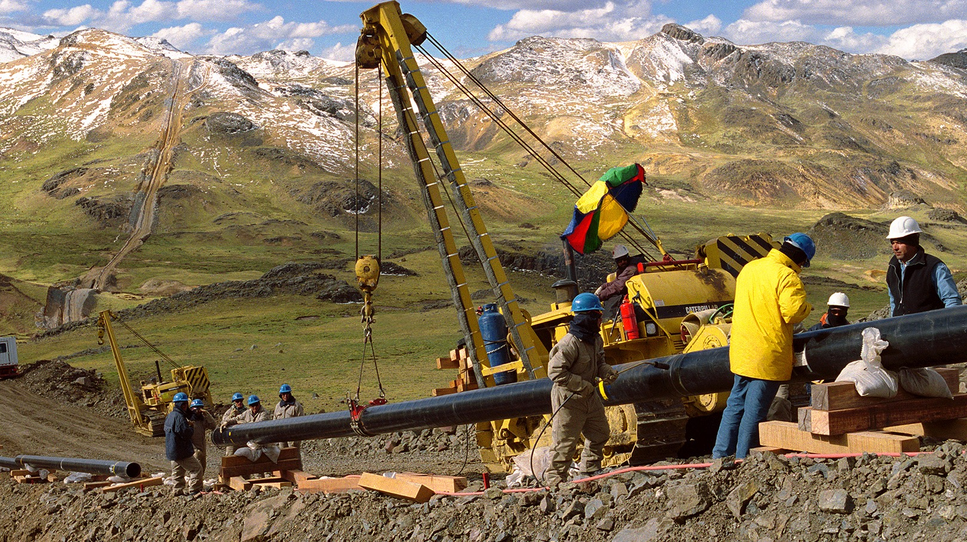
Projects highlights | Oil & Gas
01 | OFFSHORE PLATFORM P-76
02 | CAMISEA GAS PIPELINE
03 | DUNKIRK LNG REGASIFICATION TERMINAL
04 | FORTIN DE PIEDRA - VACA MUERTA
05 | ALTAMIRA COMPRESSION STATION
06 | AUCA - SHUSHUFINDI
CAMISEA GAS PIPELINE
CUSTOMER:
Transportadora de Gas del Perú
COUNTRY:
Peru
SCOPE:
EPC
COMPLETION:
2004
DESCRIPTION:
The System involves a 730 km-Natural Gas pipeline and a parallel Natural Gas Liquids pipeline of 560 km, as well as four pumping stations and two pressure reducing stations, a SCADA and communications system, and a city gate in Lima.
Return to market segments
Continue with the presentation

Slide 30
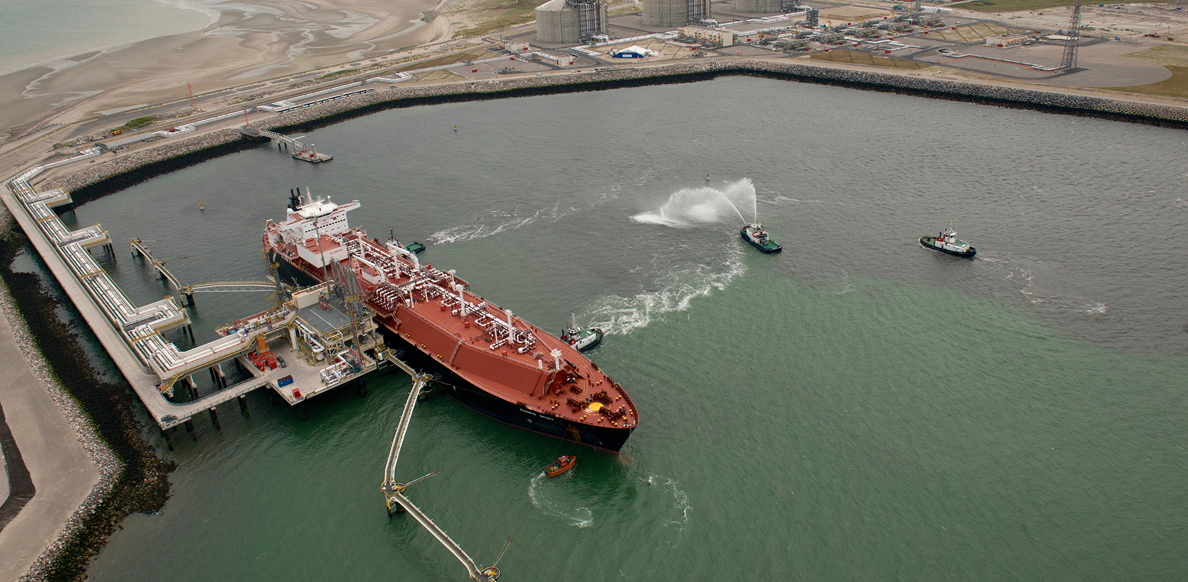
Projects highlights | Oil & Gas
01 | OFFSHORE PLATFORM P-76
02 | CAMISEA GAS PIPELINE
03 | DUNKIRK LNG REGASIFICATION TERMINAL
04 | FORTIN DE PIEDRA - VACA MUERTA
05 | ALTAMIRA COMPRESSION STATION
06 | AUCA - SHUSHUFINDI
DUNKIRK LNG REGASIFICATION TERMINAL
CUSTOMER:
Électricité
de France
COUNTRY:
France
SCOPE:
EPC
COMPLETION:
2016
DESCRIPTION:
LNG regasification terminal with a dispatch capacity of
13 billion m³/year.
Return to market segments
Continue with the presentation

Slide 31
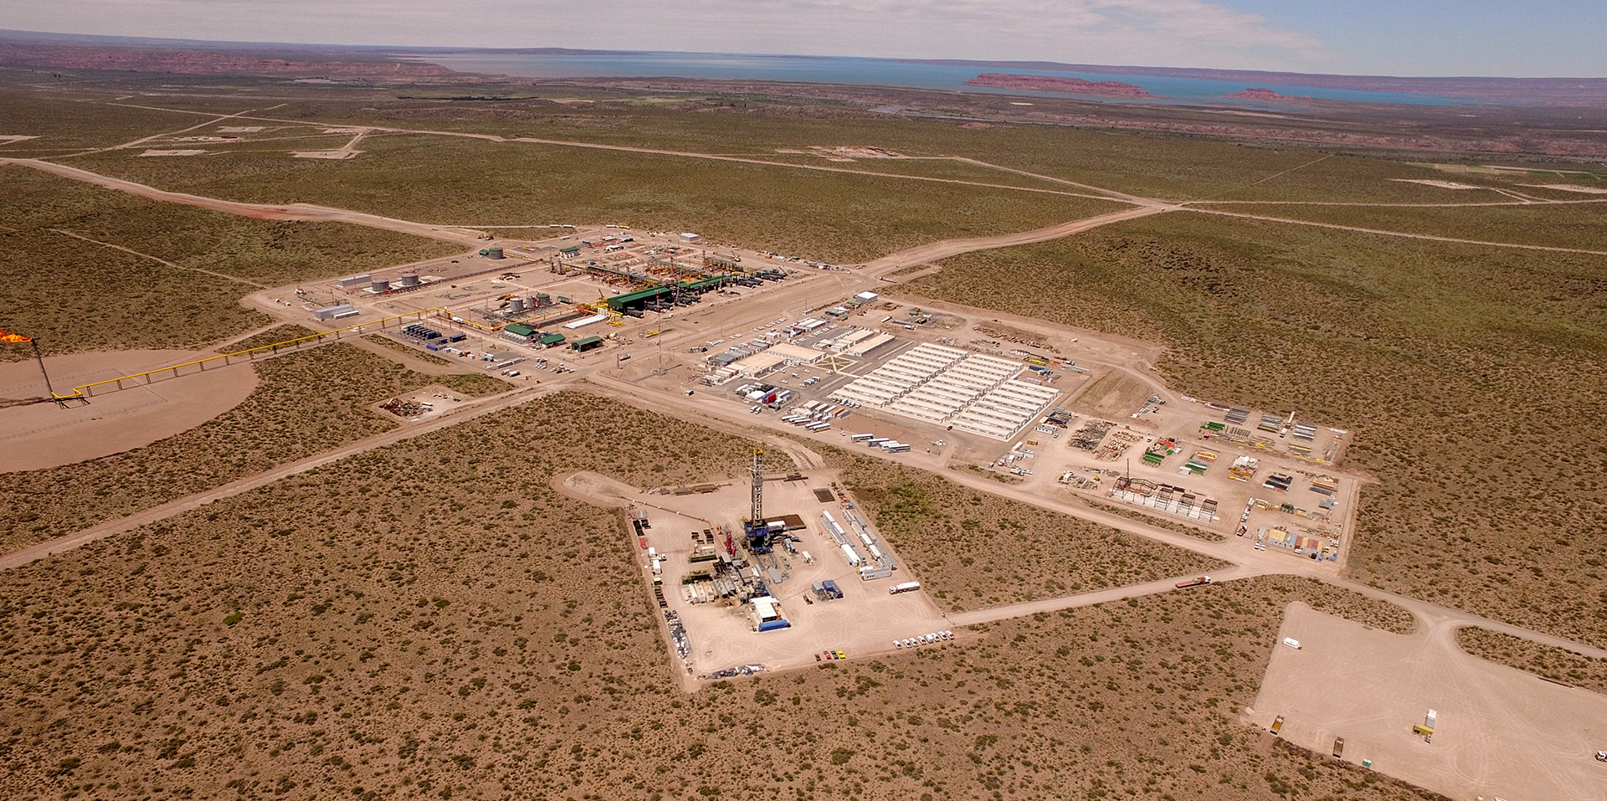
Projects highlights | Oil & Gas
01 | OFFSHORE PLATFORM P-76
02 | CAMISEA GAS PIPELINE
03 | DUNKIRK LNG REGASIFICATION TERMINAL
04 | FORTIN DE PIEDRA - VACA MUERTA
05 | ALTAMIRA COMPRESSION STATION
06 | AUCA - SHUSHUFINDI
FORTIN DE PIEDRA - VACA MUERTA
CUSTOMER:
Tecpetrol
COUNTRY:
Argentina
SCOPE:
EPC
COMPLETION:
2020
DESCRIPTION:
Design and construction of facilities to drill, treat and transport the gas produced. These works enable the processing of 17.5 MM m³/day.
Return to market segments
Continue with the presentation

Slide 32
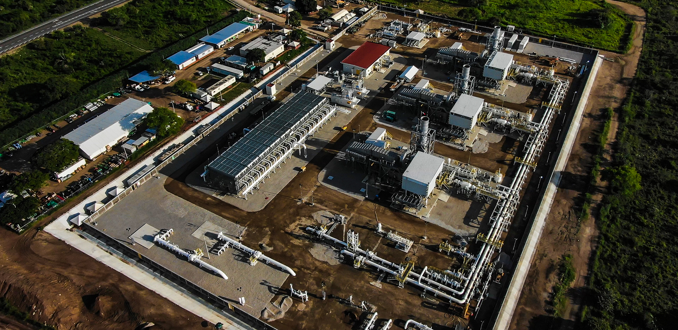
Projects highlights | Oil & Gas
01 | OFFSHORE PLATFORM P-76
02 | CAMISEA GAS PIPELINE
03 | DUNKIRK LNG REGASIFICATION TERMINAL
04 | FORTIN DE PIEDRA - VACA MUERTA
05 | ALTAMIRA COMPRESSION STATION
06 | AUCA - SHUSHUFINDI
ALTAMIRA COMPRESSION STATION
CUSTOMER:
TransCanada
COUNTRY:
Mexico
SCOPE:
EPC
COMPLETION:
2019
DESCRIPTION:
Provision of Engineering, Procurement and Construction services to build a compression station and a regulation, measurement and control station with a pressure of 570-590 PSIG and a capacity of 178 MMcfd, in Altamira.
Return to market segments
Continue with the presentation

Slide 33
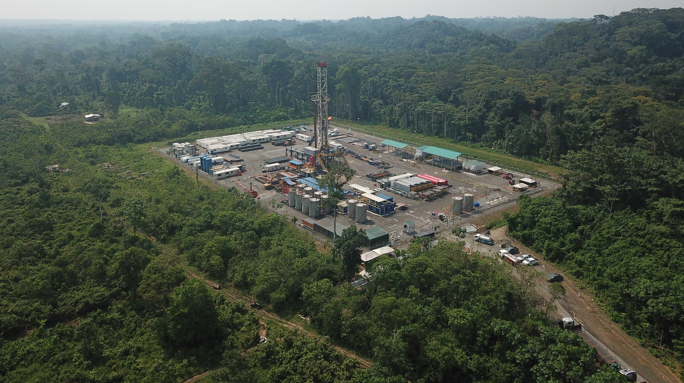
Projects highlights | Oil & Gas
01 | OFFSHORE PLATFORM P-76
02 | CAMISEA GAS PIPELINE
03 | DUNKIRK LNG REGASIFICATION TERMINAL
04 | FORTIN DE PIEDRA - VACA MUERTA
05 | ALTAMIRA COMPRESSION STATION
06 | AUCA - SHUSHUFINDI
AUCA - SHUSHUFINDI
CUSTOMER:
Schlumberger
COUNTRY:
Ecuador
SCOPE:
EPC
COMPLETION:
2024
DESCRIPTION:
Provision of engineering services, materials procurement and equipment to construct and expand platforms and facilities for entering drill bits for drilling and work over, and to build and lay the oil optimization flow lines and electricity lines in Blocks 61 and 57.
Return to market segments
Continue with the presentation

Slide 34
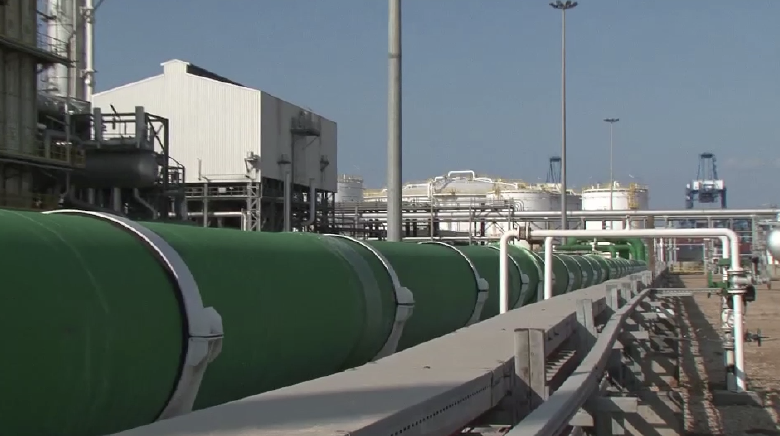
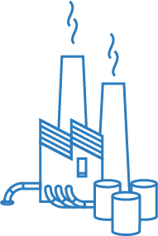
3/Downstream and Petrochemical Plants
PETROCHEMICALS
AND CHEMICALS PLANTS
REFINERIES
  Catalytic fluid
  fractioning units
  Gas treatment and sulfur recovery units
  Production plants for monomers and plastic polymers
  Olefins and polyolefins plants
  Crude (CDU) and vacuum distillation (VDU) units
  HDT and HDS gasoline and diesel plants
  Methanol plants
  Aromatics
  Delayed coker units
  Alkylation units
  Fertilizer, ammonia
  and urea units
  Nitrogen removal
  from gas
  Hydrogen
  production plants
  Isomerization units
Return to market segments
Continue with the presentation

Slide 35
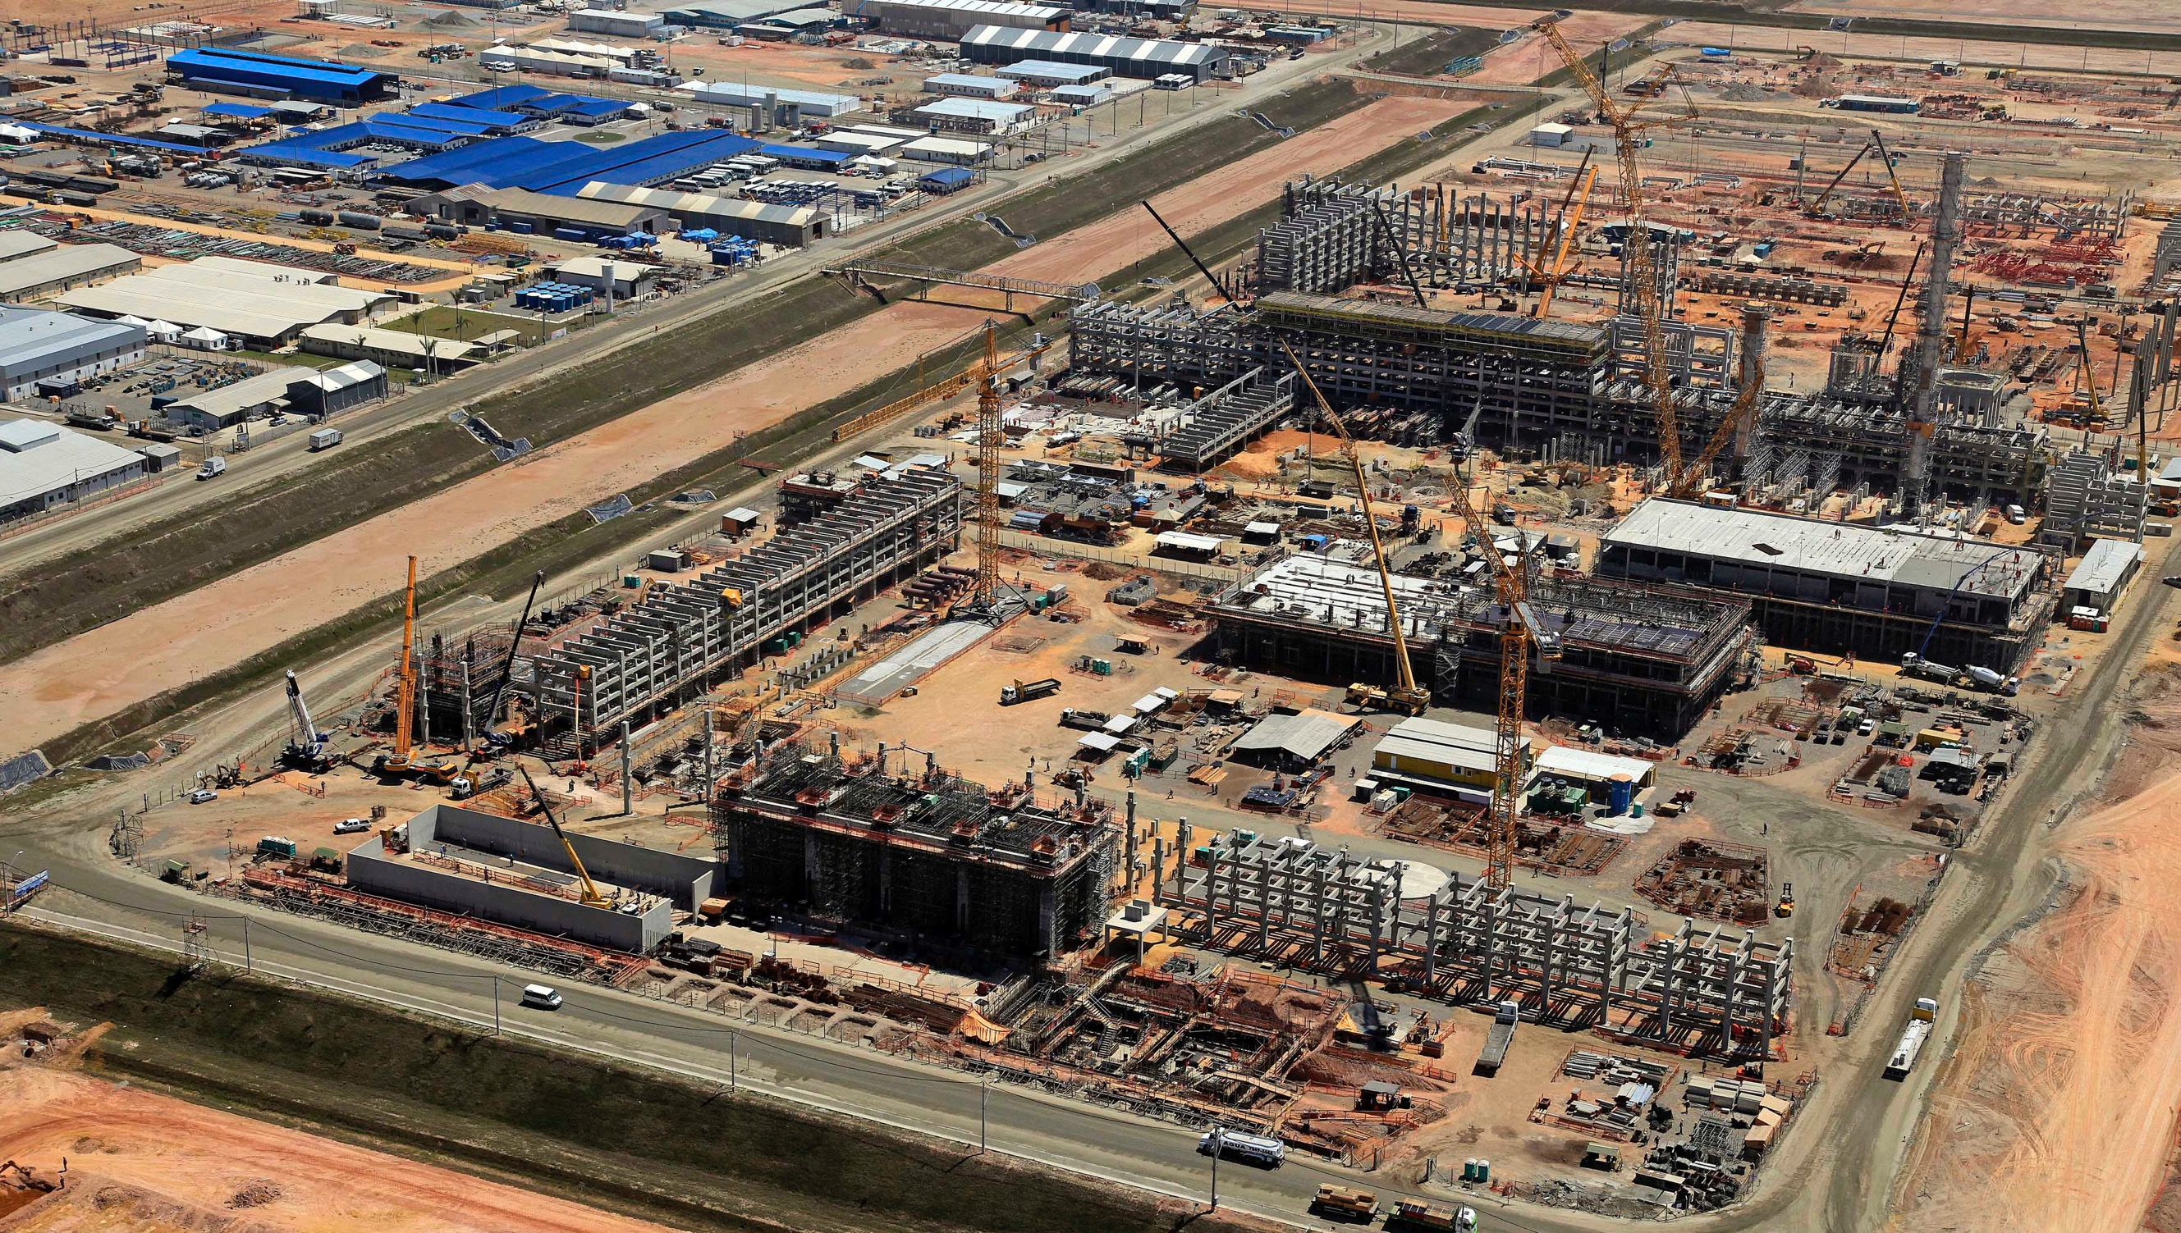
Project highlights | Downstream and Petrochemical Plants
01 | RIO DE JANEIRO PETROCHEMICAL COMPLEX - COMPERJ
02 | MODERNIZATION OF HOUT CRUDE FACILITIES
03 | PROFERTIL FERTILIZER PLANT
RIO DE JANEIRO PETROCHEMICAL COMPLEX – COMPERJ
CUSTOMER:
Petrobras
COUNTRY:
Brazil
SCOPE:
EPC
COMPLETION:
2016
DESCRIPTION:
Building the installations for a delayed coker unit, coke management
and storage yard, and electrical substations units at the Rio de Janeiro Petrochemical Complex.
Return to market segments
Continue with the presentation

Slide 36
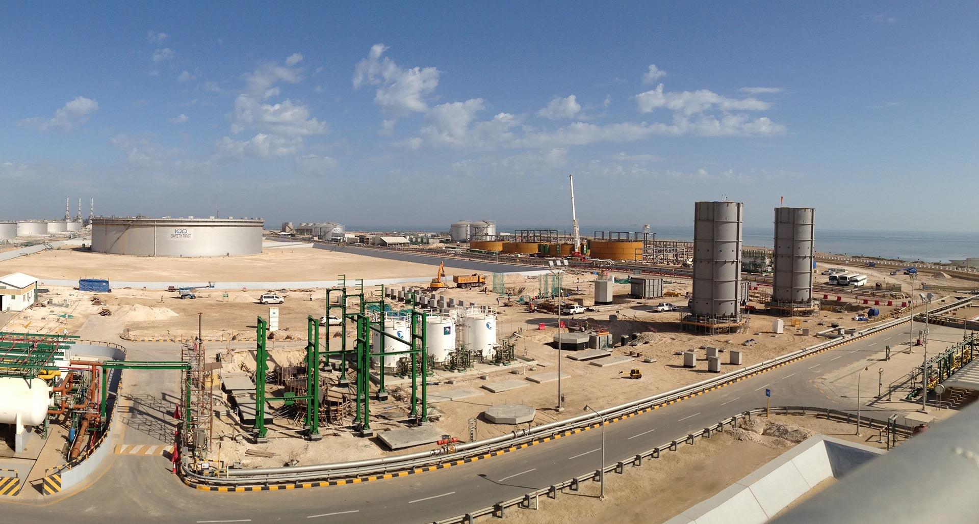
Project highlights | Downstream and Petrochemical Plants
01 | RIO DE JANEIRO PETROCHEMICAL COMPLEX - COMPERJ
02 | MODERNIZATION OF HOUT CRUDE FACILITIES
03 | PROFERTIL FERTILIZER PLANT
MODERNIZATION OF HOUT CRUDE FACILITIES
CUSTOMER:
KJO (Joint Operations
of AGOC and KGOC)
COUNTRY:
Saudi Arabia
SCOPE:
EPC
COMPLETION:
2016
DESCRIPTION:
Upgrading the Hout crude oil facilities.
Return to market segments
Continue with the presentation

Slide 37
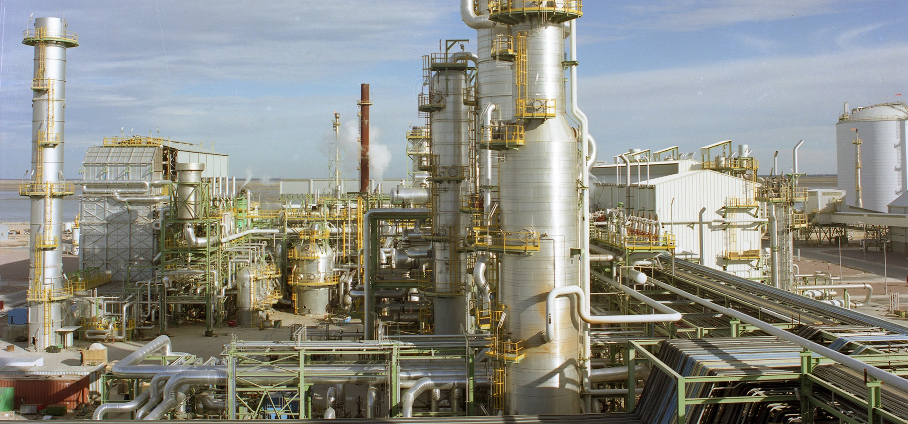
Project highlights | Downstream and Petrochemical Plants
01 | RIO DE JANEIRO PETROCHEMICAL COMPLEX - COMPERJ
02 | MODERNIZATION OF HOUT CRUDE FACILITIES
03 | PROFERTIL FERTILIZER PLANT
PROFERTIL FERTILIZER PLANT
CUSTOMER:
Profertil
COUNTRY:
Argentina
SCOPE:
EPC
COMPLETION:
2001
DESCRIPTION:
Fertilizer plant with an Ammonia production of 2,050 tons/day, Urea production of 3,250 tons/day and two Urea granulation plants of 1,850 tons/day.
Return to market segments
Continue with the presentation

Slide 38
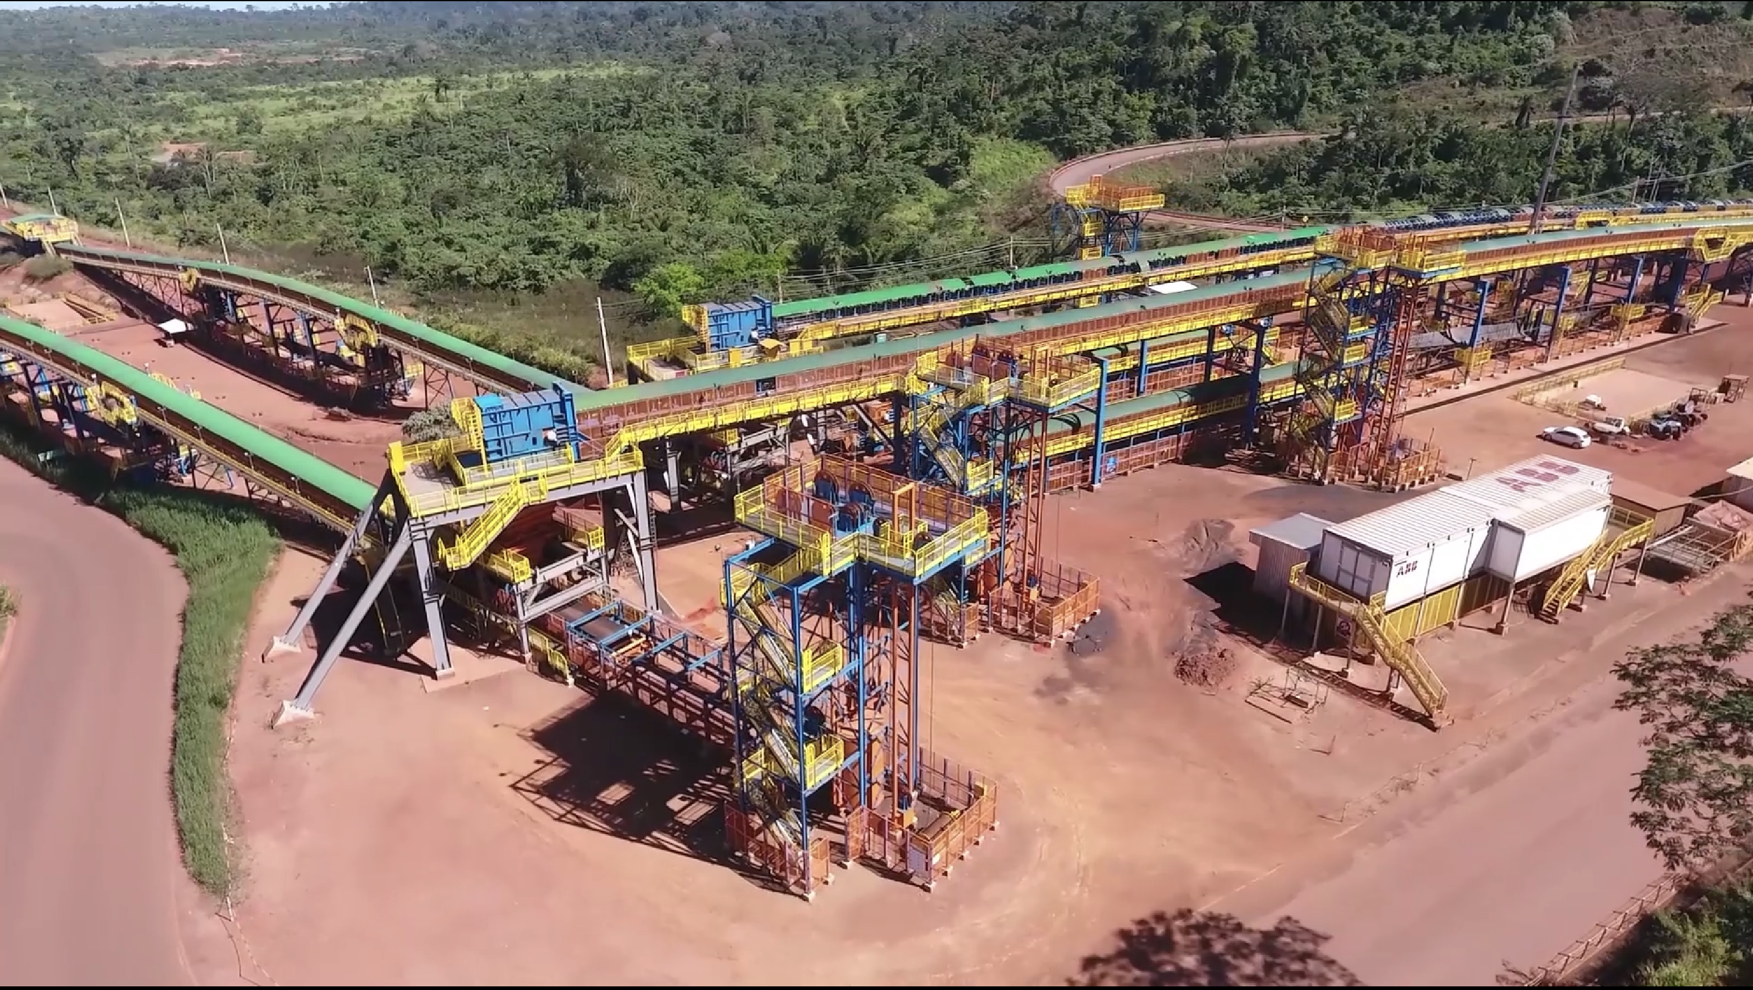
4/Mining
  Mineral processing plants
  Industrial buildings
  and structures
  Fluids handling and transport system
  Civil works (including
  access roads and ports)
  Off-site infrastructure
  Materials handling systems
  Maintenance services
Return to market segments
Continue with the presentation

Slide 39
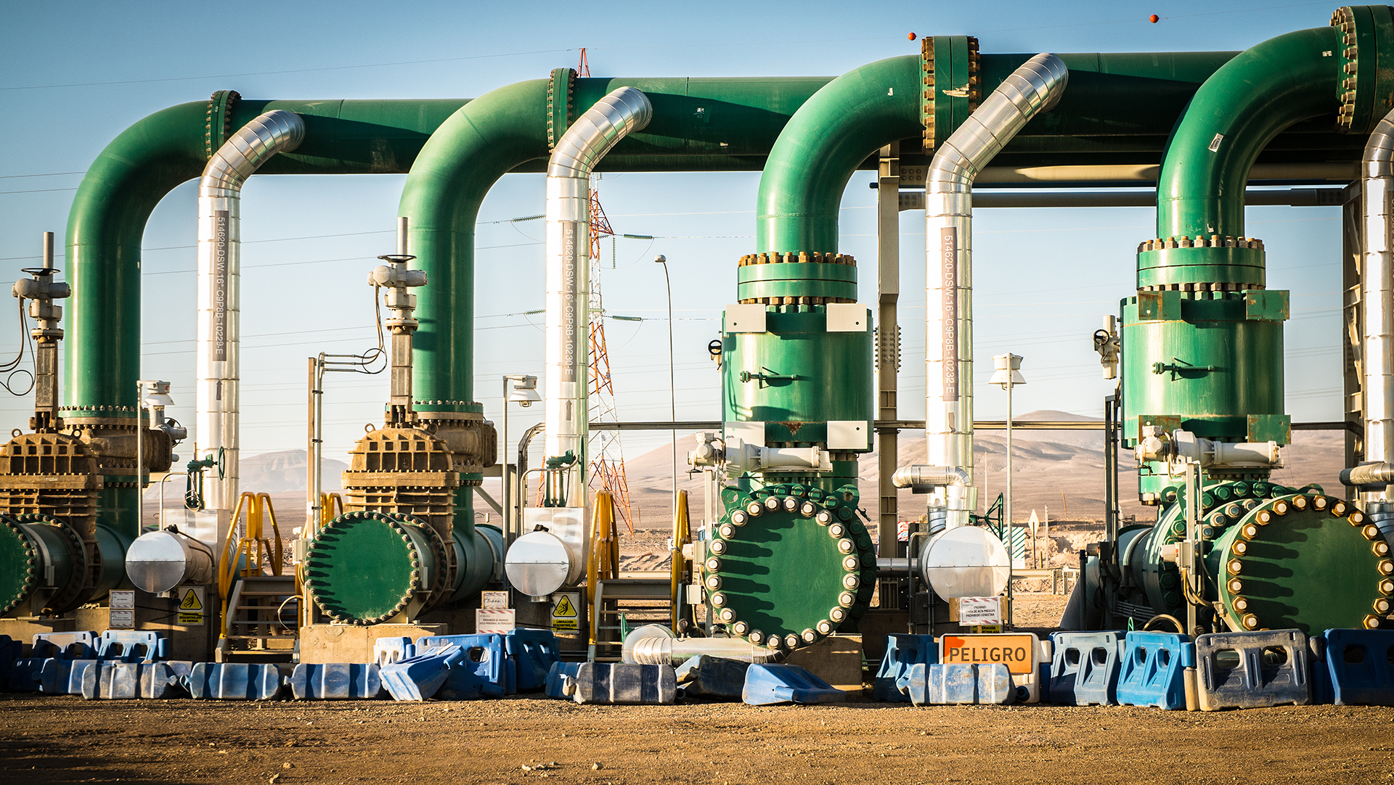
Project highlights | Mining
01 | EXPANSION OF WATER SUPPLY AT MINERA
ESCONDIDA COPPER MINE
02 | TOROMOCHO PROJECT
03 | S11D FERRO-CARAJÁS PROJECT
04 | PASCUA LAMA PROJECT
EXPANSION OF WATER SUPPLY AT MINERA ESCONDIDA COPPER MINE
CUSTOMER:
Minera Escondida
COUNTRY:
Chile
SCOPE:
C
COMPLETION:
2016
DESCRIPTION:
Construction of two separate 42"-diameter underground aqueducts from Coloso to the mine of 178 km in length. Construction and laying three 18 km-pipes of varying diameters (36", 24", 20" and 14") to distribute water within the mine's facilities.
Return to market segments
Continue with the presentation

Slide 40
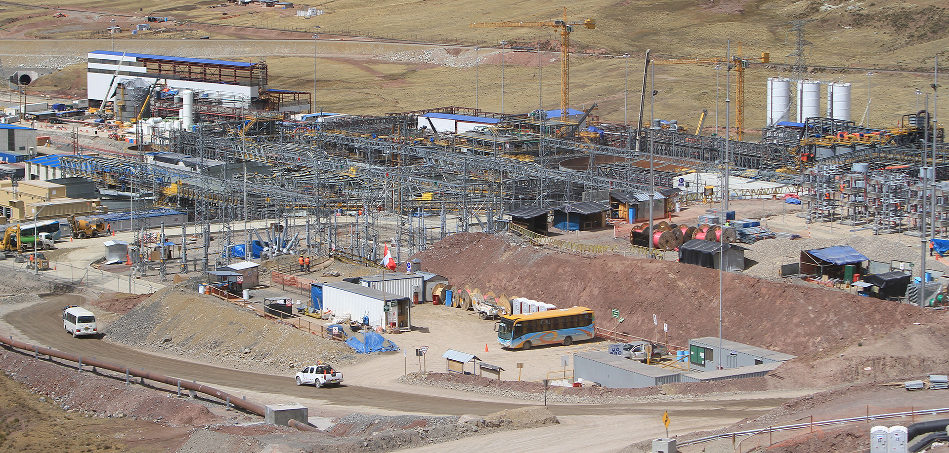
Project highlights | Mining
01 | EXPANSION OF WATER SUPPLY AT MINERA ESCONDIDA COPPER MINE
02 | TOROMOCHO PROJECT
03 | S11D FERRO-CARAJÁS PROJECT
04 | PASCUA LAMA PROJECT
TOROMOCHO PROJECT
CUSTOMER:
Minera Chinalco
Perú
COUNTRY:
Peru
SCOPE:
EPC
COMPLETION:
2014
DESCRIPTION:
Open cast mine for copper and molybdenum reserves, located in the central range of the Peruvian Andes, at an altitude of 4,700 mamsl with a production capacity of 1,838 tons/day of copper concentrate and 25.7 tons/day of molybdenum oxide.
Return to market segments
Continue with the presentation

Slide 41
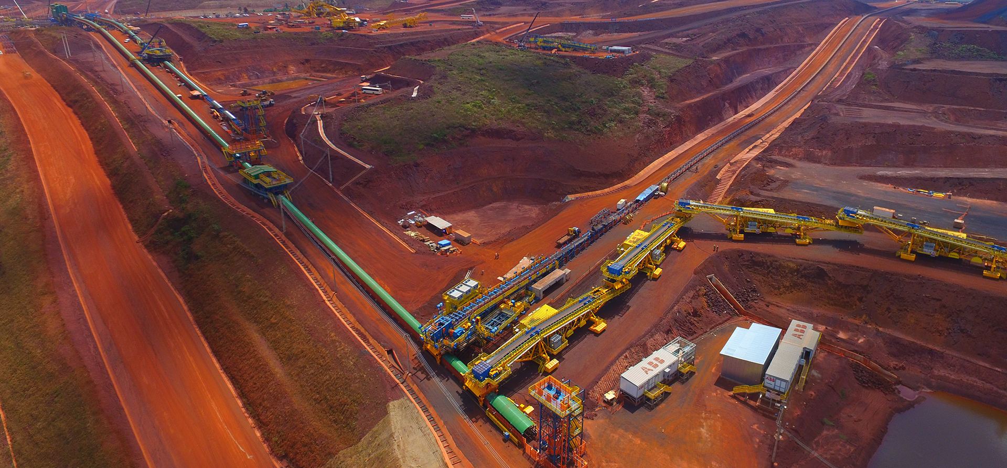
Project highlights | Mining
01 | EXPANSION OF WATER SUPPLY AT MINERA ESCONDIDA COPPER MINE
02 | TOROMOCHO PROJECT
03 | S11D FERRO-CARAJÁS PROJECT
04 | PASCUA LAMA PROJECT
S11D FERRO-CARAJÁS PROJECT
CUSTOMER:
Vale
COUNTRY:
Brazil
SCOPE:
C
COMPLETION:
2018
DESCRIPTION:
Construction and electromechanical assembly of Truckless Mining System, to replace the conventional transportation system using off-road mining trucks. Building and assembling the structures and mechanical equipment for the conveyor belts system over a total of 31.3 km, of which 7.3 km are over land.
Return to market segments
Continue with the presentation

Slide 42
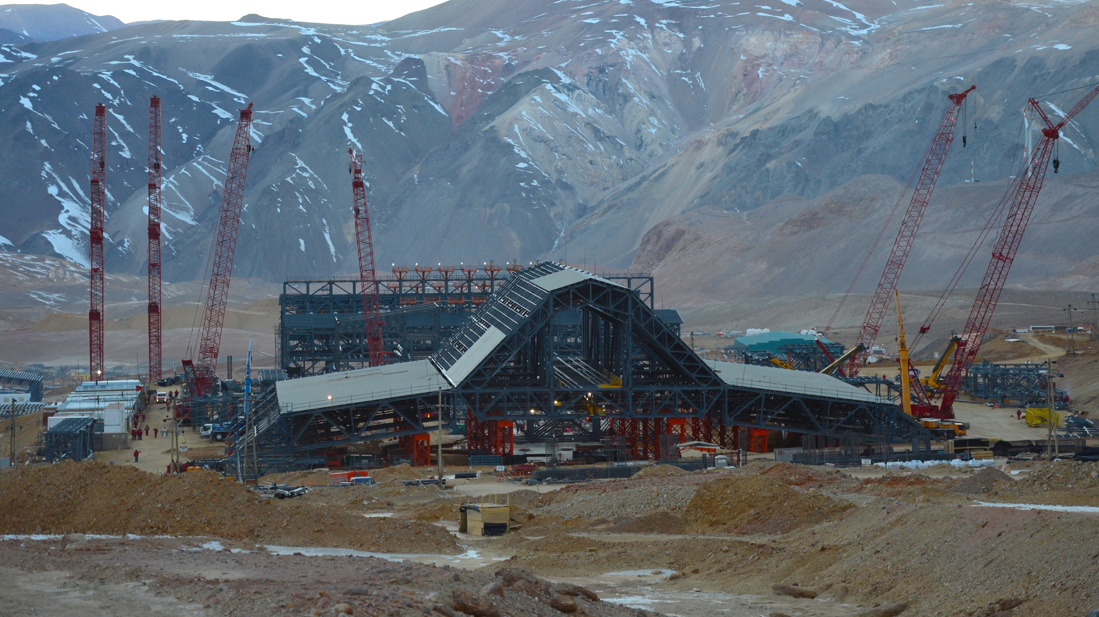
Project highlights | Mining
01 | EXPANSION OF WATER SUPPLY AT MINERA ESCONDIDA COPPER MINE
02 | TOROMOCHO PROJECT
03 | S11D FERRO-CARAJÁS PROJECT
04 | PASCUA LAMA PROJECT
PASCUA LAMA PROJECT
CUSTOMER:
Barrick
COUNTRY:
Argentina & Chile
SCOPE:
EPC
COMPLETION:
2011
DESCRIPTION:
Construction for the development of the Pascua Lama Mine on the border between Chile (Pascua) and Argentina (Lama) at an altitude ranging between 3,800 and 5,200 mamsl. This is a Greenfield project and also the world's first binational mining enterprise.
Return to market segments
Continue with the presentation

Slide 43
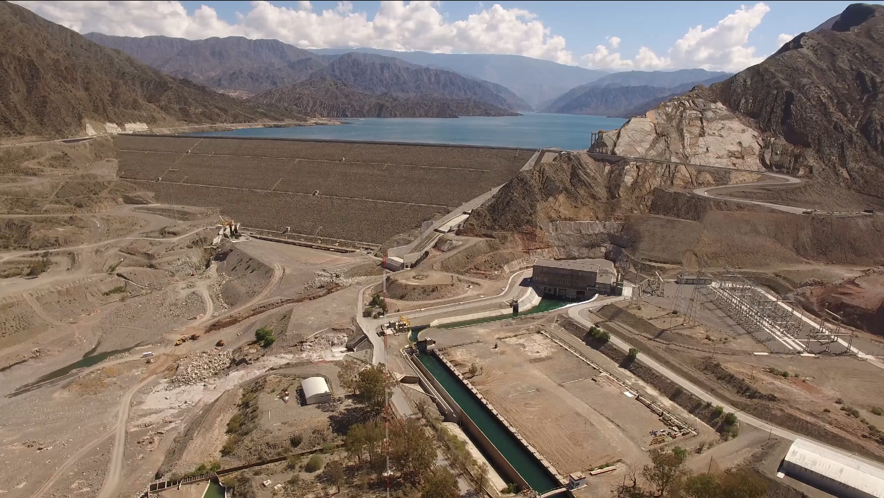
5/Civil Infrastructure Works
Dams
Underground subways
and railways
Tunnels and bridges
Roads and highways
Ports
Plants for water treatment, waste treatment and aqueducts
Return to market segments
Continue with the presentation

Slide 44
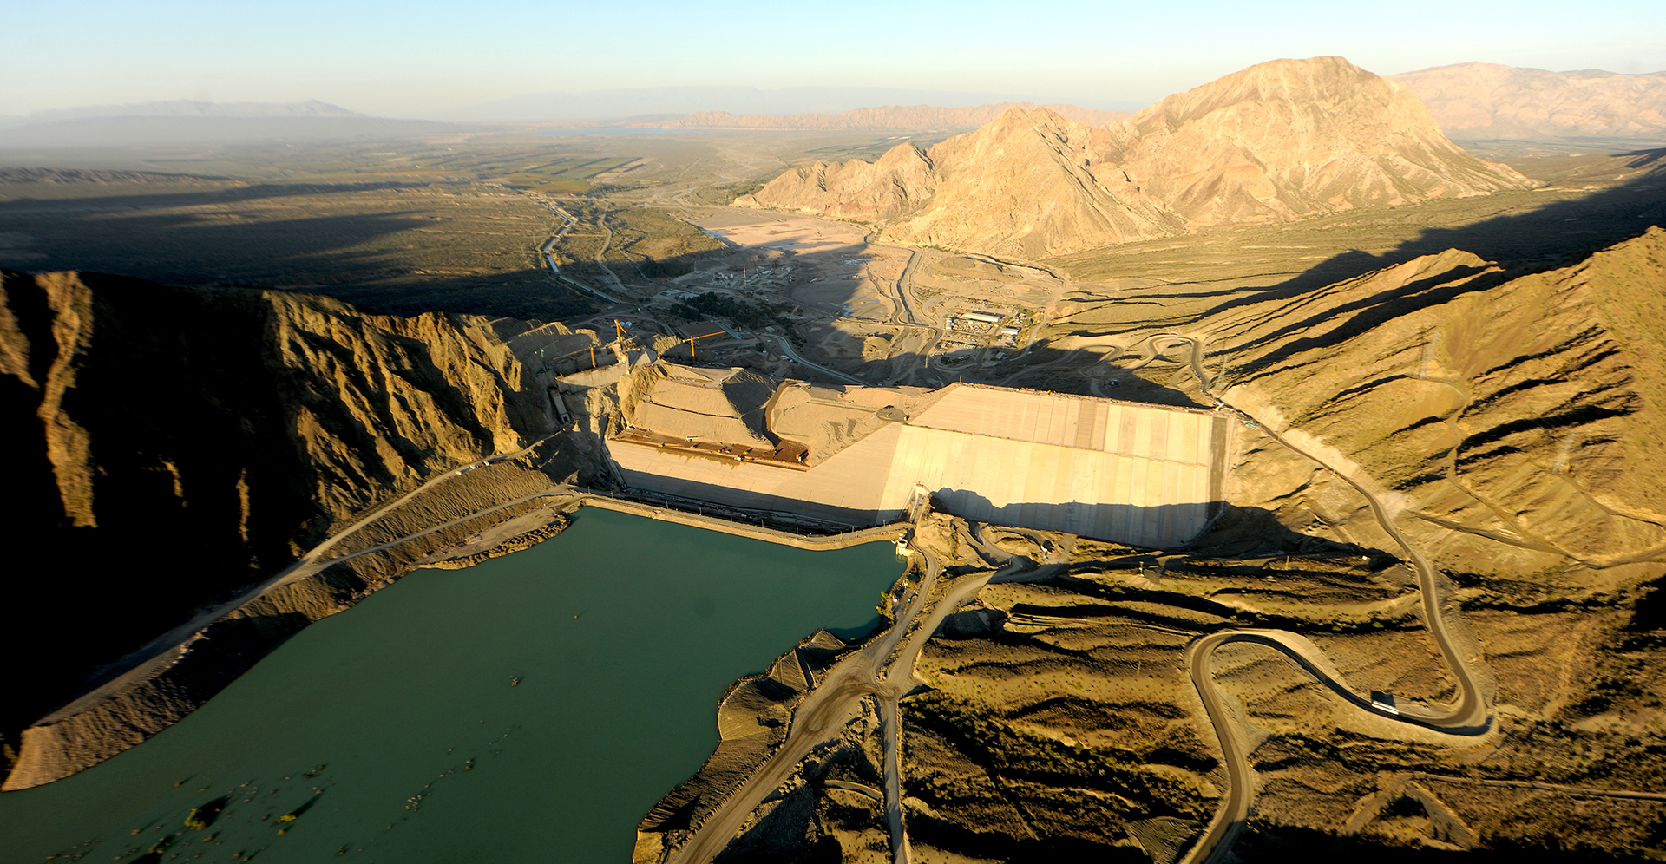
Project highlights | Civil Infrastructure Works
01 | PUNTA NEGRA HYDROELECTRIC DAM
02 | EXTENSION OF THE BUENOS AIRES "H" SUBWAY LINE
03 | EL TAMBOLAR I HYDROELECTRIC PROJECT
04 | GENERAL BELGRANO RAILWAY RECOVERY AND REPAIR PROJECT
PUNTA NEGRA HYDROELECTRIC DAM
CUSTOMER:
Energía Provisional Sociedad del Estado
(San Juan)
COUNTRY:
Argentina
SCOPE:
EPC
COMPLETION:
2016
DESCRIPTION:
Multipurpose hydroelectric concrete-face rock-fill dam on the San Juan River to generate electric power, regulate water flow and expand local irrigation capacity. Dam of 128m in height, and a power station with 2 Francis turbines of 32.5 MW each.
Return to market segments
Continue with the presentation

Slide 45
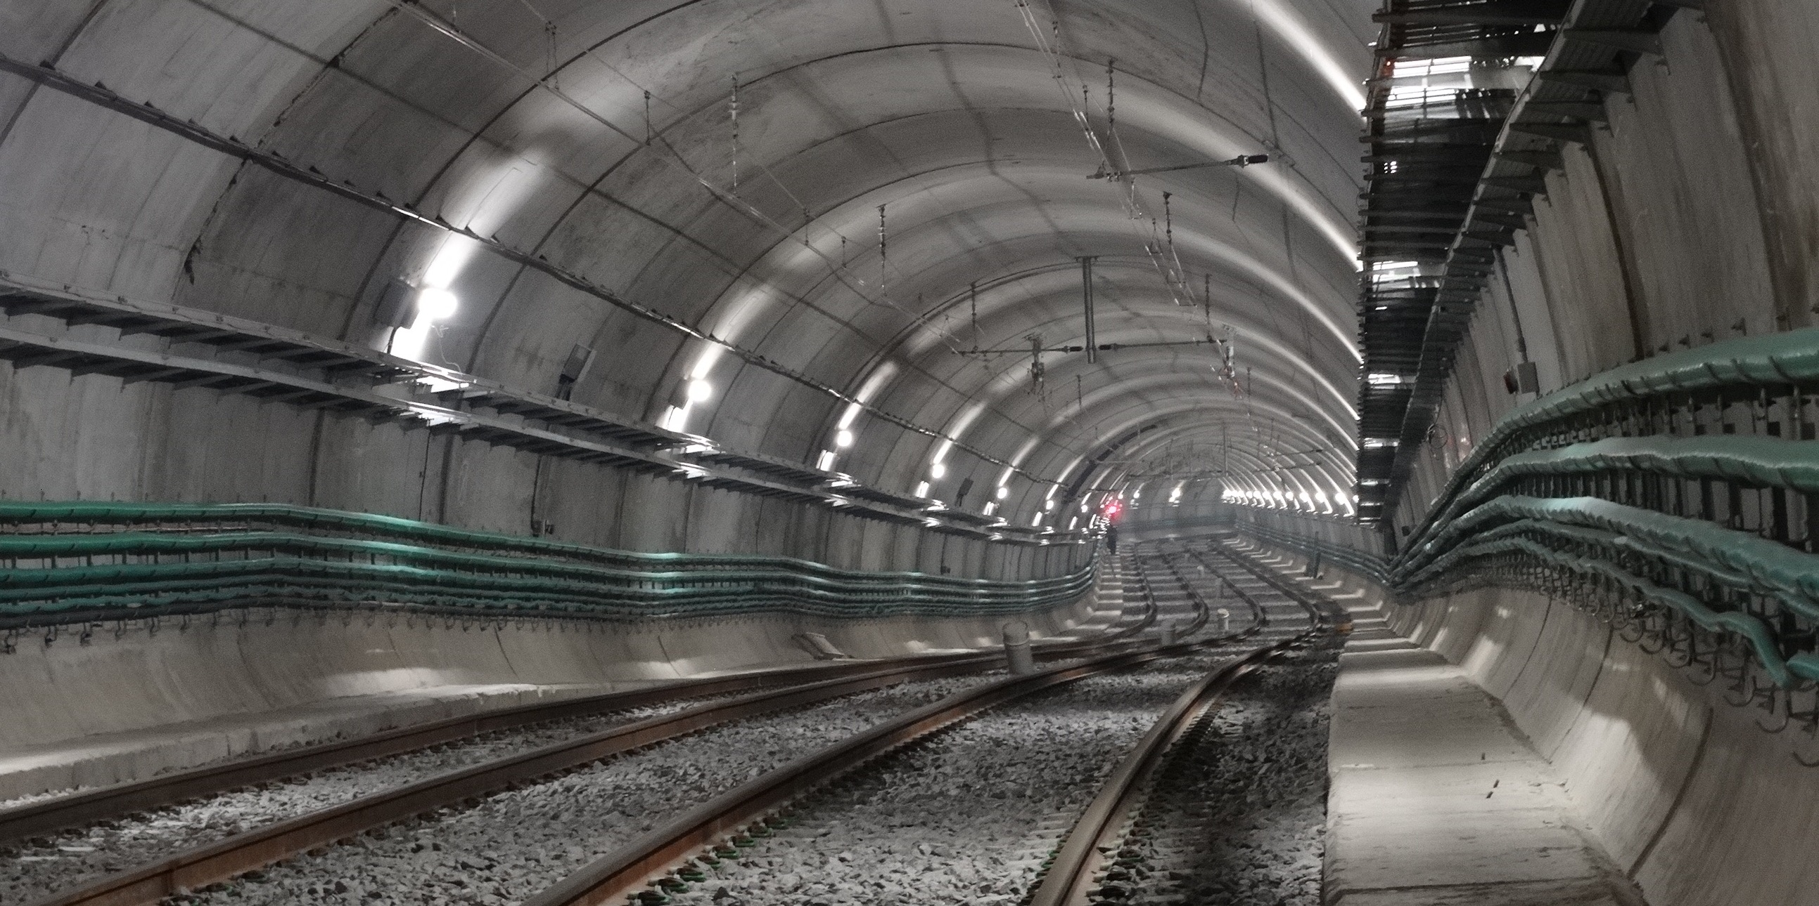
Project highlights | Civil Infrastructure Works
01 | | PUNTA NEGRA HYDROELECTRIC DAM
02 | EXTENSION OF THE BUENOS AIRES "H" SUBWAY LINE
03 | EL TAMBOLAR I HYDROELECTRIC PROJECT
04 | GENERAL BELGRANO RAILWAY RECOVERY AND REPAIR PROJECT
EXTENSION OF THE BUENOS AIRES "H" SUBWAY LINE
CUSTOMER:
Subterráneos de Buenos Aires Sociedad del Estado
COUNTRY:
Argentina
SCOPE:
EPC
COMPLETION:
2019
DESCRIPTION:
Building 4.5 km of tunnels, 4 stations, 2 workshops and underground sheds.
Return to market segments
Continue with the presentation

Slide 46
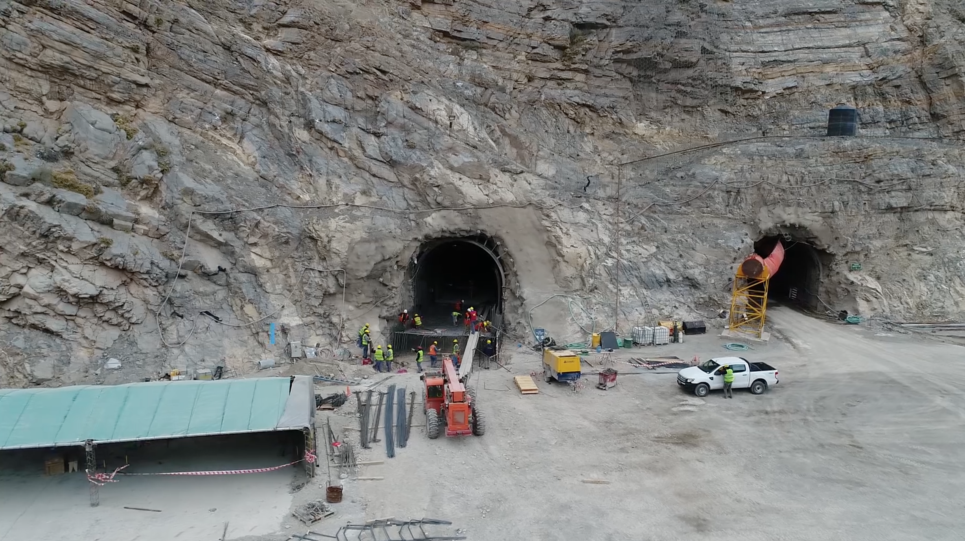
Project highlights | Civil Infrastructure Works
01 | | PUNTA NEGRA HYDROELECTRIC DAM
02 | EXTENSION OF THE BUENOS AIRES "H" SUBWAY LINE
03 | EL TAMBOLAR I HYDROELECTRIC PROJECT
04 | GENERAL BELGRANO RAILWAY RECOVERY AND REPAIR PROJECT
EL TAMBOLAR I HYDROELECTRIC PROJECT
CUSTOMER:
Energía Provincial Sociedad del Estado (San Juan)
COUNTRY:
Argentina
SCOPE:
EPC
COMPLETION:
2018
DESCRIPTION:
Basic and executive design, geological and geotechnical surveys. Detail engineering and construction of the river diversion, internal access and roads, crew camps and workshops required to build the dam and power station.
Return to market segments
Continue with the presentation

Slide 47
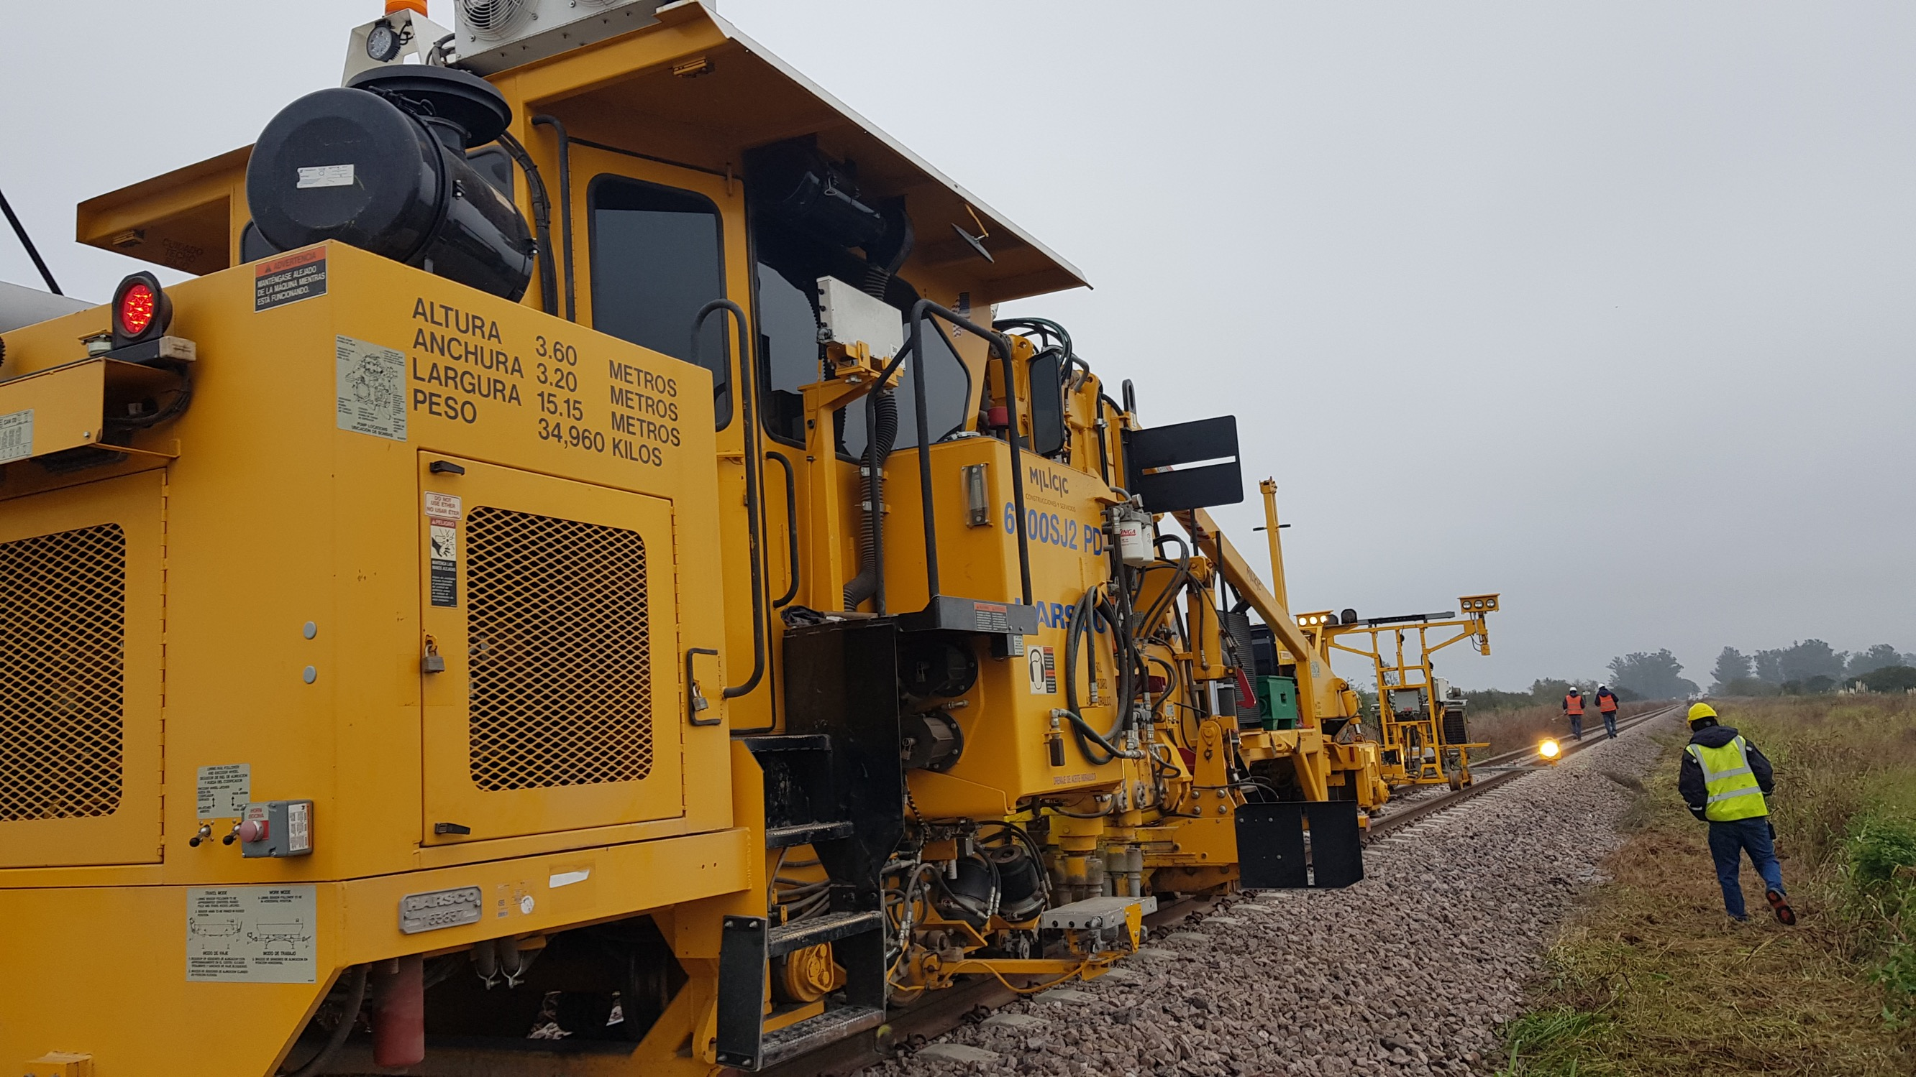
Project highlights | Civil Infrastructure Works
01 | | PUNTA NEGRA HYDROELECTRIC DAM
02 | EXTENSION OF THE BUENOS AIRES "H" SUBWAY LINE
03 | EL TAMBOLAR I HYDROELECTRIC PROJECT
04 | GENERAL BELGRANO RAILWAY RECOVERY AND REPAIR PROJECT
GENERAL BELGRANO RAILWAY RECOVERY AND REPAIR PROJECT
CUSTOMER:
Administración
de Infraestructuras Ferroviarias
COUNTRY:
Argentina
SCOPE:
EPC
COMPLETION:
2020
DESCRIPTION:
Executive project design, detail engineering, supplies and construction to overhaul 109 km of railway lines in metric gauge, in the province of Santa Fe.
Return to market segments
Continue with the presentation

Slide 48
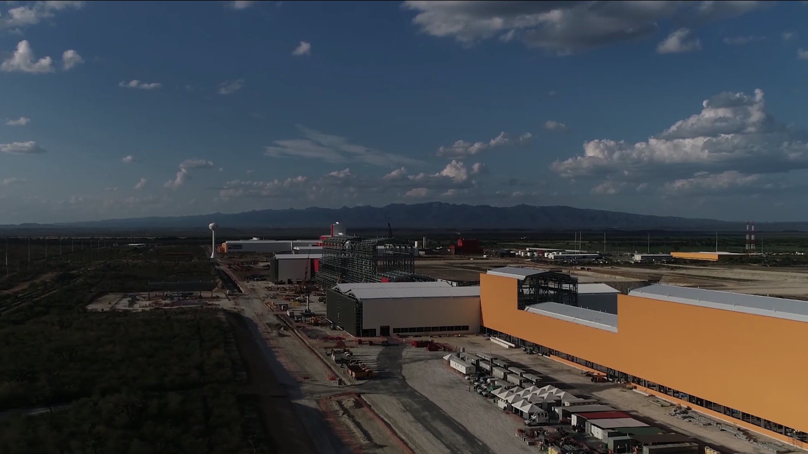
6/Industrial plants
STEELWORKS
OTHER INDUSTRIAL PLANTS
  Integral long steel mills
  Integral flat steel mills
  Aluminum foundries
  Pulp and paper mills
  Cold and hot rolling mills
  Cement production plants
  Steelworks
  Continuous casting
  Cokers
Return to market segments
Continue with the presentation

Slide 49
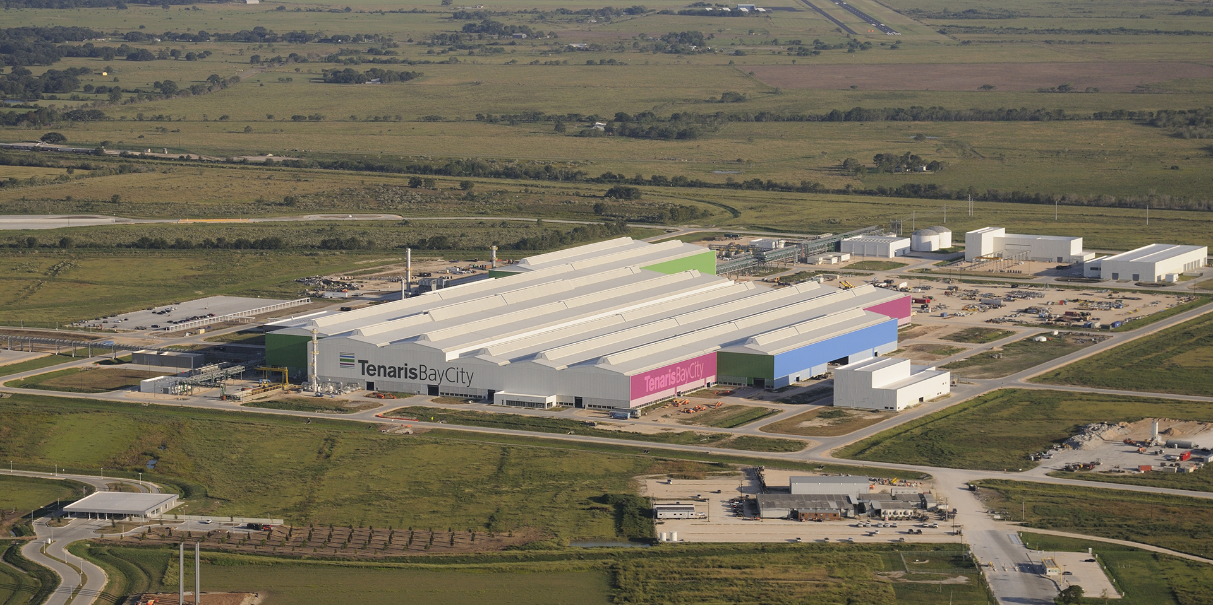
Project highlights | Civil Infrastructure Works
01 | TENARIS BAY CITY
02 | 3T ROLLING MILL
03 | GREENFIELD PESQUERIA PLANT
04 | EXTENSION OF ALUAR PLANT
TENARIS BAY CITY
CUSTOMER:
Tenaris
COUNTRY:
USA
SCOPE:
EPCM
COMPLETION:
2017
DESCRIPTION:
Construction of a mill to manufacture seamless pipes ranging from 114.3 to 244.5 mm in diameter, and thicknesses of between 5.7 and 25.4 mm, with an estimated output of 616,000 tons/year for Tenaris's OCTG product line.
Return to market segments
Continue with the presentation

Slide 50

Project highlights | Civil Infrastructure Works
01 | TENARIS BAY CITY
02 | 3T ROLLING MILL
03 | GREENFIELD PESQUERIA PLANT
04 | EXTENSION OF ALUAR PLANT
3T ROLLING MILL
CUSTOMER:
Tenaris
COUNTRY:
Mexico
SCOPE:
EPC
COMPLETION:
2011
DESCRIPTION:
Construction of a hot rolling mill and two cold rolling mills, in addition to all the off-site works complementing operational services.
Return to market segments
Continue with the presentation

Slide 51

Project highlights | Civil Infrastructure Works
01 | TENARIS BAY CITY
04 | EXTENSION OF ALUAR PLANT
01 | TENARIS BAY CITY
02 | 3T ROLLING MILL
03 | GREENFIELD PESQUERIA PLANT
GREENFIELD PESQUERIA PLANT
CUSTOMER:
Ternium
COUNTRY:
México
SCOPE:
PC
COMPLETION:
2013
DESCRIPTION:
Cold rolling plant with an output of 1.5 million tons/year. The plant is equipped to produce 1,880 mm-wide steel sheet, intended exclusively for the automotive industry.
Return to market segments
Continue with the presentation

Slide 52

Project highlights | Civil Infrastructure Works
01 | TENARIS BAY CITY
02 | 3T ROLLING MILL
03 | GREENFIELD PESQUERIA PLANT
04 | EXTENSION OF ALUAR PLANT
EXTENSION OF ALUAR PLANT
CUSTOMER:
Aluar
COUNTRY:
Argentina
SCOPE:
EPC
COMPLETION:
1999
DESCRIPTION:
Expansion of Aluar aluminum smelter, increasing annual production to 72,000 tons.
Return to market segments
Continue with the presentation

Slide 53





Our history | Main projects
1970s
1980s
1990s
2000s
2010s
Zárate Brazo Largo Bridge, Argentina
Shegdun Yanbu Pipeline, Saudi Arabia
RLAM Refinery Expansion, Brazil
Camisea Gas Pipeline, Peru
P-76 offshore platform, Brazil
Norperuano Pipeline, Peru
Expansion of Lujan de Cuyo Refinery, Argentina
Petacalco coal reception and handling terminal, Mexico
Heavy Crude Oil Pipeline, Ecuador
Pesqueria Thermal Power Plant, Mexico
Propulsora Siderúrgica, Argentina
Arroyito heavy water plant, Argentina
Profertil Petrochemicals Complex, Argentina
Los Caracoles Hydroelectric Plant, Argentina
Peru LNG Pipeline, Peru
Dunkirk LNG regasification terminal, France

Slide 54

Our history | Main projects
1970s
1980s
1990s
2000s
2010s
Zárate Brazo Largo Bridge, Argentina
Shegdun Yanbu Pipeline, Saudi Arabia
RLAM Refinery Expansion, Brazil
Camisea Gas Pipeline, Peru
P-76 offshore platform, Brazil
Norperuano Pipeline, Peru
Expansion of Lujan de Cuyo Refinery, Argentina
Petacalco coal reception and handling terminal, Mexico
Heavy Crude Oil Pipeline, Ecuador
Pesqueria Thermal Power Plant, Mexico
Propulsora Siderúrgica, Argentina
Arroyito heavy water plant, Argentina
Profertil Petrochemicals Complex, Argentina
Los Caracoles Hydroelectric Plant, Argentina
Peru LNG Pipeline, Peru
Dunkirk LNG regasification terminal, France

Slide 55





Project Highlights in Argentina
EPC
EPC + O&M
EPC
EPC
EPC
Genelba Plus combined cycle power plant
Fortín de Piedra, Vaca Muerta
Gasoducto Tratayén-Mega
Expansion of Buenos Aires Subway Line H
Light Diesel hydrotreatment unit - YPF
Adding 380 MW to the national energy grid.
The top shale gas Project in the country, producing 13% of the gas consumed at domestic level.
The first crossing managed remotely due to COVID-19.
The largest infrastructure work in the City of Buenos Aires for the last 60 years.
Reforms made to refinery to allow it to meet new sulfur content specifications for fuels.

Slide 56




Project Highlights in Brazil
C
C
EPC
C
EPC
Santos - San Pablo oil pipeline
Itaipú Hydroelectric Power Plant
Presidente Bernardes de Cubatão Refinery
Ferro Carajás - S11D
FPSO P-76
First project in the country. The pipelines laid by Techint make up 60% of Brazilian network as a whole.
We carried out all the assembly tasks to build what is to day the largest hydroelectric power generation plant in the world.
Thanks to the HDT unit, the refinery reduced sulfur content to improve fuel quality.
The capacity of the world’s largest iron ore producer was increased in a sustainable and innovative way.
One of the largest offshore projects ever completed in Brazil, the P-76 stores and transfers 150,000 bpd of oil.

Slide 57





Project Highlights in Chile
EPC + O&M
EPC + O&M
EPC
EPC
EPC
BHP Escondida – various EPC and maintenance for Concentrates Plant
Anglo American- Los Bronces Mine – Various projects
AMSA - Minera Esperanza
AMSA- Los Pelambres – Pipelines and stations
ENGIE- Gasoducto NorAndino
Minera Escondida is the largest copper mine in the world.
Including the construction of new aqueduct and ore pipeline, as well as various maintenance works for existing facilities.
Seawater pumping system to concentrates plant at 2,200 masl and concentrates pipeline to port of Michilla.
Tailings pond at El Mauro developed by Techint, allowing Mina Los Pelambres to produce copper for 30 years.
One of the first projects to add an environmental team to work alongside the construction team.

Slide 58





Project Highlights in Colombia
EPC
EPC
EPC
EPC
EPC
Cusiana- La Belleza oil pipeline
Ballena-Barrancabermeja gas pipeline
Expansion of Cerrejón coal mining complex
CPF Pendare
CPF Cupiagua
223 km de Ø 30” y 36”
579 km de Ø 18“
The plant’s capacity was taken from 17 to 21 MTPA (million tons per annum).
New crude oil processing plant, with a capacity of 110,000 bpd.
New oil processing plant with a capacity of 220,000 bpd and 900 MMcf3 gas.
50% of the pipeline network in Colombia was built by Techint E&C.

Slide 59





Project Highlights in Ecuador
EPC
EPC
EPC
EPC
C
Heavy Crude Oil pipeline (OCP)
Auca & Shushufindi fields - Upstream Plants & Flowlines
Drinking Water Treatment system in Guayaquil
Papallacta project
Quito tunnels
Duplication of crude oil transport capacity from the Amazon rainforest to the coast where it is shipped.
Works executed since 2012 have increased production to +80KBPD (Auca) and +70KBPD (Shushufindi).
The new system solved drinking water shortages affecting the city.
The project meant that city of Quito could improve its supply of drinking water by 3 m3 per second.
Techint’s first work in the country was finished in record time, solving the serious traffic problems affecting the city.

Slide 60





Project Highlights in Mexico
EPC
EPC
EPC
PC
EPC
Norte III Combined Cycle Power Plant
Altamira Compression Station
Los Ramones II Norte gas pipeline
Greenfield plant in Pesquería
LNG Costa Azul regasification terminal
With an output capacity of 907 MW, it produces energy to power over half a million homes.
Some 40% of the gas consumed in Mexico is processed at this compression plant.
Transporting 1.2 MMm3/day, this is one of the most crucial infrastructure works of the last 40 years for the country.
State-of-the-art technology set a special environmental standard for this kind of plant, earning it LEED certification.
Supplies 1,000 MMSCFD of natural gas to electricity generation plants and other industries in the state.

Slide 61





Project Highlights in Italy
E
E
E
E
E
Porto Marghera Small Scale LNG Terminal
ENI Framework Agreement
Marghera Levante Power Plant
Policlinico of Milan
Dalmine Zero Emission
FEED and PMC Services for a 32,000 m3 capacity SS LNG Terminal for ship bunkering and truck loading.
Engineering Services (FS, BEDP, FEED and DE) for the 4 Italian refineries of ENI Group.
Basic and Detailed Engineering for a 760 Mw net output Combined Cycle Power Plant based on 1 class “H” Gas Turbine.
Engineering, Project and Construction Management for State-of-Art Hospital in Milan: 700 Beds, 22 Op theaters, over 80.000 sqm.
Engineering Services (FS, BEDP) for the projected replacement of natural gas with green hydrogen to cut CO₂ for the EAF and the laminator.

Slide 62



We belong to
a global group
of companies
3.3 million
tons of seamless and
welded pipe shipments
12.5 million
tons steel products* shipments
1.3 billion
USD in annual sales
170,000
barrels of oil equivalent produced per day
55,500
full-time employees
22.1 billion
920 million
USD in backlog
1 million
unique clients
USD in sales
*Does not include iron ore

Slide 63

Thank
you
www.techint.com

