Slide 1
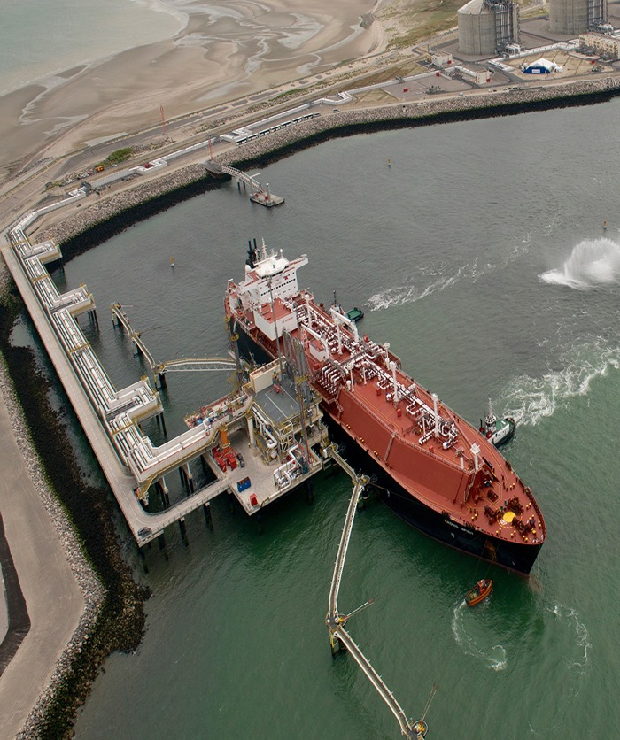
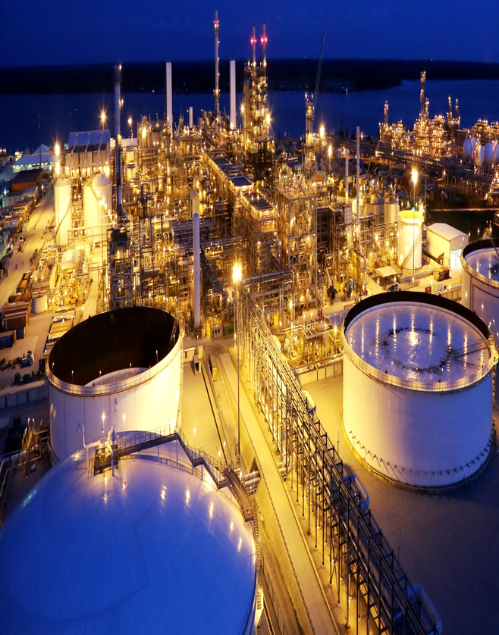
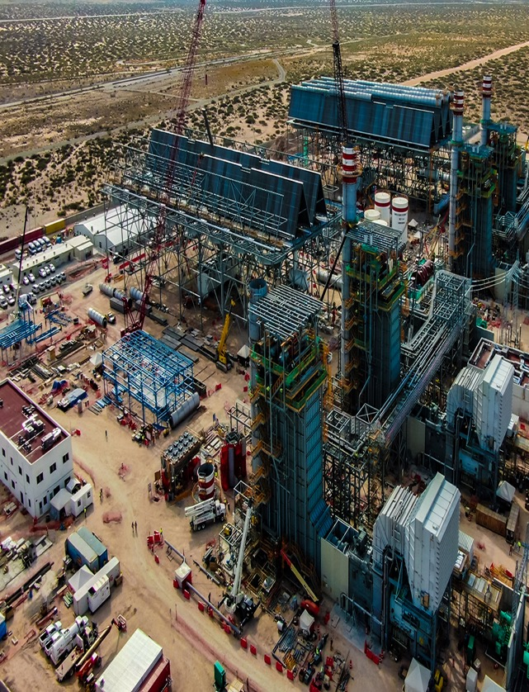
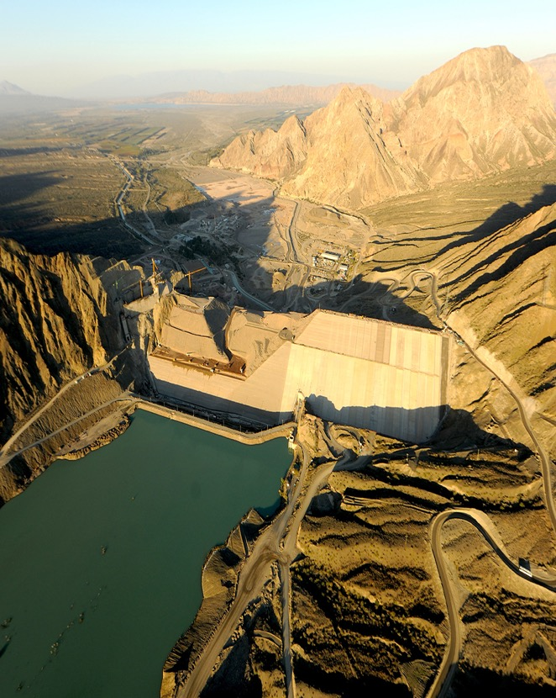
Projects Highlights by Region
Europe
Africa & Middle East
Americas
Argentina
01.
02.
03.
04.

Slide 2
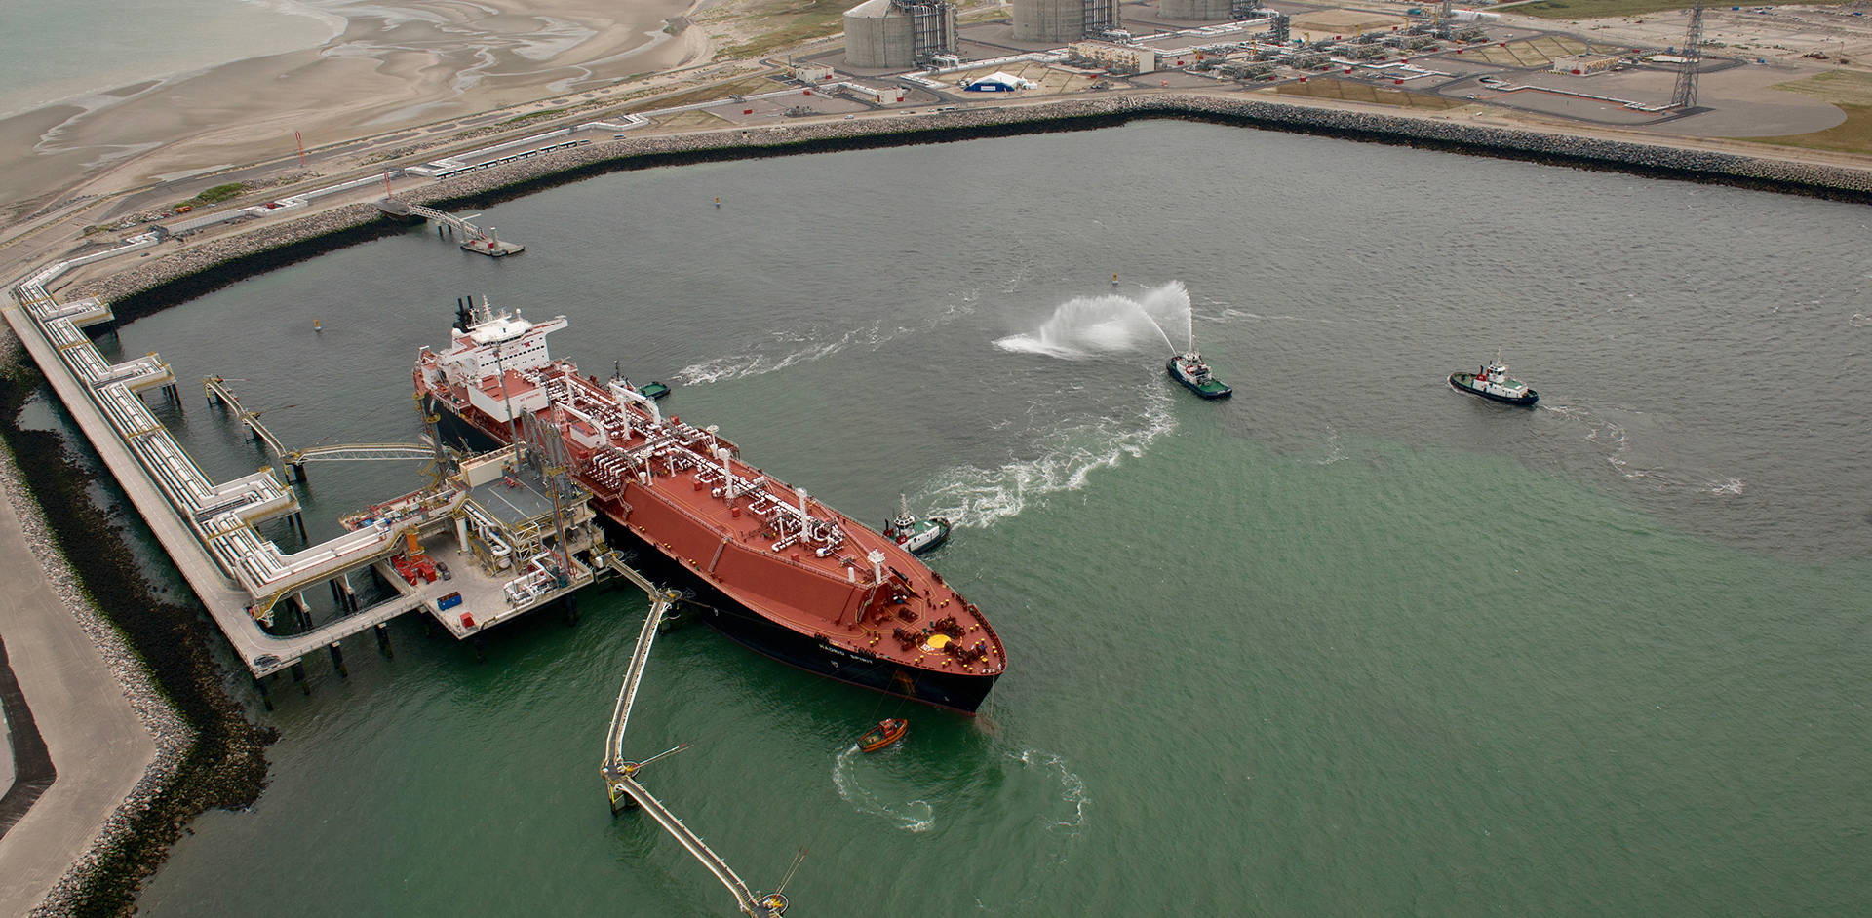
Projects Highlights - Europe

Slide 3
Project Highlights | Oil & Gas
DUNKIRK LNG REGASIFICATION TERMINAL
CUSTOMER: Électricité de France
COUNTRY: France
SCOPE:
EPC
COMPLETION:
2016
DESCRIPTION: LNG regasification terminal with a dispatch capacity of 13 billion m³/year.
CONTRACT VALUE (US$ MILLIONS)
756

Slide 4
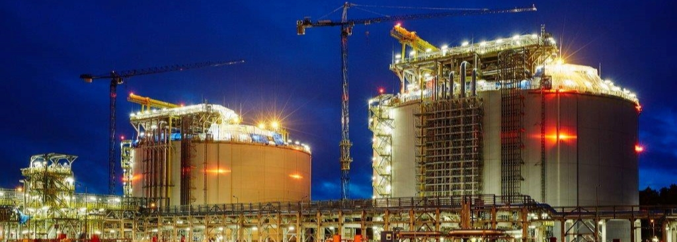
Project Highlights | Oil & Gas
SWINOUJSCIE LNG GAS TERMINAL
CUSTOMER: Polskie LNG S.A. (owned by (GAZ-SYSTEM S.A.)
COUNTRY: Poland
SCOPE:
EPC
COMPLETION:
2016
DESCRIPTION: LNG Regasification Terminal of 5 BCMA with two 160,000 cu.m. full containment Storage Tanks. Main facilities: LNG Carrier (50 000 m3 to 216 000 m3); Unloading ( 3 arms 4 000 m3/h each ( Total 12 000 m3/h); Jetty (1,650 m long & ship unloading to LNG Tk); 2 Full containment LNG Tanks (160 000 m3 each); Recondenser (450 m3/h max); Gas send-out ; Gasification (type SCV and ORV): Nitrogen production (21 000 m3 N2/h); Road Tankers loading (95 000 T LNG/y); Future Ext.: (tie-ins incl in EPC) and Jetty marine & civil works.
CONTRACT VALUE (US$ MILLIONS)
715

Slide 5
Project Highlights | Energy
ZEEBRUGGE LNG TERMINAL SECOND EXPANSION
CUSTOMER: Fluxys LNG S.A. (Belgium)
COUNTRY: Belgium
SCOPE: EPC
COMPLETION: 2016
DESCRIPTION: 2nd Capacity Enhancement of LNG Regasification Terminal, consisting of adding a second jetty, enabling the facility to increase capacity and further develop into a hub for supplying LNG as fuel for ships and long-haul trucks. The facilities also have an additional LNG loading/unloading capacity of 14,000 m3/hour.
Contract in JV with Sener
CONTRACT VALUE (US$ MILLIONS)
108

Slide 6
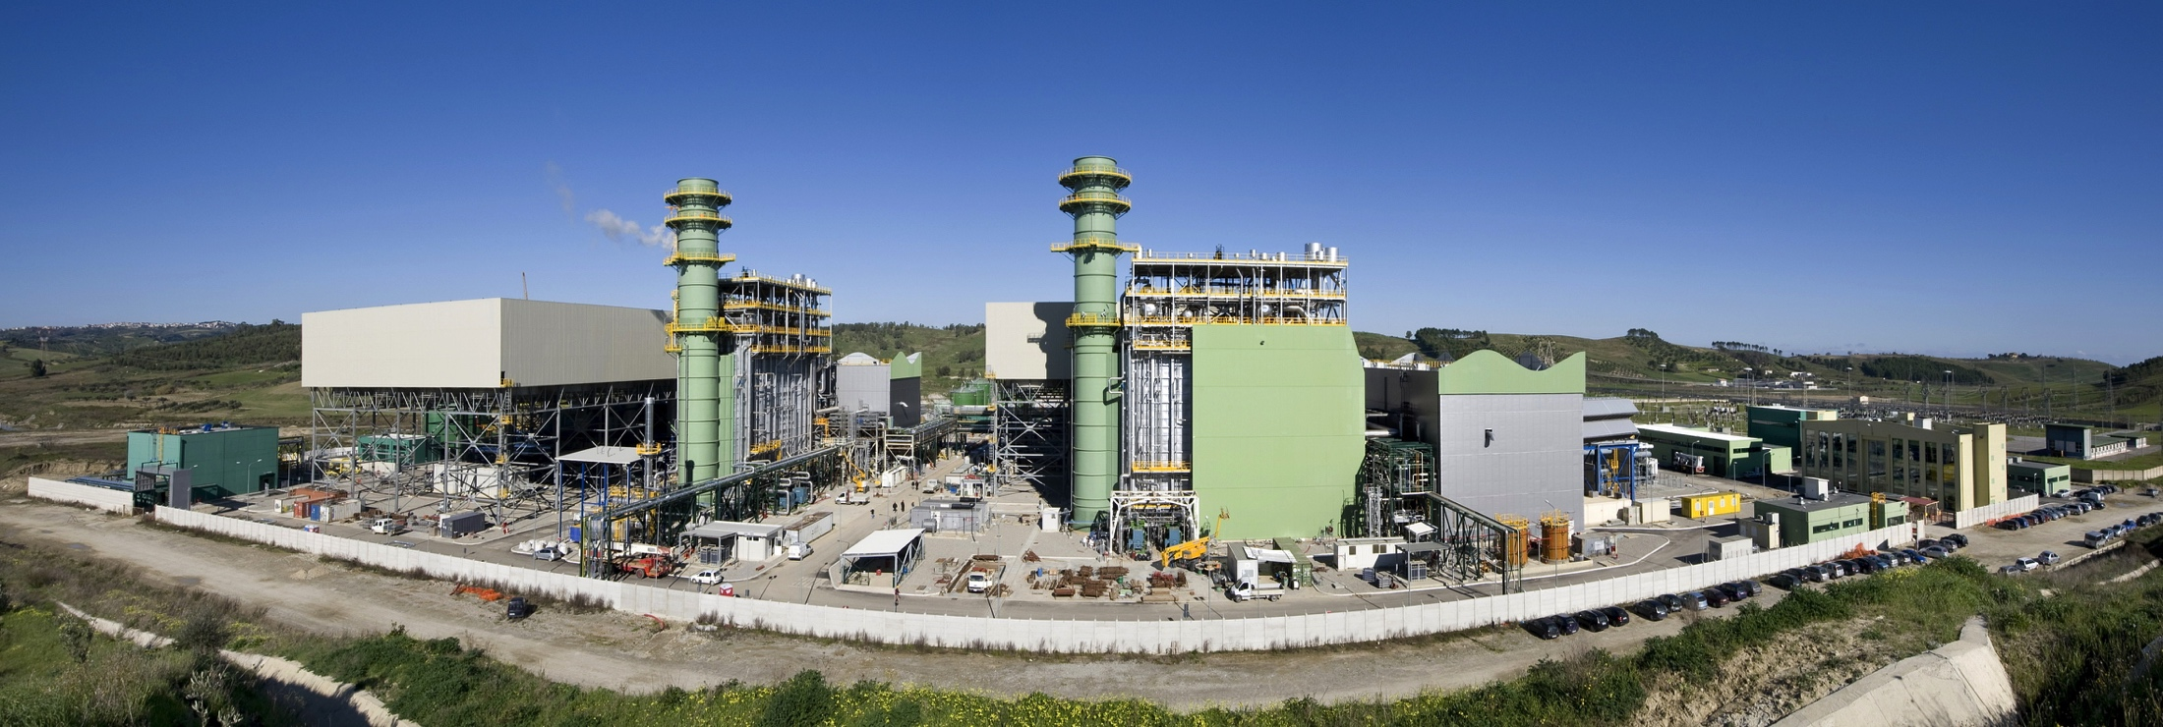
Project Highlights | Energy
SCANDALE COMBINED CYCLE POWER PLANT [2 x 400 MW]
CUSTOMER: Eurosviluppo Elettrica (Endesa + ASM Brescia)
COUNTRY: Italy
SCOPE: EPC
COMPLETION: 2010
DESCRIPTION: 2x400 MW CCGT of the multishaft type, including a cogeneration system for heat supply to an industrial food complex.
Each power train consists of a 270 MW GT-generator and of a 130 MW ST-generator, of the condensing type. Gas Turbine type: ALSTOM GT26 (2 units). HRSG: ANSALDO Boilers, of the horizontal, 3 pressure levels-RH type. In consortium with Alstom Power and EMIT.
CONTRACT VALUE (US$ MILLIONS)
450

Slide 7
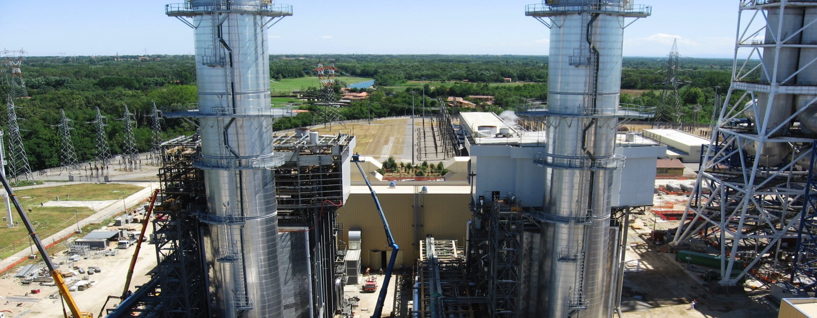
Project Highlights | Energy
TURBIGO POWER PLANT [800 MW]
CUSTOMER: Edipower S. p. A.
COUNTRY: Italy
SCOPE: EPC
COMPLETION: 2007
DESCRIPTION: Repowering of the existing Gas Fired Combined Cycle Power Plant, which includes: two HRSG's, of the horizontal, three pressure levels-RH type; refurbishment of the existing steam turbine generator; all mechanical, electrical and I&C balance of plant equipment/systems, including the river water intake system; civil and structural works; erection of complete plant, including the two Gas Turbine-Generators type V943A-4 supplied by Siemens
CONTRACT VALUE (US$ MILLIONS)
290

Slide 8
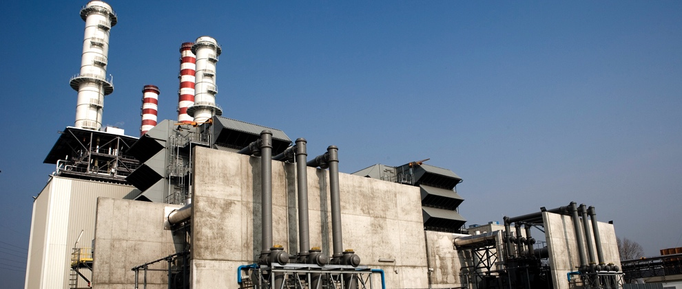
Project Highlights | Energy
PIACENZA 80 MW REPOWERING OF THE EXISTING POWER PLANT
CUSTOMER: Edipower S. p. A.
COUNTRY: Italy
SCOPE: EPC
COMPLETION: 2006
DESCRIPTION: Repowering works included the design and supply of the two HRSG's, of the horizontal, three pressure levels-RH type; refurbishment of the existing steam turbine generator; all the mechanical, electrical and I&C balance of plant equipment/systems; civil and structural works; erection of the complete plant, including the two Gas Turbine-Generators type V943A-4 supplied by Siemens; In J.V. with Fiat Engineering and under a consortium with Siemens
CONTRACT VALUE (US$ MILLIONS)
263

Slide 9
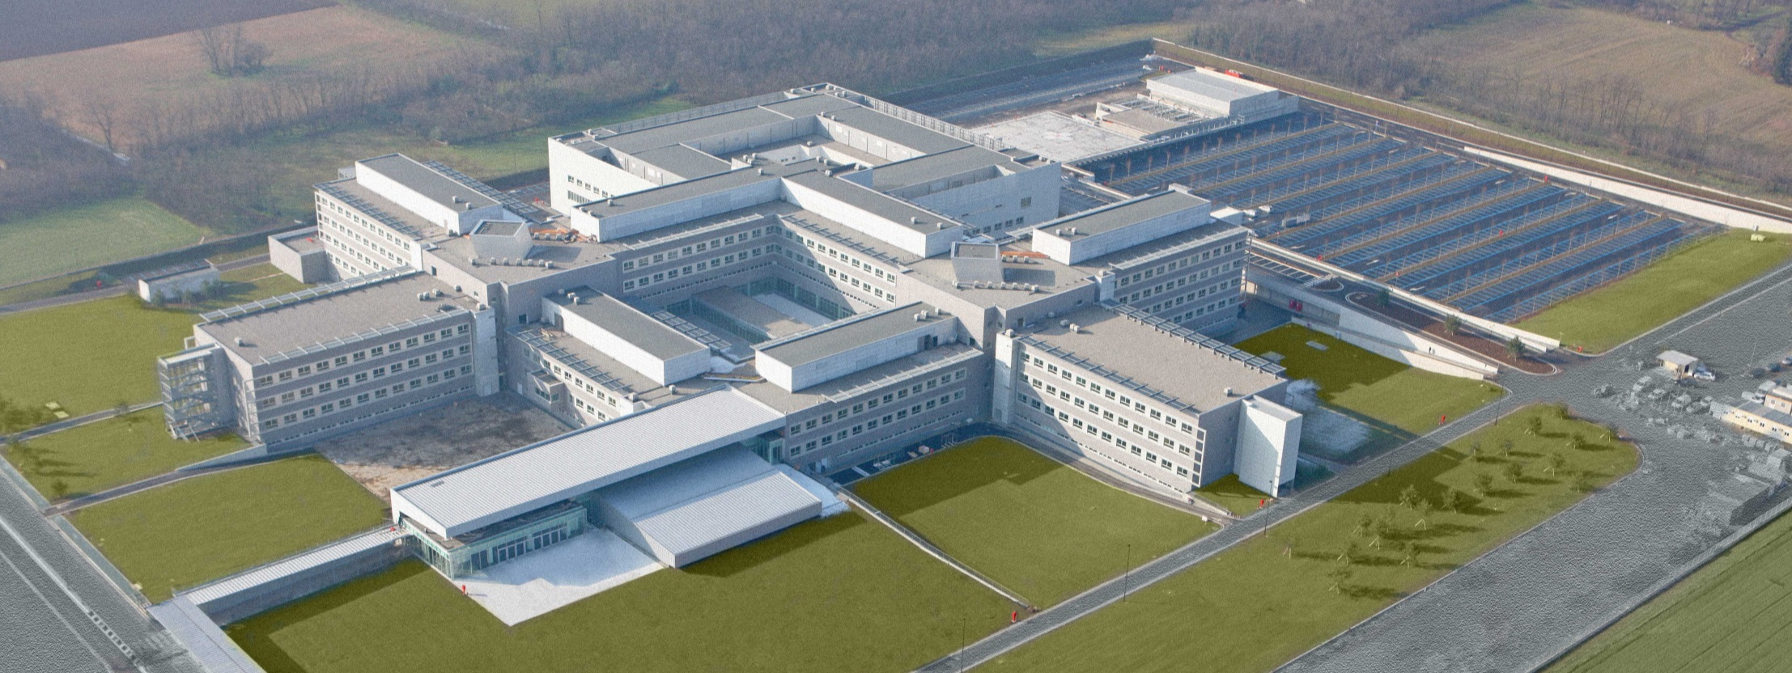
Project Highlights | Civil Infrastructure Works
LEGNANO HOSPITAL
CUSTOMER: Azienda Ospedaliera Ospedale Civile Di Legnano
COUNTRY: Italy
SCOPE:
EPC
COMPLETION:
2010
DESCRIPTION: Definitive and executive project, construction, management of non-medical services (cleaning, catering, maintenance of buildings and technological plant, wardrobe service and integrated linen and uniform management, catering for patients and employees). Concession of EPC construction, operation and maintenance (24 years) for the Hospital Structure (550 beds capacity), excluding medical services. - Total healthcare surface area: 71,000 m2 - Surface area of technological plant and services: 10,000 m2 - Gardens and roads: 55,750 m2 - Parking spaces: 1,920 Start up of operation: Sep-2010
CONTRACT VALUE (US$ MILLIONS)
158

Slide 10
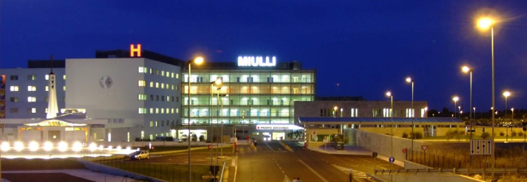
Project Highlights | Civil Infrastructure Works
MIULLI HOSPITAL
CUSTOMER: Fimco S.p.A. (Ospedalii Miulli))
COUNTRY: Italy
SCOPE:
E-CM
COMPLETION:
2005
DESCRIPTION: Preliminary and detailed design; medical equipment included. Project and Construction Management of a New 700 beds Hospital Complex in Bari. Site surface 165,150 sqm Covered surface 15,910 sqm Total surface of main building 70,615 sqm Total surface of other buildings 5,510 sq Surface for car parks 33,000 sqm Beds: 692 Inpatient unit: n. 577; Day-surgery: n. 28 Dialysis: n. 30; Emergency unit: n. 8; Intensive care unit, UCC, stroke unit, in-patient nursing unit: n. 42; D.H.: n. 20 Operating rooms: n. 18 Clinic: 12 Connecting building: 6
CONTRACT VALUE (US$ MILLIONS)
131

Slide 11
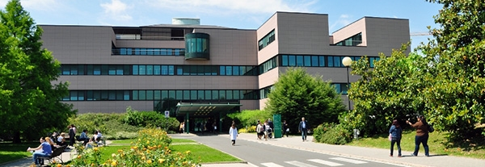
Project Highlights | Civil Infrastructure Works
HUMANITAS CLINICAL INSTITUTE
CUSTOMER: Inmobiliare Mirasole S.p.A. e Humanitas S.p.A.
COUNTRY: Italy
SCOPE:
EPC
COMPLETION:
1996
DESCRIPTION: New private polyfunctional hospital in Milan. Design & Construction of a 380 beds acute care hospital, 6 Operating Theatres connected with a centralized Sterilization Unit. Imaging Diagnostic Department equipped with 6 X-ray Rooms, 7 Special Diagnostic Rooms and a Nuclear Medicine and NMR Unit. Central Laboratory including Clinical-Chemistry, Microbiology, Virology and Haematology Units, as well as common support areas. Morgue and Medical Examiner Room.
CONTRACT VALUE (US$ MILLIONS)
92

Slide 12
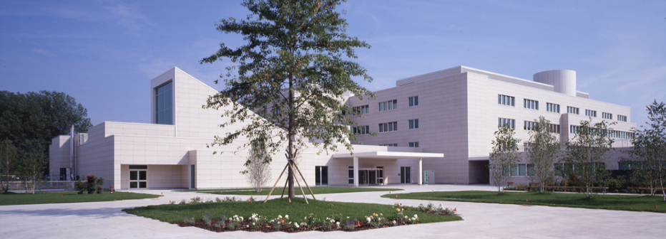
Project Highlights | Civil Infrastructure Works
ACUTE INTENSIVE CARE CENTER
CUSTOMER: Inmobiliare Mirasole S.p.A. Humanitas S.p.A.
COUNTRY: Italy
SCOPE:
EPC
COMPLETION:
1996
DESCRIPTION: New private multifunctional hospital in Milan. Design and construction of a 380 beds acute care hospital, which includes: 6 operating theatres connected with a centralized sterilization Unit; imaging diagnostic department equipped with 6 X-ray Rooms; 7 special diagnostic rooms and a nuclear medicine and NMR unit; central laboratory including clinical - chemistry, microbiology, virology and hematology units, as well as common support areas; morgue and medical examiner room.
CONTRACT VALUE (US$ MILLIONS)
120

Slide 13
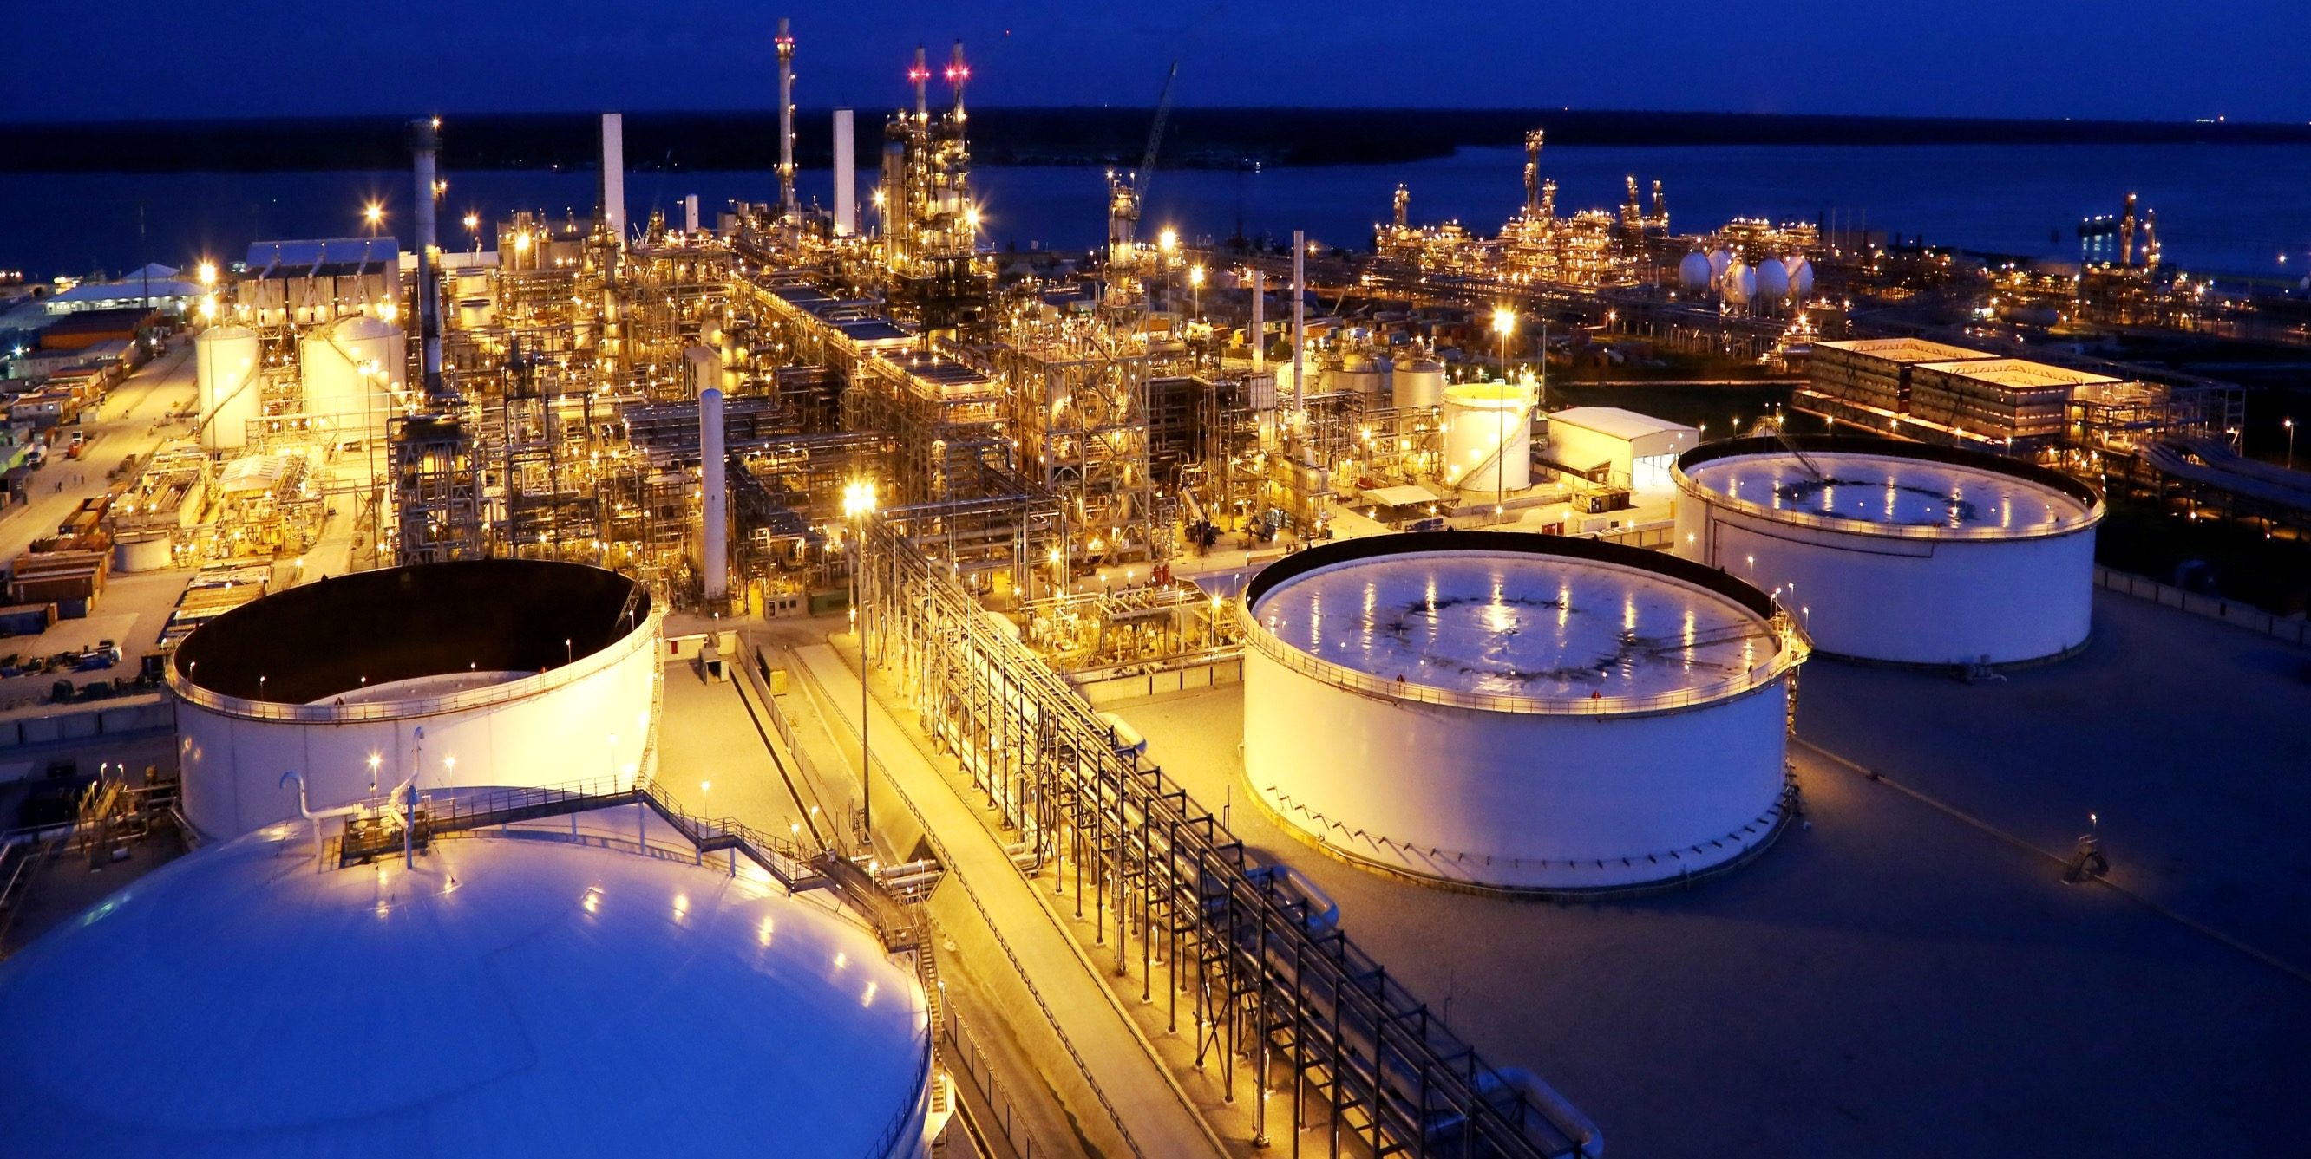
Projects Highlights – Africa & Middle East

Slide 14
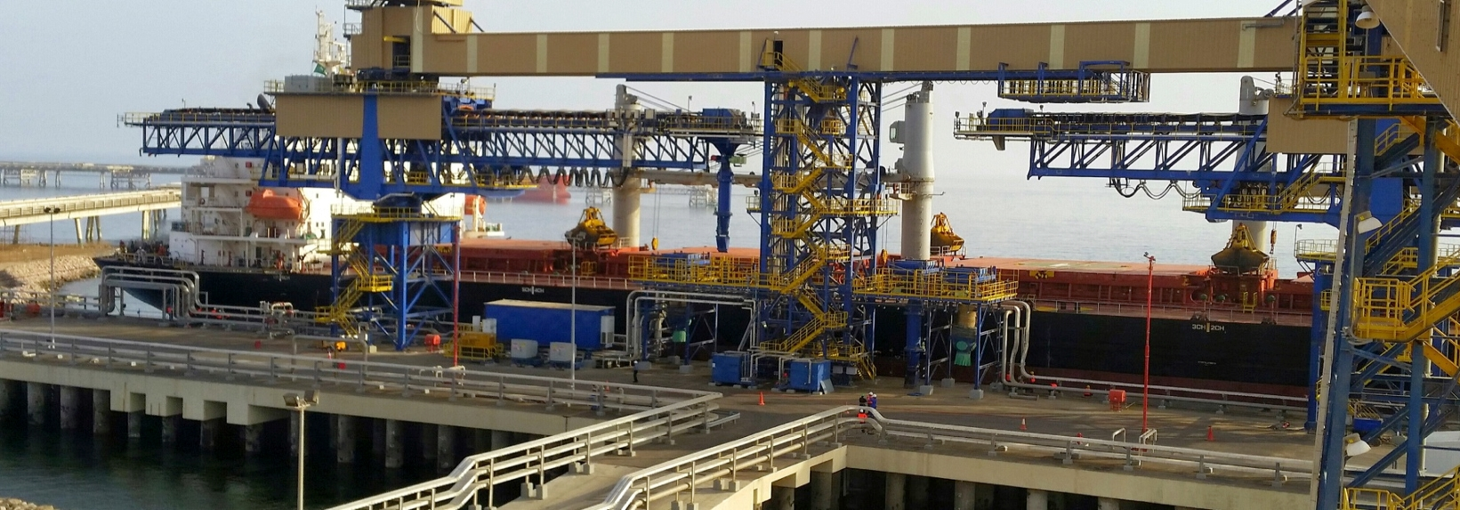
Project Highlights | Oil & Gas
YANBU EXPORT REFINERY PROJECT SOLID HANDLING PACKAGE (SP3)
CUSTOMER: Saudi Aramco
COUNTRY: Saudi Arabia
SCOPE:
EPC
COMPLETION:
2014
DESCRIPTION: Solid coke is transported via conveyors from the Delayed Coker unit located inside the YERP, stacked into storage building and than reclaimed to load vessels for export by means of dedicated belt conveyors and shiploader. Facilities: Coke Transport & Storage: (31,500 mT of coke); Sulphur Pelletizer and Loading ; KFIP Storage & Load-out Facilities: Sulfur Storage: (84mT/hr), Coke Unloading and Storage: (771 mT/hr), Ship Load-out Facility: (loading capacity 2000 mT/hr of coke into ships of a size 30,000 to 50,000 DWT)
.
CONTRACT VALUE (US$ MILLIONS)
270

Slide 15
Project Highlights | Oil & Gas
ESCRAVOS GAS TO LIQUIDS (GTL) PROJECT
CUSTOMER: Southern Gas Constructors (SGC) - (JV between Chevron, KBR and Saipem)
COUNTRY: Nigeria
SCOPE:
C
COMPLETION:
2013
DESCRIPTION: This facility provides significant environmental benefits by converting natural gas to produce ultra clean GTL diesel. The plant has an output capacity of 1.7 million tons/year & 34,000 bpd of premium quality GTL fuel (synthetic fuel suitable for diesel engines) and naphtha products and liquefied petroleum gas for export.
CONTRACT VALUE (US$ MILLIONS)
383

Slide 16
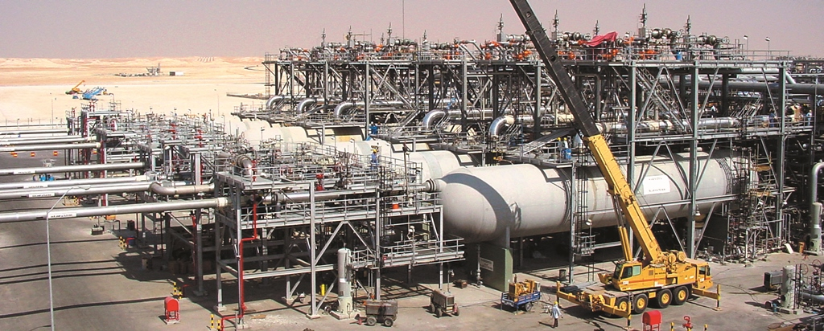
Project Highlights | Oil & Gas
HAWIYAH INLETS & AUXILIARY FACILITIES
CUSTOMER: Saudi Aramco
COUNTRY: Saudi Arabia
SCOPE:
EPC
COMPLETION:
2001
DESCRIPTION: Hawiyah Inlets and Auxiliary Facilities The inlet facilities package includes 6 slug catchers (three phase separators) and 5 air coolers followed by 5 three phase separators. It also comprises 2 hydrocarbon stabilizer modules, 2 sour water stripper modules, auxiliaries and the main electric power supply substations. Batch slug catcher is sized for 540 MMSCFD with a design pressure and temperature of 693 PSI and 248 ºF.
CONTRACT VALUE (US$ MILLIONS)
280

Slide 17
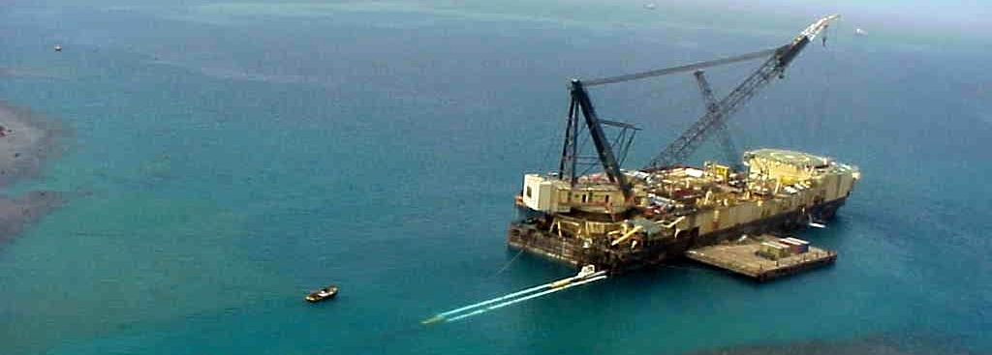
Project Highlights | Oil & Gas
MUGLAD BASIN OIL DEVELOPMENT PROJECT
CUSTOMER: Greater Nile Petroleum Operating Company Ltd
COUNTRY: Sudan
SCOPE:
EPC
COMPLETION:
2000
DESCRIPTION:
5 storage tanks of 400,000 bbld/each at Marsa Bashir Marine Terminal, including valves, pumps, scraper traps, flush tanks, control system, firefighting system, cathodic protection and buildings, 2 off-shore lines of 1,800 m/36”, 1 line of 500 m/14", 2 submarine hoses of 24" with ropes of 16" between the pipeline and the buoy, with a loading capacity of 2,000,000 bbld, including 1 recovery tank, 1 storage tank, 1 water tank, 1 tank drain line towards the sea, a craft harbor for service vessels, effluents treatment system, fuel and crude heating system (30 kW), electric power generation (10.5 MW), pumping (6,750 kW) and metering system; 6 Pumping Stations to serve the 1,500 km Heglig - Port Sudan Oil Pipeline, with a total capacity of 150,000 bbld, upgradable to 425,000 bbld.
CONTRACT VALUE (US$ MILLIONS)
272

Slide 18
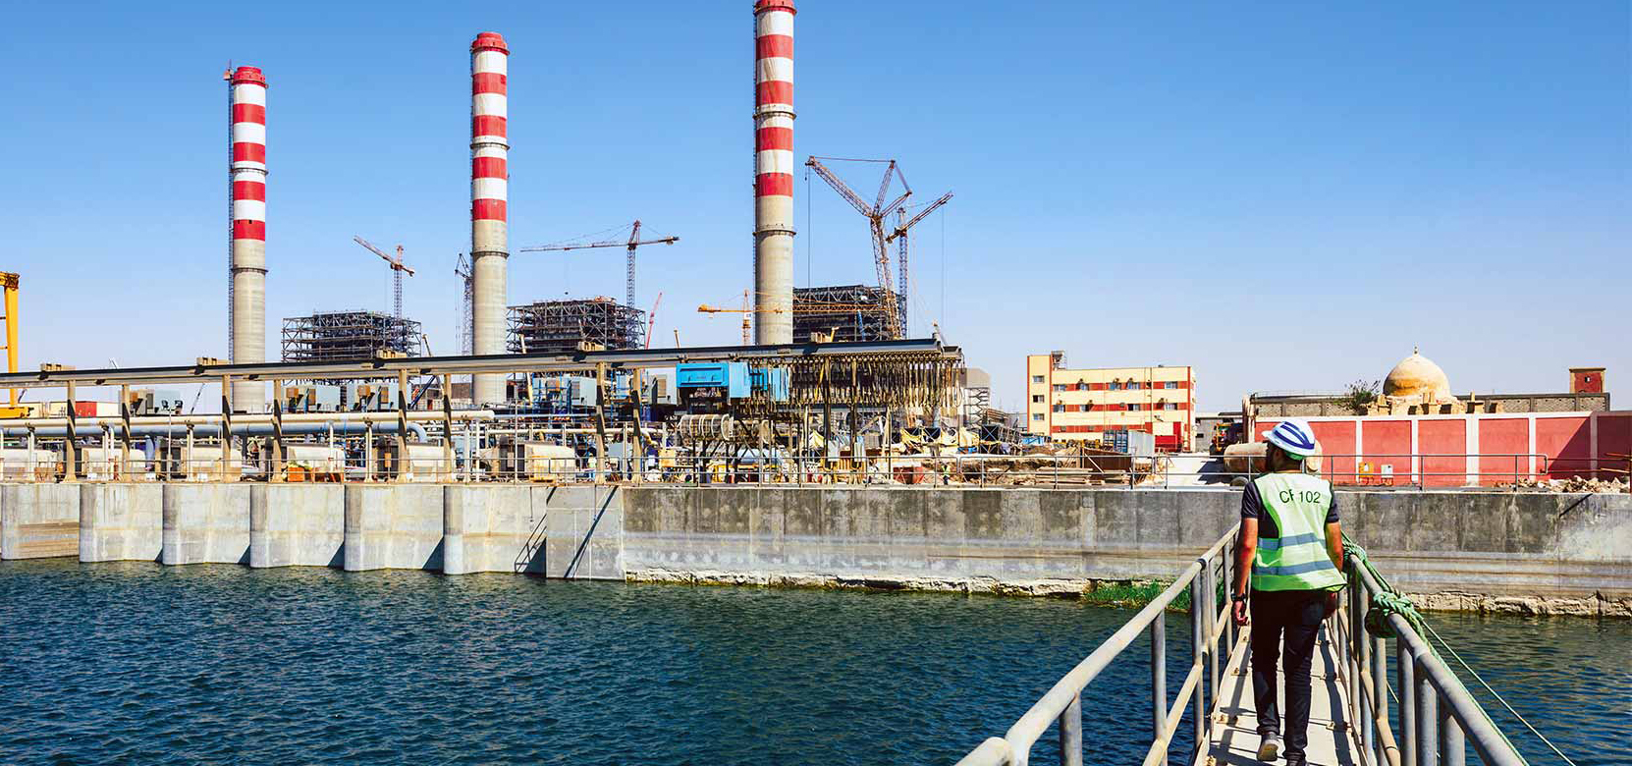
Project Highlights | Energy
SOUTH HELWAN SUPERCRITICAL THERMOELECTRIC POWER PLANT [650MW]
CUSTOMER:
Upper Egypt Electricity Production Company; Egyptian Electricity Holding Company
COUNTRY:
Egypt
SCOPE:
EPC
COMPLETION:
2018
DESCRIPTION:
EPC services for the auxiliary systems (Plant Balance) of the oil- and gas-fueled Supercritical Thermoelectric Power Plant. Work includes installing three steam generation boilers, operated by 3 steam turbines with a generation capacity of 650 MW each.
CONTRACT VALUE (US$ MILLIONS)
79

Slide 19
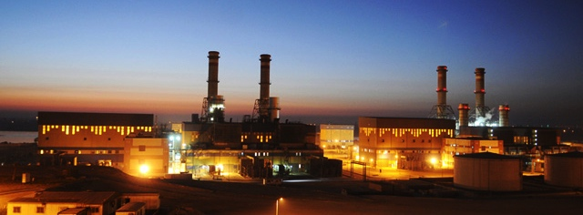
Project Highlights | Energy
EL KUREIMAT III POWER STATION
CUSTOMER: UEEPC
COUNTRY: Egypt
SCOPE: EPC
COMPLETION: 2009
DESCRIPTION: EL KUREIMAT III Power Station750 MW Combined Cycle Project -2x250 MW Combustion Turbine Generator(s) & Auxiliaries Package.
Design and supply of the Mechanical, Electrical, I&C balance of plant, the overall Erection including the CTG's, Commissioning of the B.O.P. and the CTG's and assistance to Commissioning for the C.T.G.'s.
Turbine type: GE 2xGT 9FAIn
CONTRACT VALUE (US$ MILLIONS)
113

Slide 20
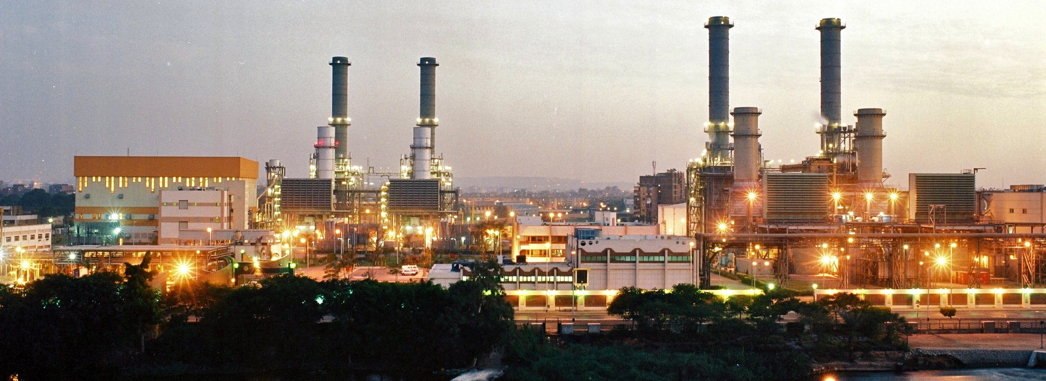
Project Highlights | Energy
CAIRO NORTH POWER STATION PHASE II (750 MW)
CUSTOMER: C.E.P.C. (E.E.H.C.)
COUNTRY: Egypt
SCOPE: EPC
COMPLETION: 2006
DESCRIPTION: Cairo North Power Station II Phase - 750 MW Combined cycle project (2x250 MW Combustion turbine generators type: GE 2xGT 9FA & Auxiliaries lot).
Design and supply of the mechanical, electrical, I&C balance of plant, the overall erection including the CTG's, commissioning of the B.O.P. and the CTG's and assistance to commissioning for the C.T.G.'s.
In consortium with General Electric Co.
CONTRACT VALUE (US$ MILLIONS)
103

Slide 21
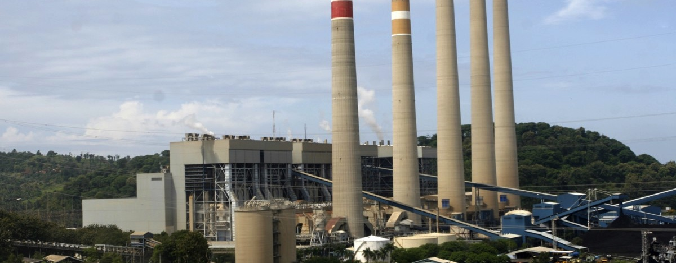
Project Highlights | Energy
SURALAYA THERMAL POWER PLANT
CUSTOMER: PLN
COUNTRY: Indonesia
SCOPE:
EPC
COMPLETION:
1998
DESCRIPTION: Steam power plant including 3 x 600 MW steam boilers / coal fired units, HP - LP heaters, rotating machines, heat exchangers, feed water pumps, cooling water systems and pumps, screening systems, storage tanks, HVAC and fire fighting system. Scope of Work: Engineering, procurement and construction of balance of plant (mechanical, electrical, I&C), including commissioning. Consortium with Marubeni and Stone & Webster.
CONTRACT VALUE (US$ MILLIONS)
135

Slide 22
Project Highlights | Industrial Plants
RUWAIS SULPHUR HANDLING TERMINAL SHT2
CUSTOMER: Gasco (subsidiary of Abu Dhabi National Oil Co.)
COUNTRY: UAE
SCOPE:
EPC
COMPLETION:
2015
DESCRIPTION: The Sulphur Terminal Scope includes: Granule sulphur receiving capacity of 22,000 TPD ; Granule Sulphur Storage Capacity for 15 days with Stacking and Reclaiming Facilities; Train Loop and Railcar Unloading Facility; Ship-loading system (Ship loaders: 2 x 4000 TPH ); Marine terminal: 80,000 DWT vessels; Utility and Off-site Units.; Administration, Control and Maintenance Buildings. In Consortium with Al Jaber Group.
CONTRACT VALUE (US$ MILLIONS)
325

Slide 23
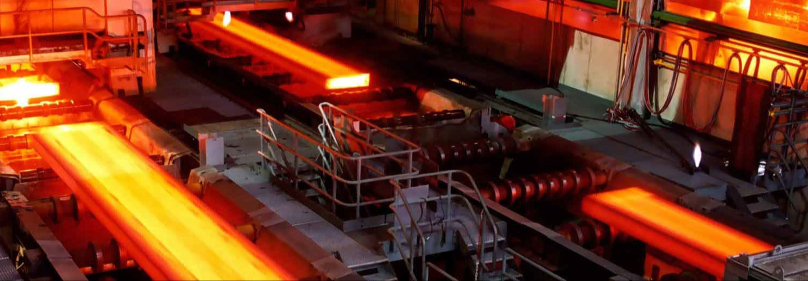
Projects Highlights | Industrial Plants
MOBARAKEH STEEL COMPLEX EXPANSION
CUSTOMER: National Iranian Steel Company Mobarekeh Steel Company.
COUNTRY: Iran
SCOPE:
EPC
COMPLETION:
2004
DESCRIPTION: Expansion of Mobarakeh Steel Complex to increase the production of steel from 3.0 up to 4.1 million ton/year and improving the quality of the downstream production of hot and cold rolled coils. Expansion of raw materials yards capacity, revamping of 4 EAF and expansion of the steel melting shop, installation of furnace active panels for hot strip mill, new pickle line and a new continuous reprocessing and recoiling line.
CONTRACT VALUE (US$ MILLIONS)
300

Slide 24
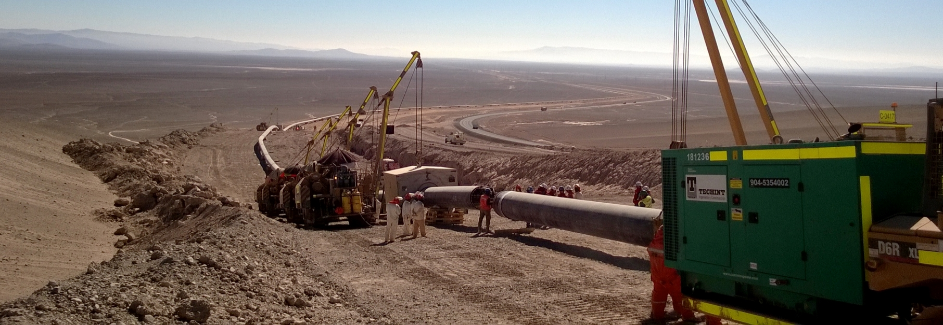
Projects Highlights | Civil Infrastructure Works
YANBU-MADINAH WATER TRANSMISSION SYSTEM
CUSTOMER: Saline Water Conersion Corporation - SWCC
COUNTRY: Saudi Arabia
SCOPE:
EPC
COMPLETION:
1999
DESCRIPTION: Yanbu - Madinah Water Transmission System. LOT 3C + LOT 3D, 202 km high pressure water pipeline (150 km of Ø 60" and 50 km of Ø 32"), 178 km low pressure of Ø 52", 26", 24" and 12", Steel Pipe API-5L-X65, 2 pumping stations with total power installed of 91.200 KW, steel tanks for storage of water and concrete reservoirs with a capacity of 1.361.000 m3, SCADA systems and telecommunications buildings and living quarters for personnel and complementary installations.
CONTRACT VALUE (US$ MILLIONS)
460

Slide 25
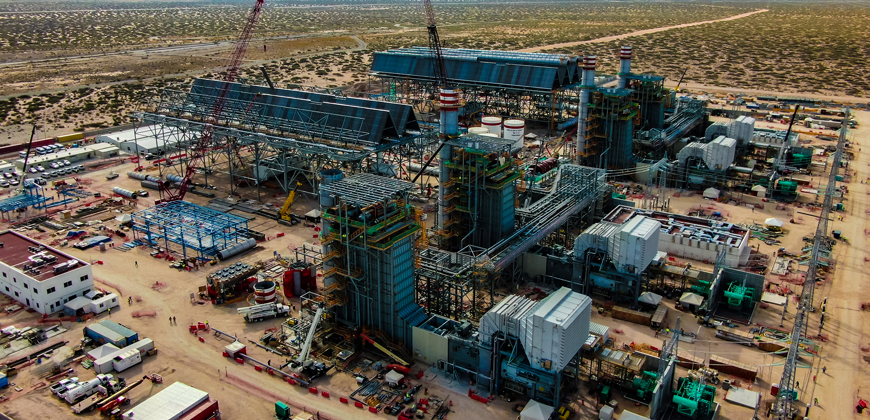
Projects Highlights - Americas

Slide 26
Project Highlights | Energy
NORTE III COMBINED CYCLE POWER PLANT
COSTUMER:
AJNIII
COUNTRY:
Mexico
SCOPE:
EPC
COMPLETION:
2020
DESCRIPTION:
Construction and operation, for a period of 25 years, of a Combined Cycle Power Plant consisting of two 2TGx1TV modules with a guaranteed minimum net power of 907 MW and a Heat Rate of 6,369 kJ/kWh.
CONTRACT VALUE (US$ MILLIONS)
574

Slide 27
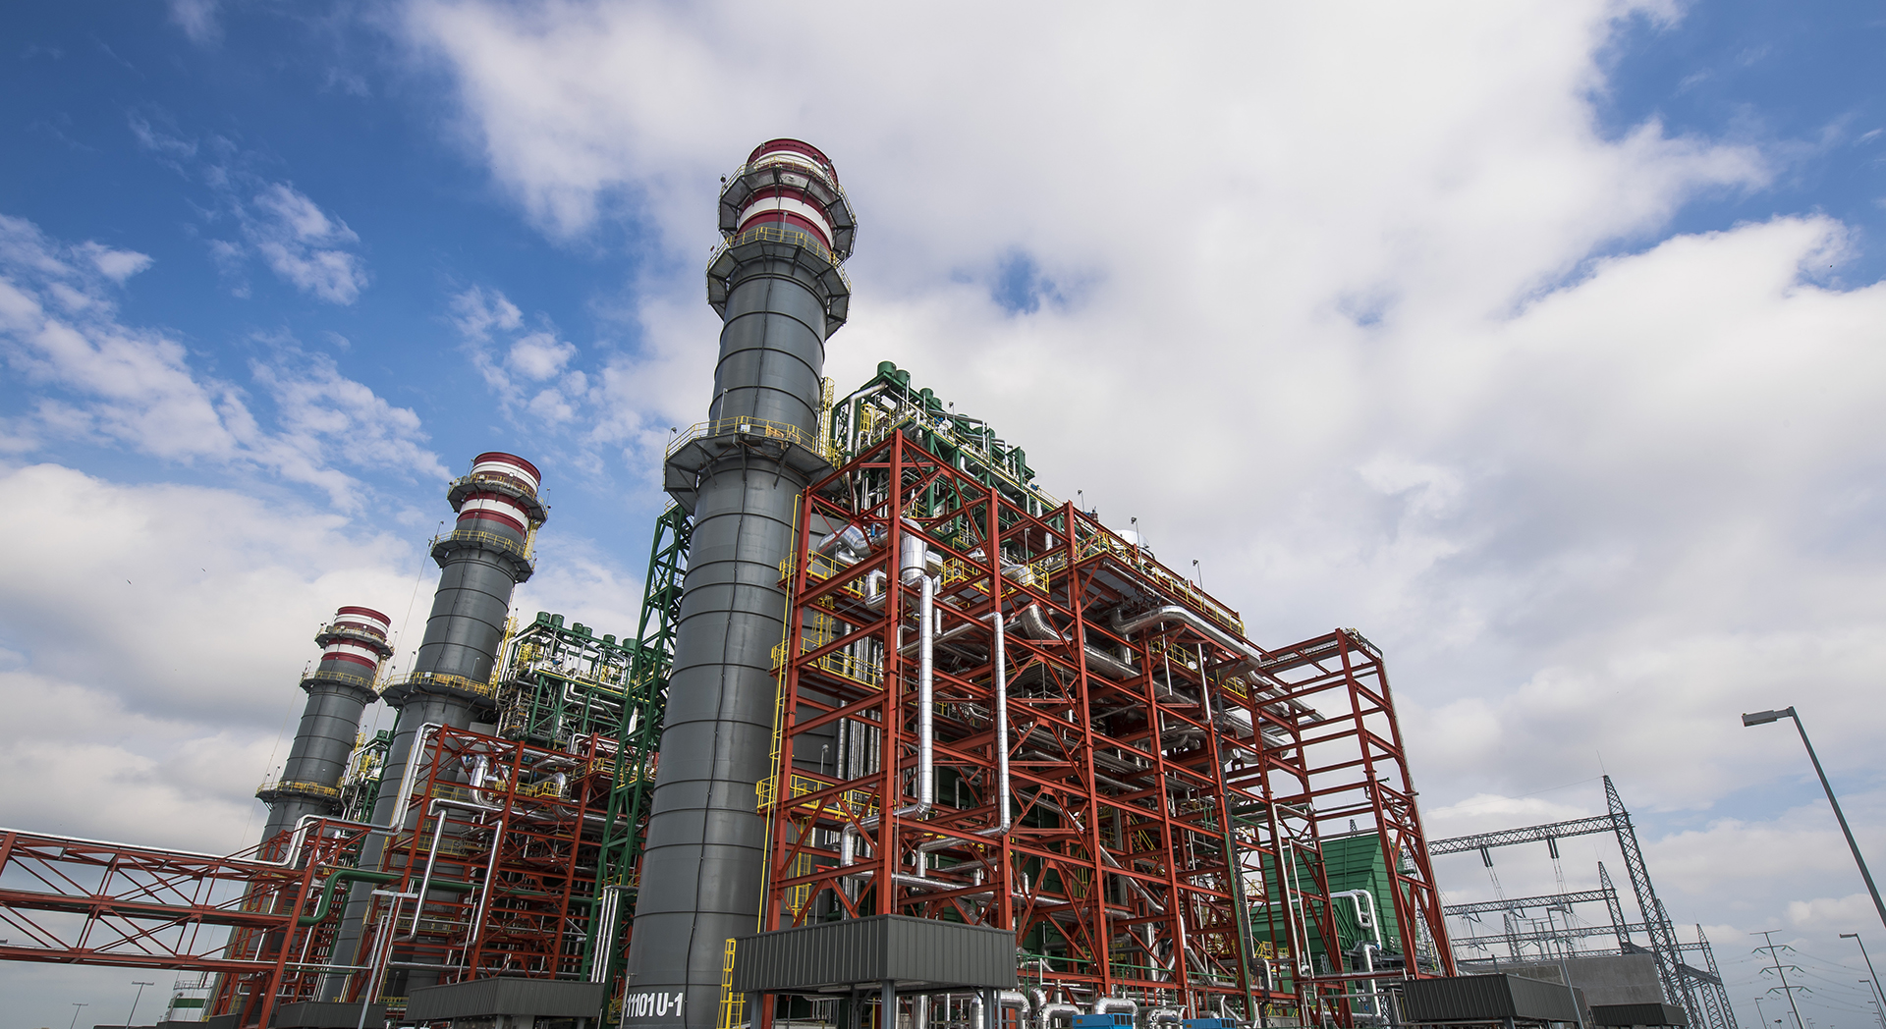
Project Highlights | Energy
PESQUERÍA POWER PLANT [900MW]
CUSTOMER: Techgen
COUNTRY: Mexico
SCOPE: EPC
COMPLETION: 2015
DESCRIPTION: Combined cycle power generation with a capacity of 900 MW and a configuration of three gas turbines.
CONTRACT VALUE (US$ MILLIONS)
750

Slide 28
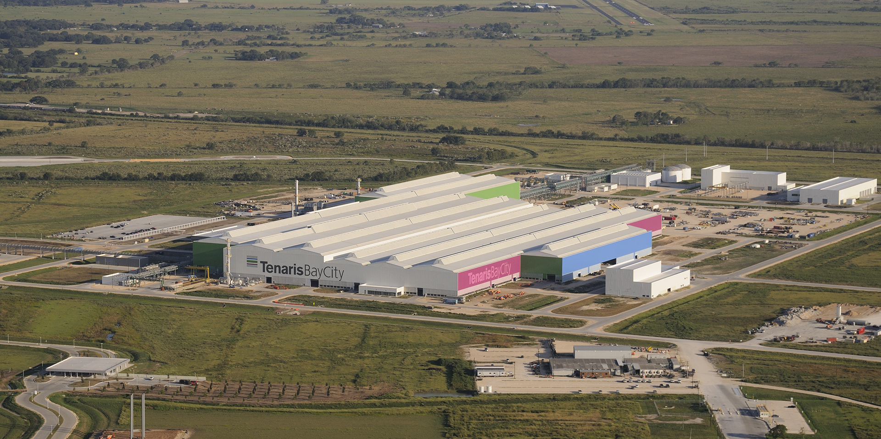
Project Highlights | Industrial Plants
TENARIS BAY CITY
CUSTOMER:
Tenaris
COUNTRY:
USA
SCOPE:
EPCM
COMPLETION:
2017
DESCRIPTION:
Construction of a mill to manufacture seamless pipes ranging from 114.3 to 244.5 mm in diameter, and thicknesses of between 5.7 and 25.4 mm, with an estimated output of 616,000 tons/year for Tenaris's OCTG product line.
CONTRACT VALUE (US$ MILLIONS)
47

Slide 29
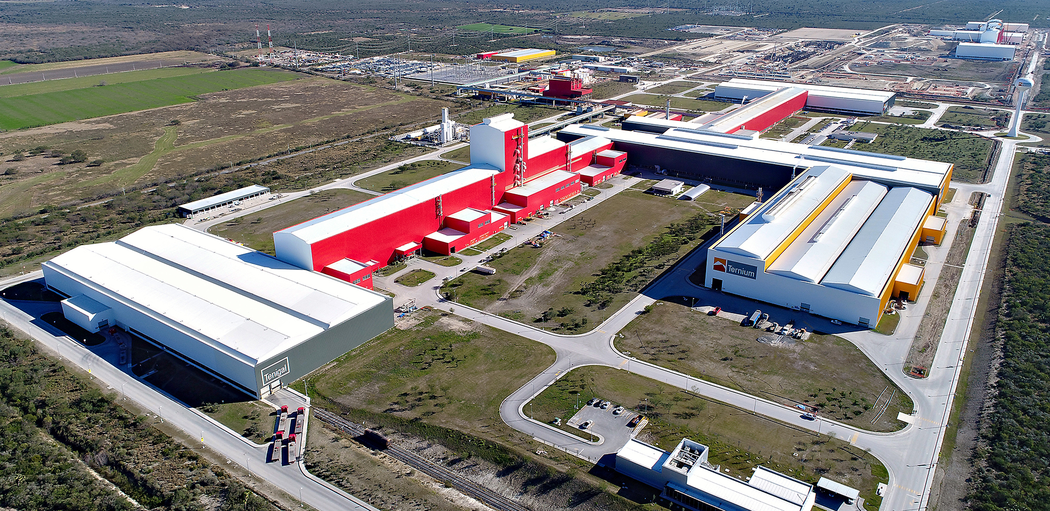
Project Highlights | Industrial Plants
GREENFIELD PESQUERIA PLANT
CUSTOMER: Ternium
COUNTRY: Mexico
SCOPE:
PC
COMPLETION:
2013
DESCRIPTION:
Cold rolling plant with an output of 1.5 million tons/year. The plant is equipped to produce 1,880 mm-wide steel sheet, intended exclusively for the automotive industry.
CONTRACT VALUE (US$ MILLIONS)
170

Slide 30
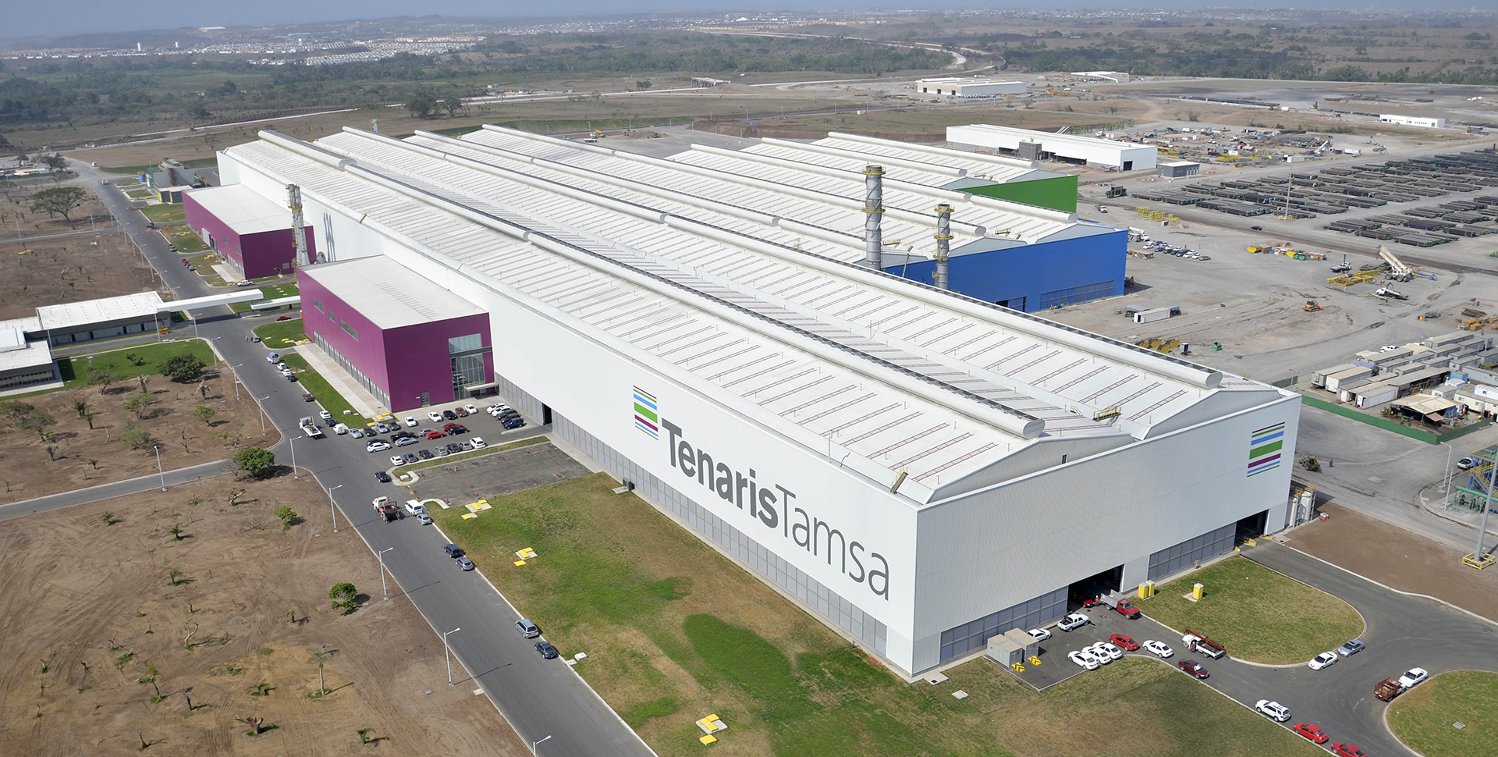
Project Highlights | Industrial Plants
3T ROLLING MILL
CUSTOMER:
Tenaris - Tamsa
COUNTRY:
Mexico
SCOPE:
EPC
COMPLETION:
2011
DESCRIPTION:
Construction of a hot rolling mill and two cold rolling mills, in addition to all the off-site works complementing operational services.
CONTRACT VALUE (US$ MILLIONS)
158

Slide 31
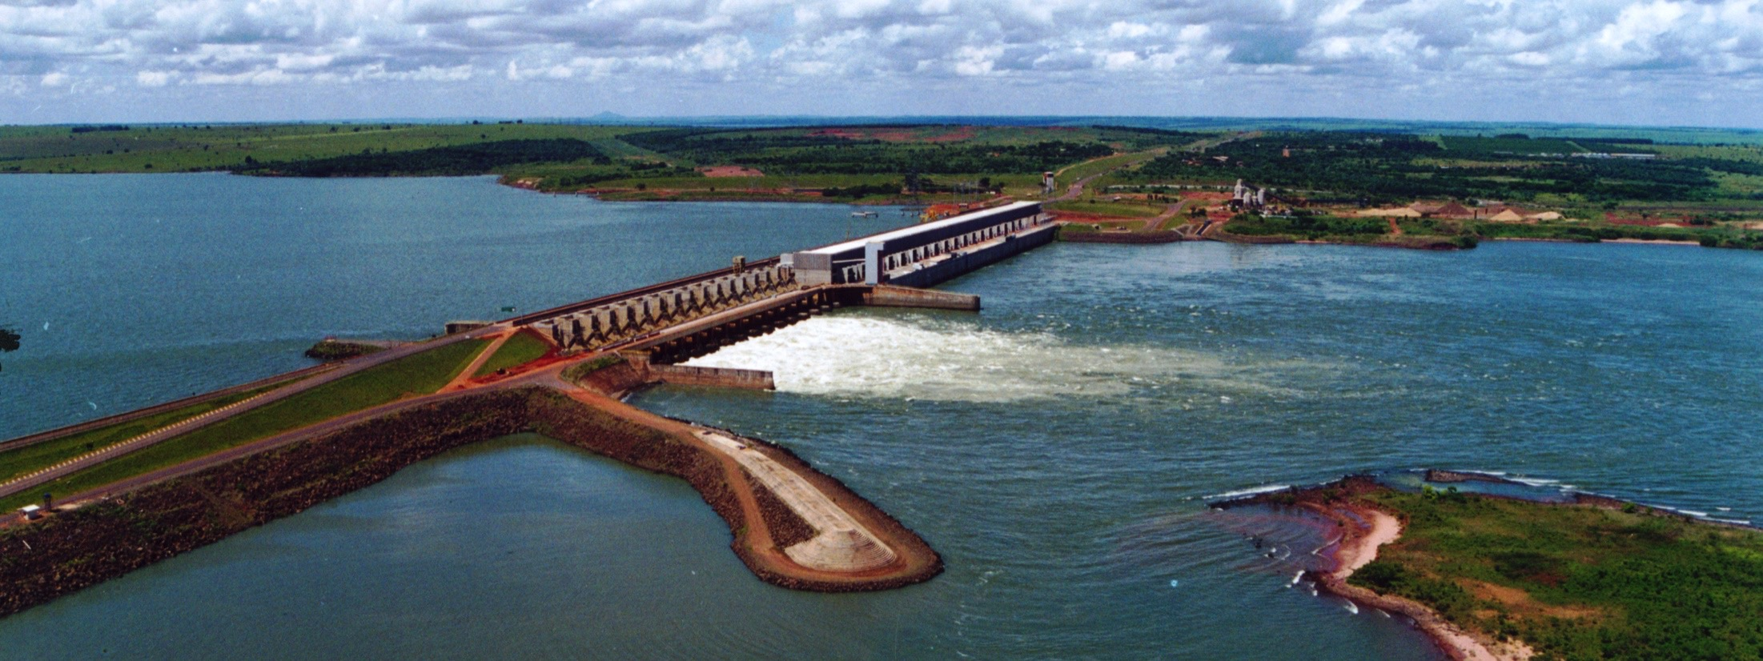
Project Highlights | Civil Infrastructure Works
PORTO PRIMAVERA HYDROELECTRIC PROJECT
CUSTOMER: Companhia Energética de São Paulo
COUNTRY:
Brazil
SCOPE:
C
COMPLETION:
2003
DESCRIPTION:
Located over the Paraná River, in Rosana-SP.
Electrical and mechanical erection.
The scope of works comprises 18 (eighteen) 103 MW Kaplan turbines, with their complete accessories, transformer stations, sluice gates, water intake, spillway and fish elevator, traveling cranes and associated electrical and mechanical services
.
CONTRACT VALUE (US$ MILLIONS)
120

Slide 32
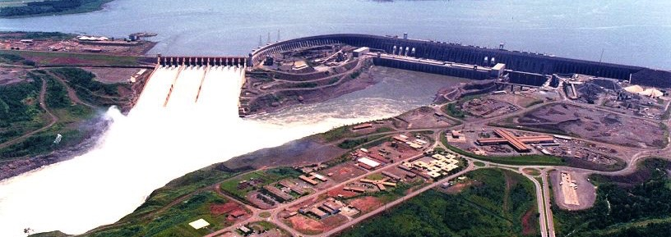
Project Highlights | Civil Infrastructure Works
ITAIPÚ HYDROELECTRIC PROJECT
CUSTOMER: Itaipú Binacional
COUNTRY: Paraguay - Brazil
SCOPE: C
COMPLETION: 1991
DESCRIPTION: Complete electromechanical erection of the Itaipú hydroelectric project, 12,600 MW, located on the Paraná river, 25 km from Foz do Rio Iguazú.
Main equipment erected: 13 main radial tainter gates of 20 x 20 m, 3 radial tainter gates of 13 x 13 m, 1 sluice gate of 9 x 4 m, 18 Francis turbines of 700 MW each, 36 intake gates of 5 x 12.25 m, substation of 400 kV (right riverbank) and substation of 750 kV (left riverbank).
CONTRACT VALUE (US$ MILLIONS)
182

Slide 33
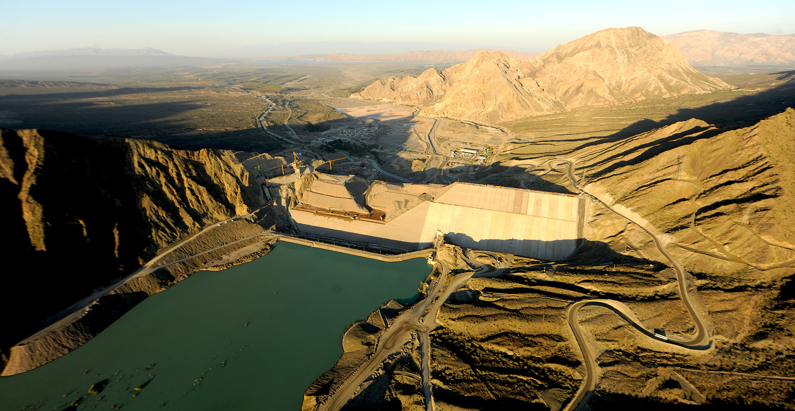
Projects Highlights - Argentina

Slide 34
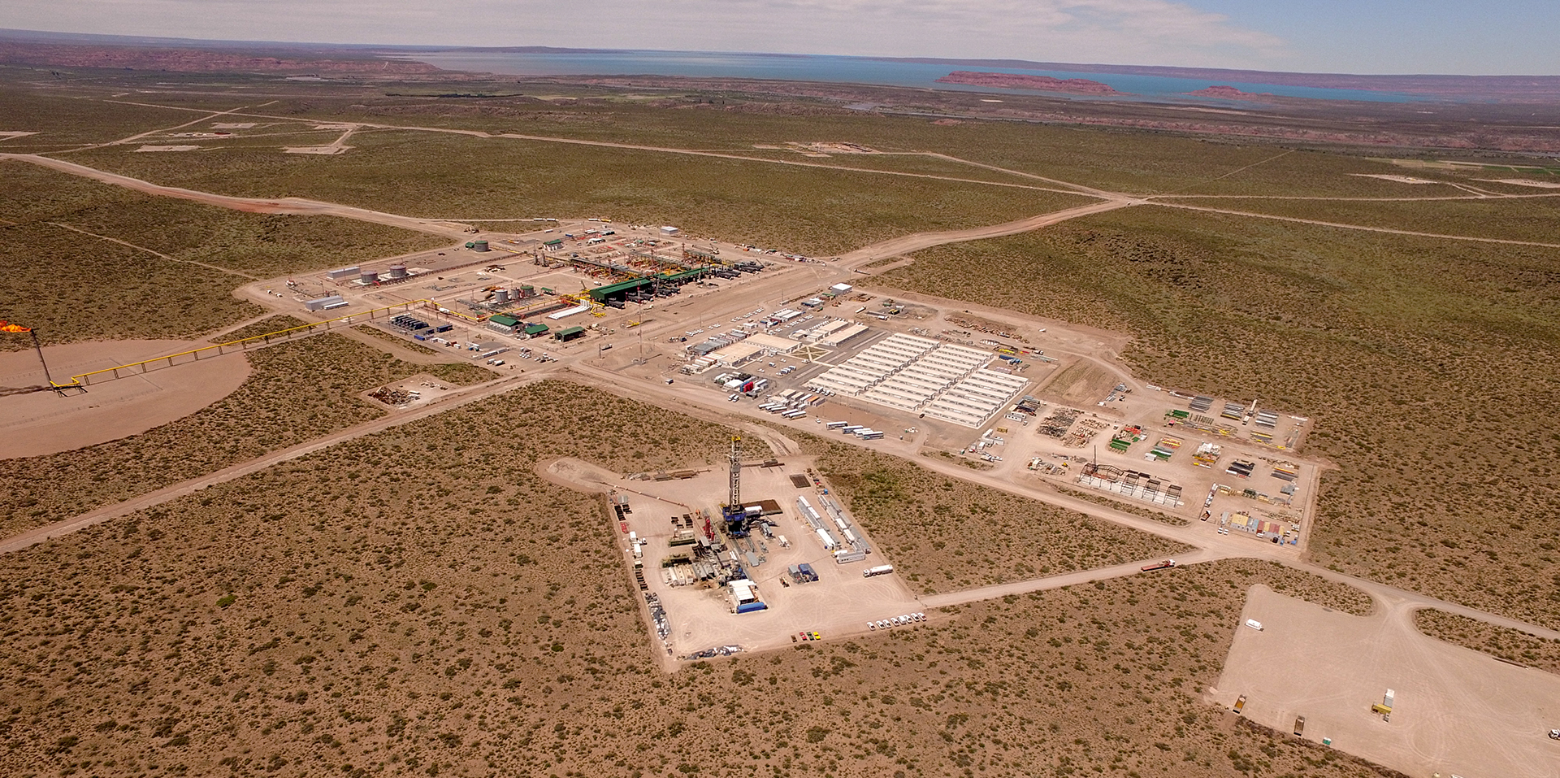
Projects Highlights | Oil & Gas
FORTIN DE PIEDRA - VACA MUERTA
CUSTOMER: Tecpetrol
COUNTRY: Argentina
SCOPE:
EPC
COMPLETION:
2020
DESCRIPTION: Design and construction of facilities to drill, treat and transport the gas produced. These works enable the processing of 17.5 MM m³/day.
CONTRACT VALUE (US$ MILLIONS)
574

Slide 35
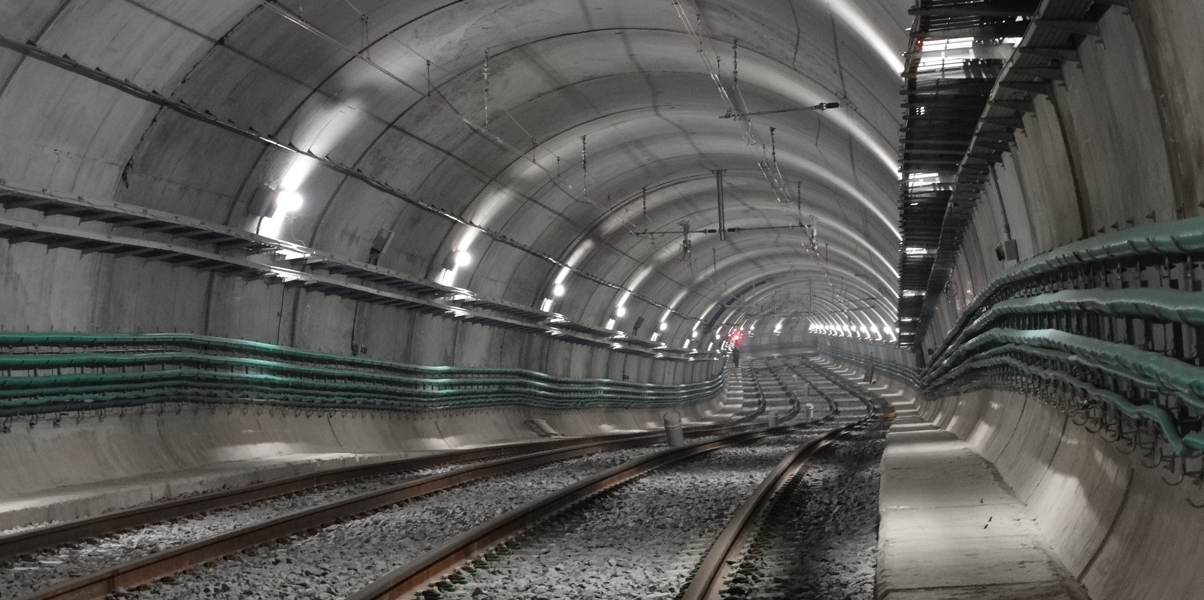
Project Highlights | Civil Infrastructure Works
EXTENSION OF THE BUENOS AIRES "H" SUBWAY LINE
CUSTOMER:
Subterráneos de Buenos Aires Sociedad del Estado
COUNTRY:
Argentina
SCOPE:
EPC
COMPLETION:
2019
DESCRIPTION: Building 4.5 km of tunnels, 4 stations, 2 workshops and underground sheds.
CONTRACT VALUE (US$ MILLIONS)
470

Slide 36
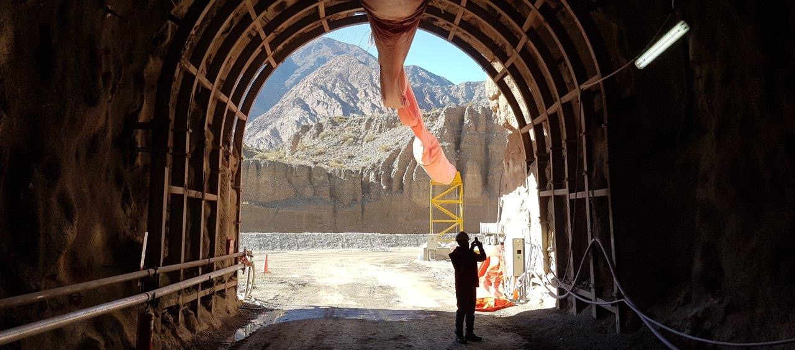
Project Highlights | Civil Infrastructure Works
EL TAMBOLAR HYDROELECTRIC PROJECT
CUSTOMER: Energía Provisional Sociedad del Estado (San Juan)
COUNTRY:
Argentina
SCOPE:
EPC
COMPLETION:
2018
DESCRIPTION:
The project comprises the basic and detail design of El Tambolar Hydroelectric Project, including geologic and geotechnical studies; detail engineering of diversion tunnels and sluiceway; construction of access and internal roads; construction of camp site and facilities for the final project construction and construction of diversion tunnel and sluiceway, including excavation and concrete finishing..
.
CONTRACT VALUE (US$ MILLIONS)
98

Slide 37
Project Highlights | Civil Infrastructure Works
PUNTA NEGRA HYDROELECTRIC DAM
CUSTOMER: Energía Provisional Sociedad del Estado (San Juan)
COUNTRY:
Argentina
SCOPE:
EPC
COMPLETION:
2016
DESCRIPTION:
Multipurpose hydroelectric concrete-face rock-fill dam on the San Juan River to generate electric power, regulate water flow and expand local irrigation capacity. Dam of 128m in height, and a power station with 2 Francis turbines of 32.5 MW each.
CONTRACT VALUE (US$ MILLIONS)
515

Slide 38
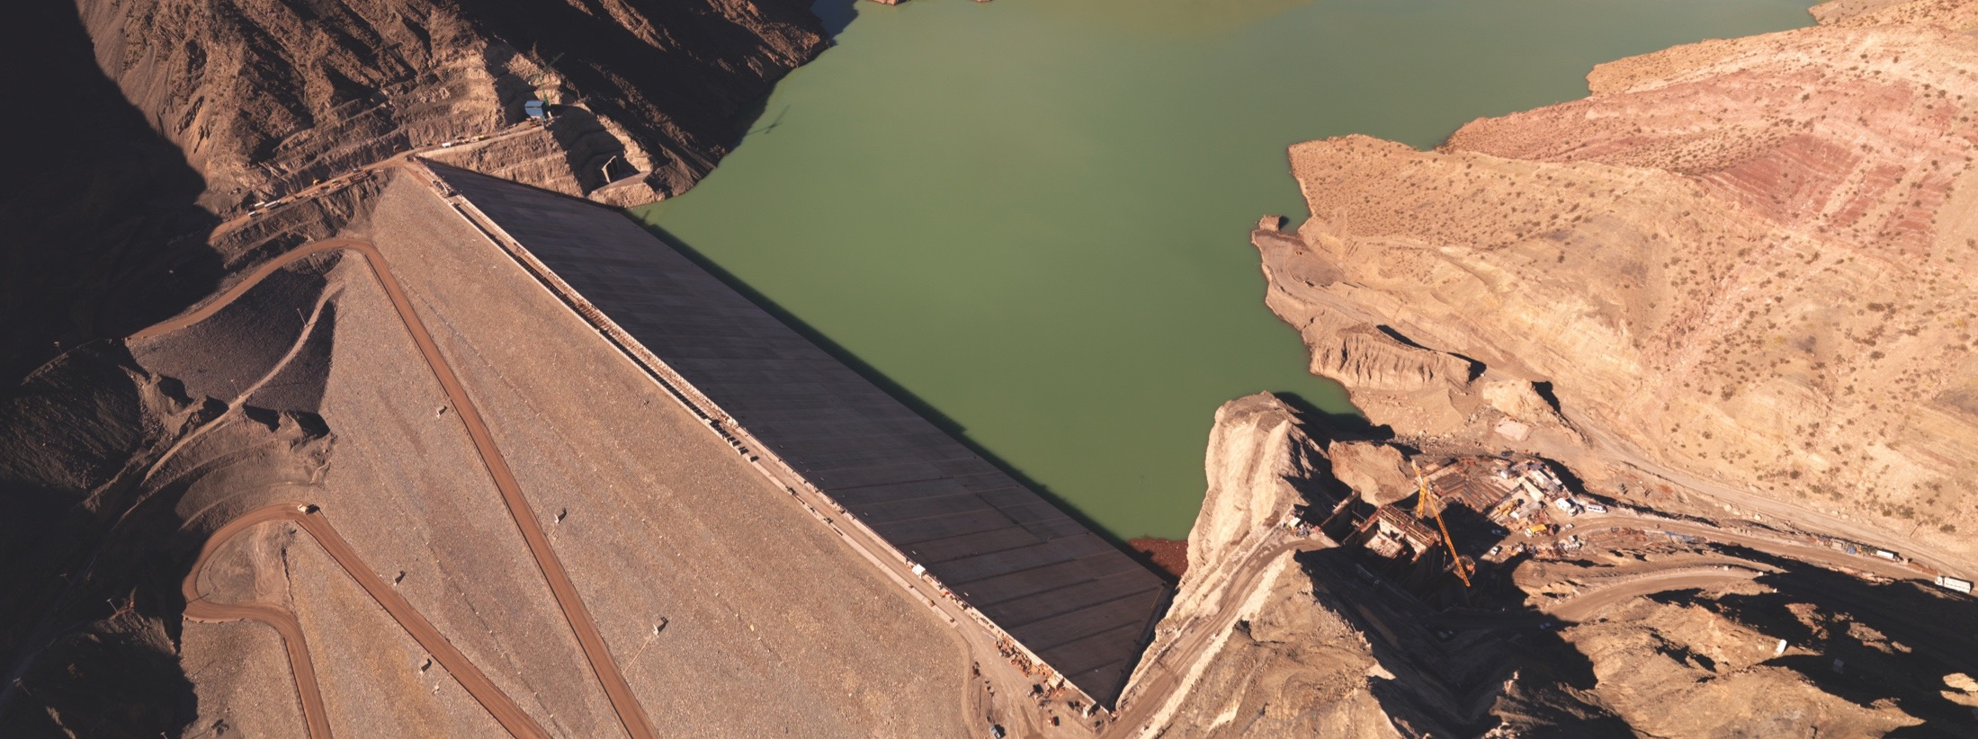
Project Highlights | Civil Infrastructure Works
LOS CARACOLES HYDROELECTRIC PROJECT
CUSTOMER: Energía Provisional Sociedad del Estado (San Juan)
COUNTRY:
Argentina
SCOPE:
EPC
COMPLETION:
2009
DESCRIPTION:
Construction of a new dam over the San Juan river, located 53 km from San Juan city.
The dam is equipped with two 65 MW Francis type turbines and a 43 km / 134 kV power transmission line linking Caracoles and San Juan city, among other ancillary works.
CONTRACT VALUE (US$ MILLIONS)
330

Slide 39
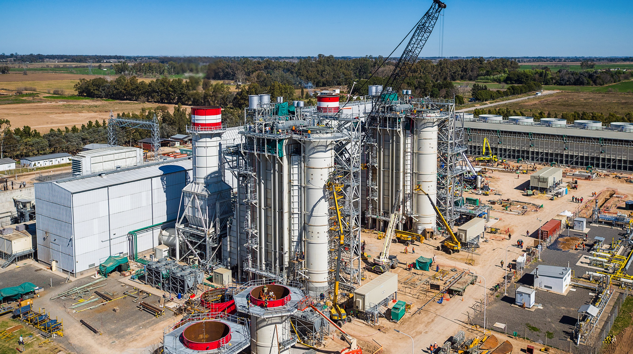
Project Highlights | Energy
GENELBA PLUS COMBINED CYCLE POWER PLANT [360MW]
CUSTOMER:
Pampa Energy
COUNTRY:
Argentina
SCOPE:
EPC
COMPLETION:
2020
DESCRIPTION:
Expansion of the GENELBA Thermoelectric Power Plant, taking the existing 169 MW gas turbine to a 2+1 combined cycle configuration with a thermal design power of 360 MW.
CONTRACT VALUE (US$ MILLIONS)
160

